Slide 1
Finding Act through Sabinate Legal

Slide 2
Open the library database through Google Chrome: Select online database

Slide 3
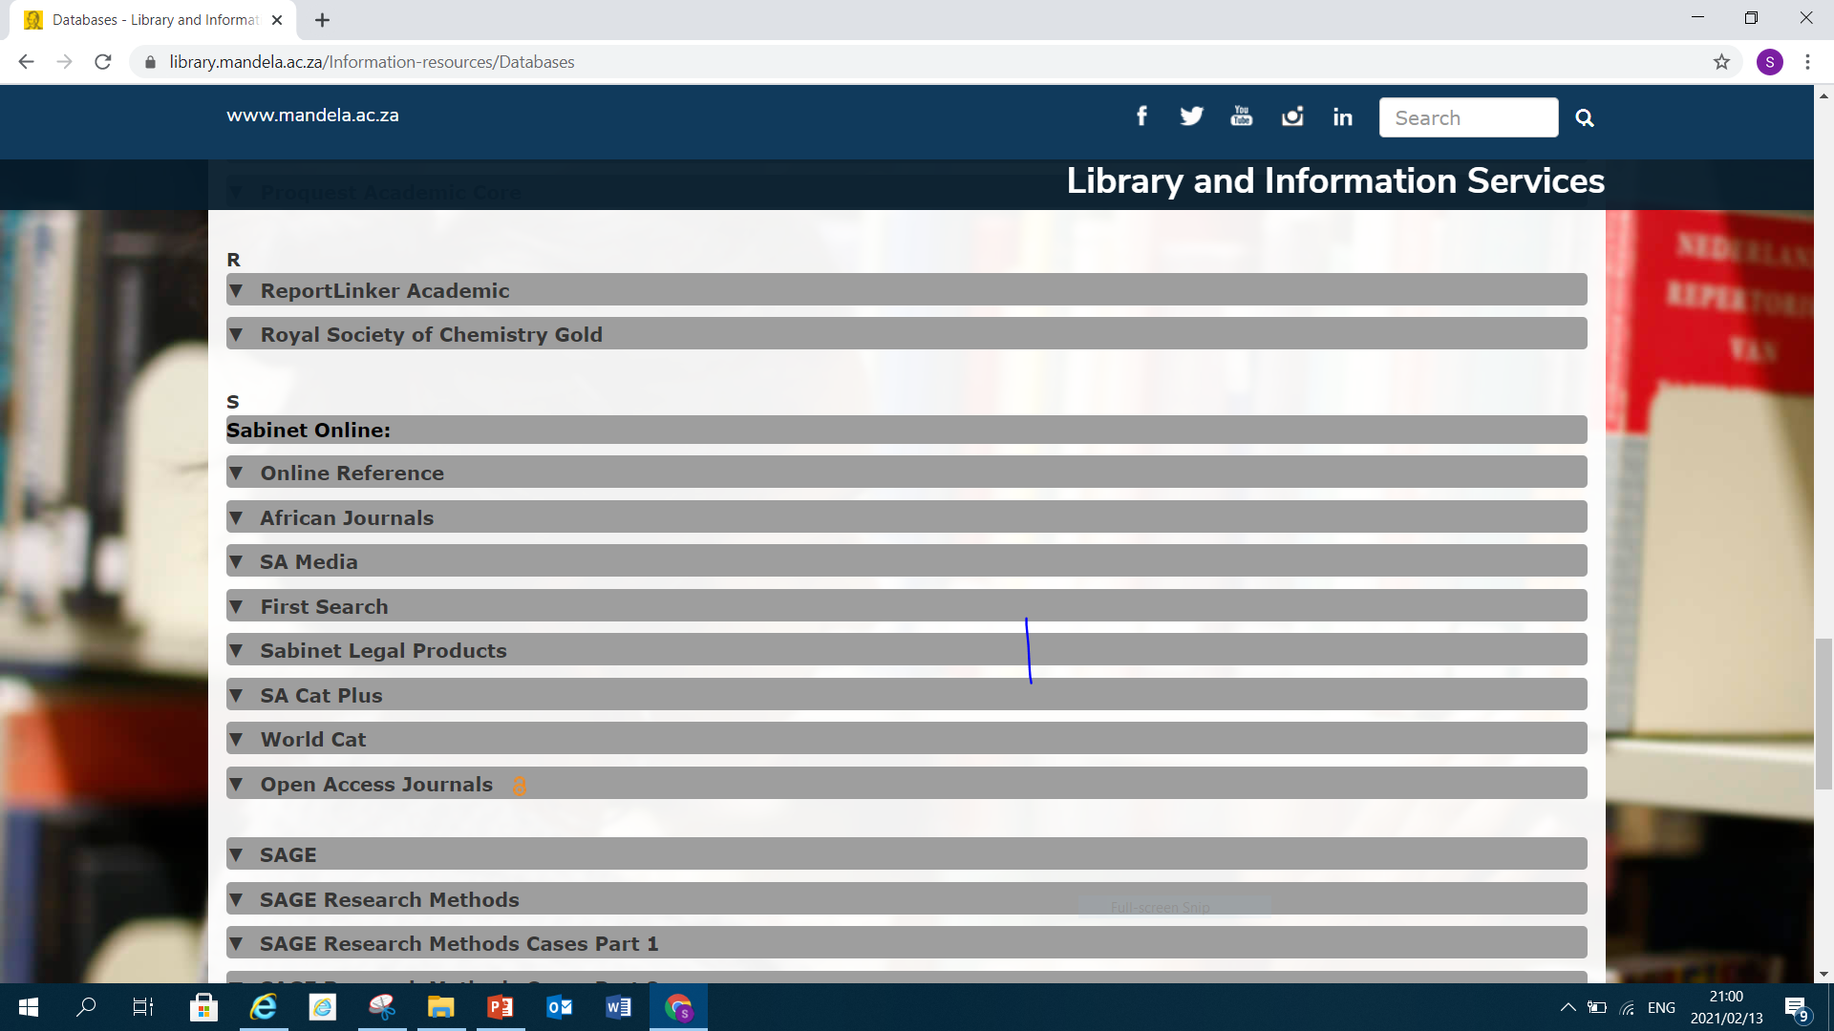
Scroll down and select Sabinet Legal Products

Slide 4
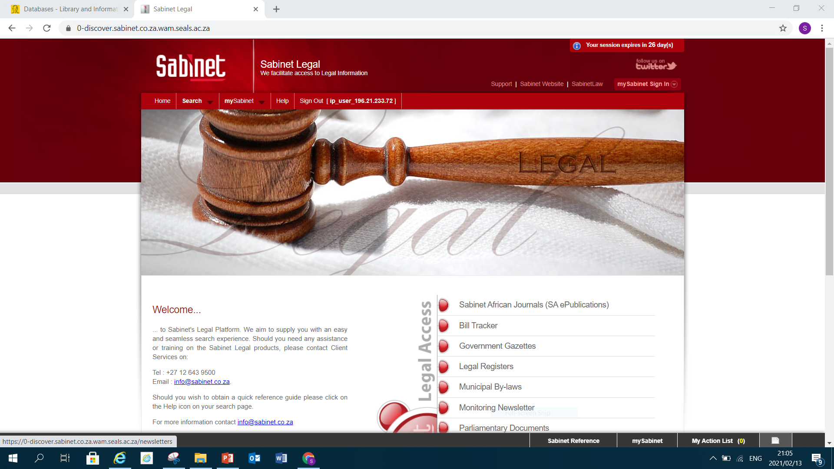
Click on Sabinet Legal

Slide 5
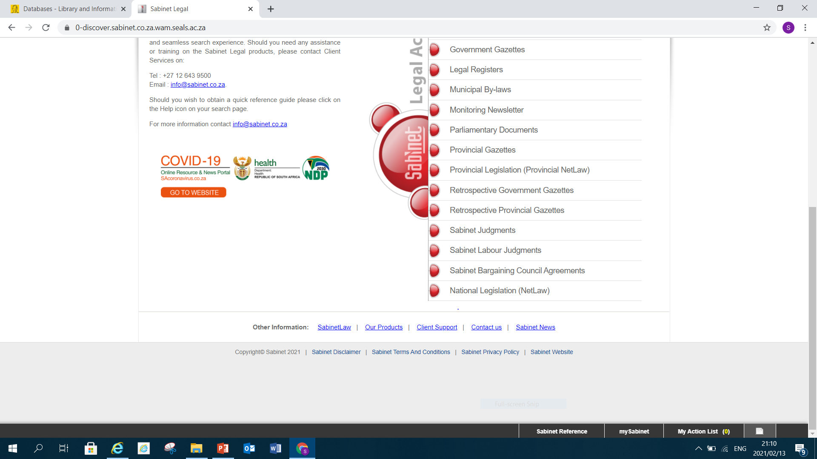
Select National Legislation (NetLaw)

Slide 6
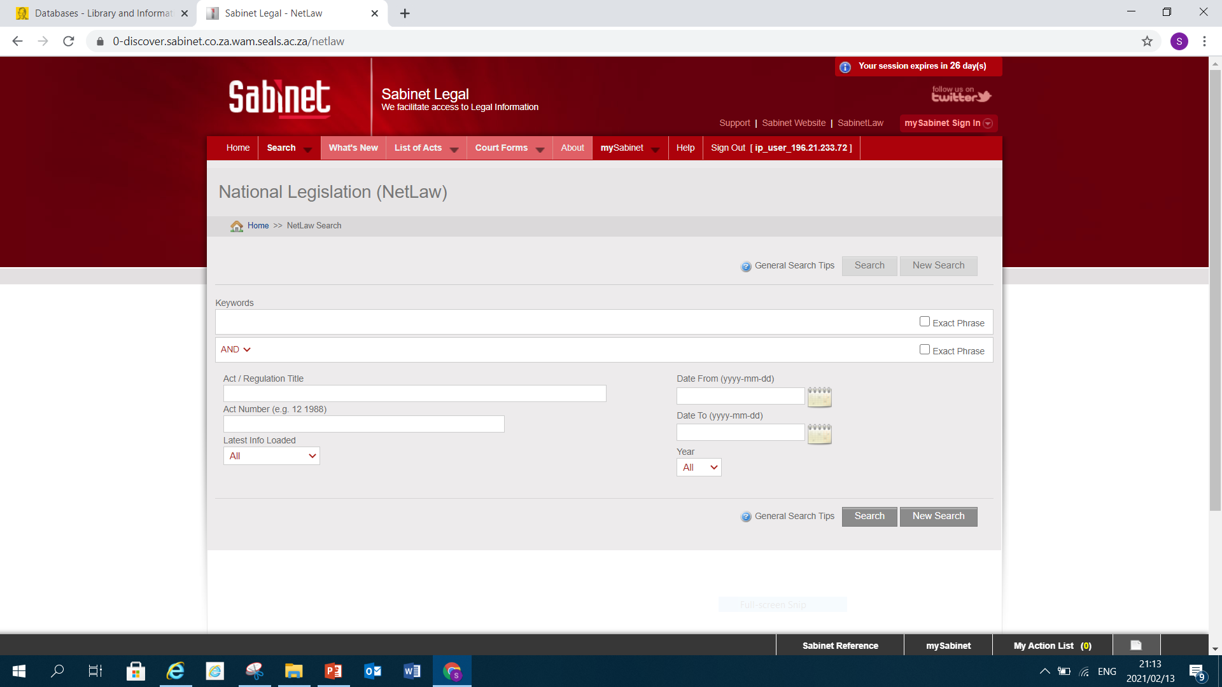
Click on List of Act or type in the key words of the Act or fill in the citation of the Act : For the training purpose I will select Lists of Act Menu

Slide 7
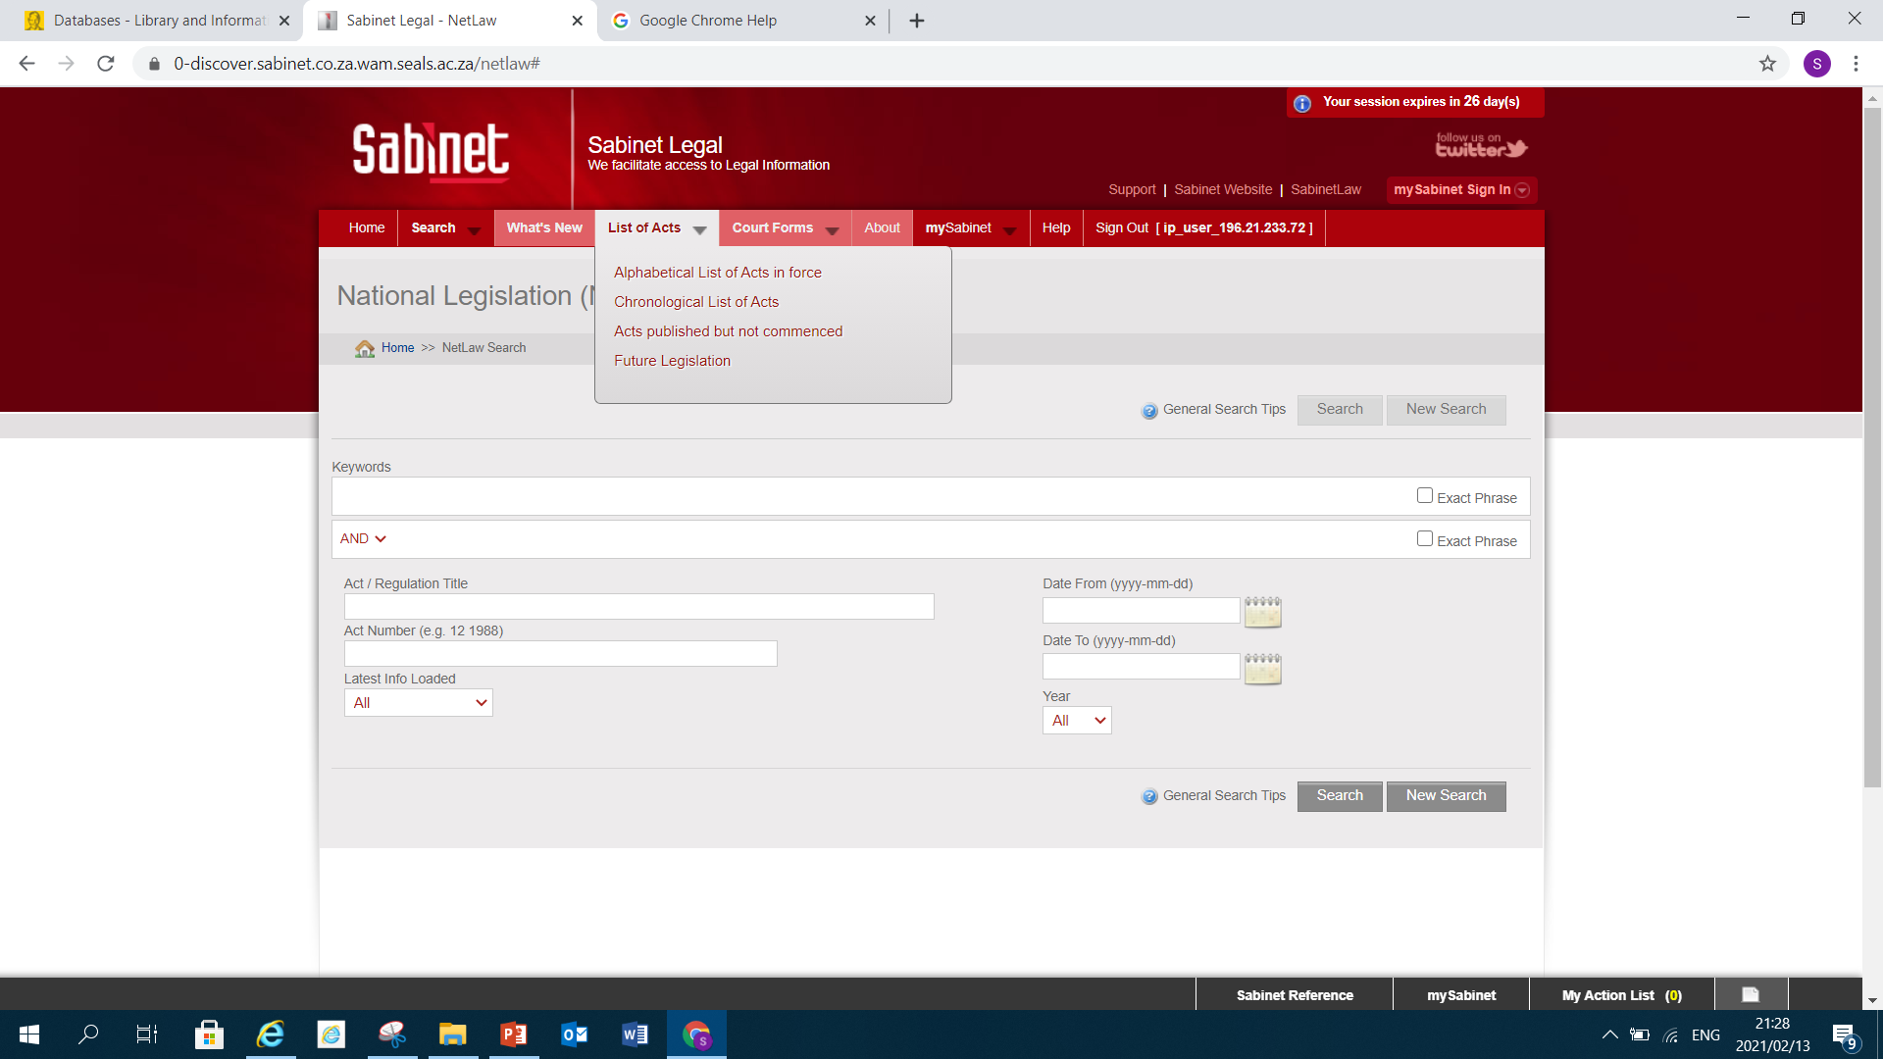
Select Alphabetical list of Acts in force

Slide 8
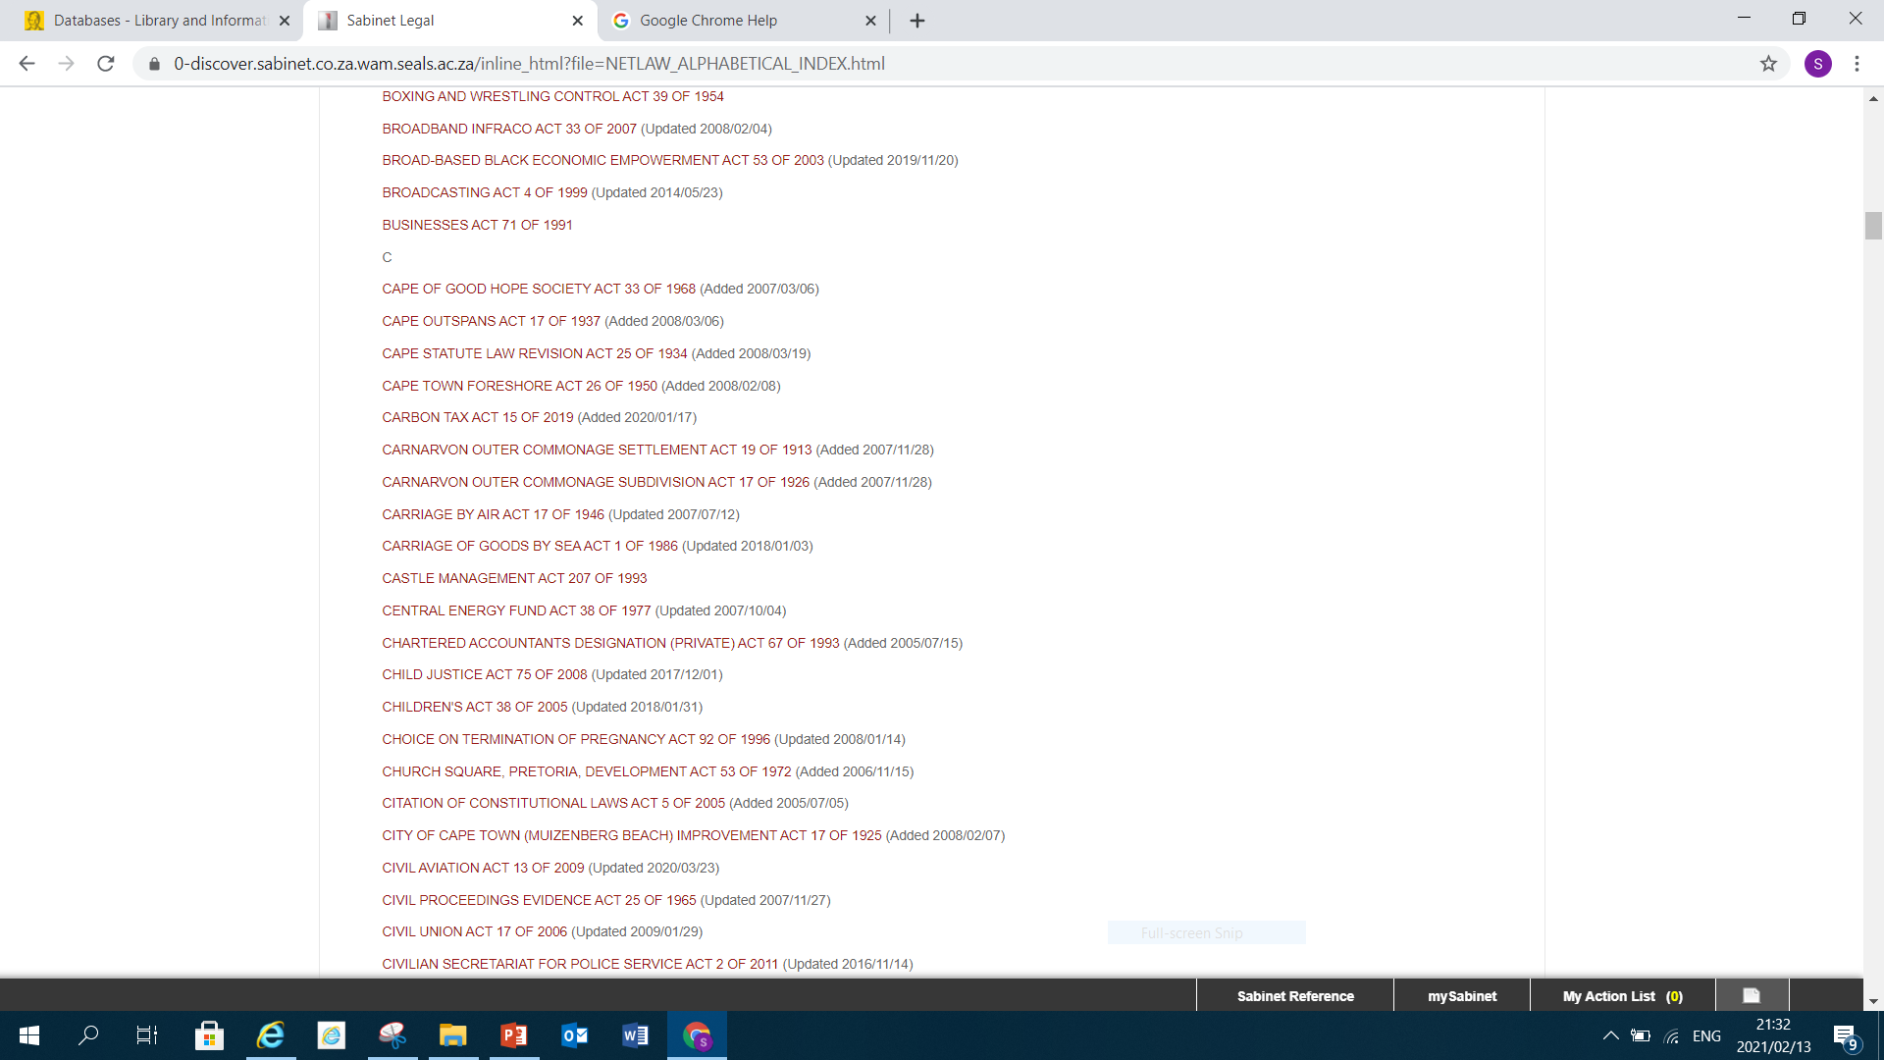
If you are looking for Children’s Act 38 of 2005 scroll down and select the Act

Slide 9
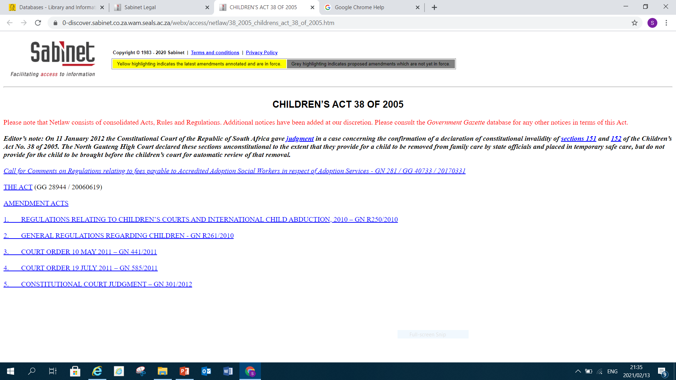
Click on the Act

Slide 10
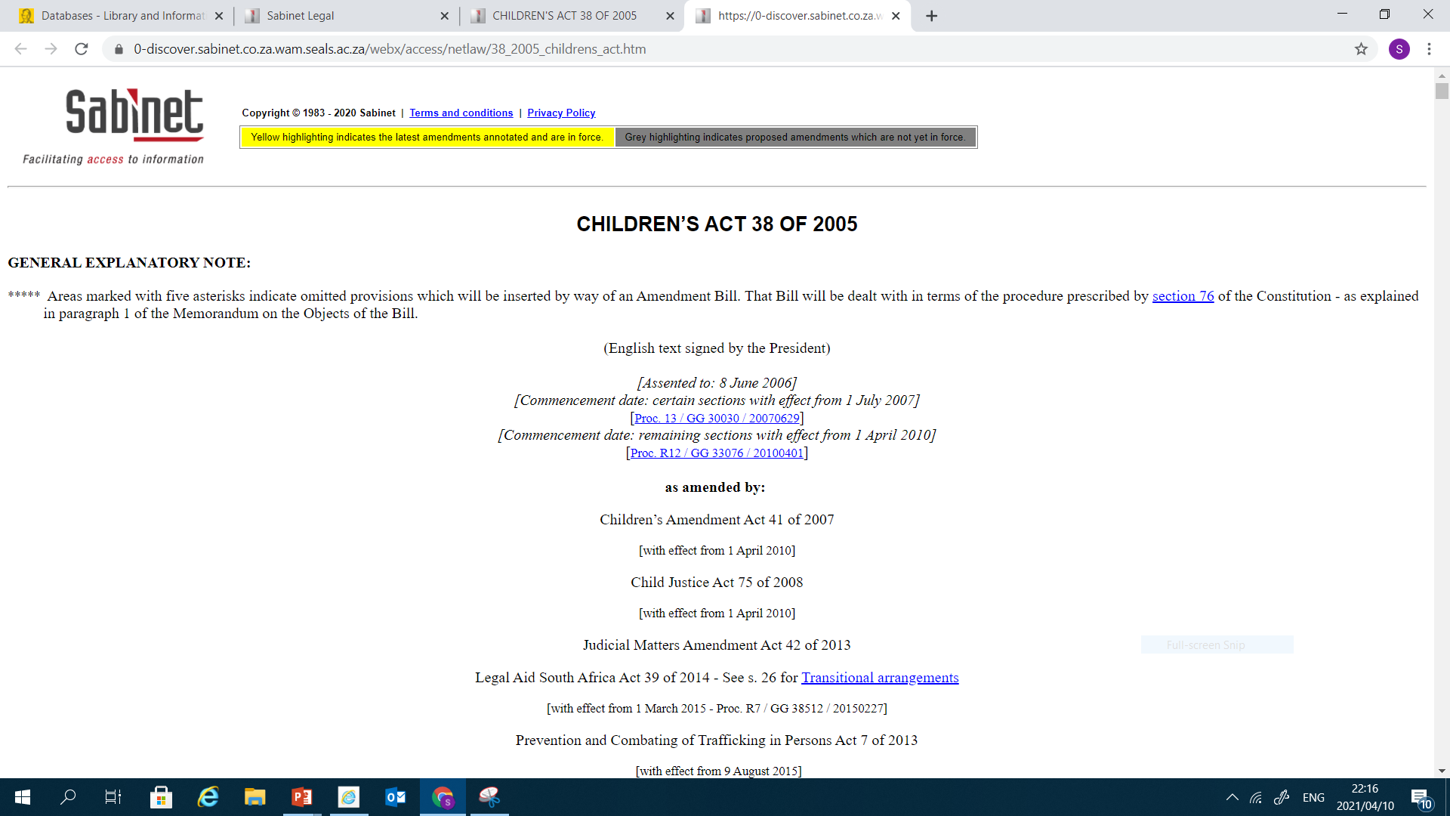

Slide 11
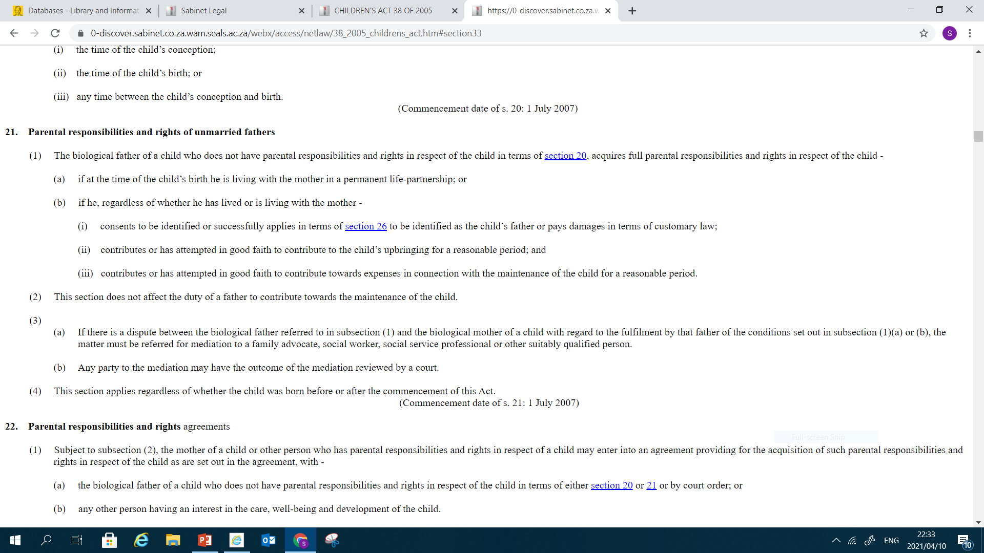
Scroll down to search parental responsibilities and rights for unmarried fathers.

Slide 12
THANK YOU

