Slide 1
Finding legal information in the Nelson Mandela law library

Slide 2
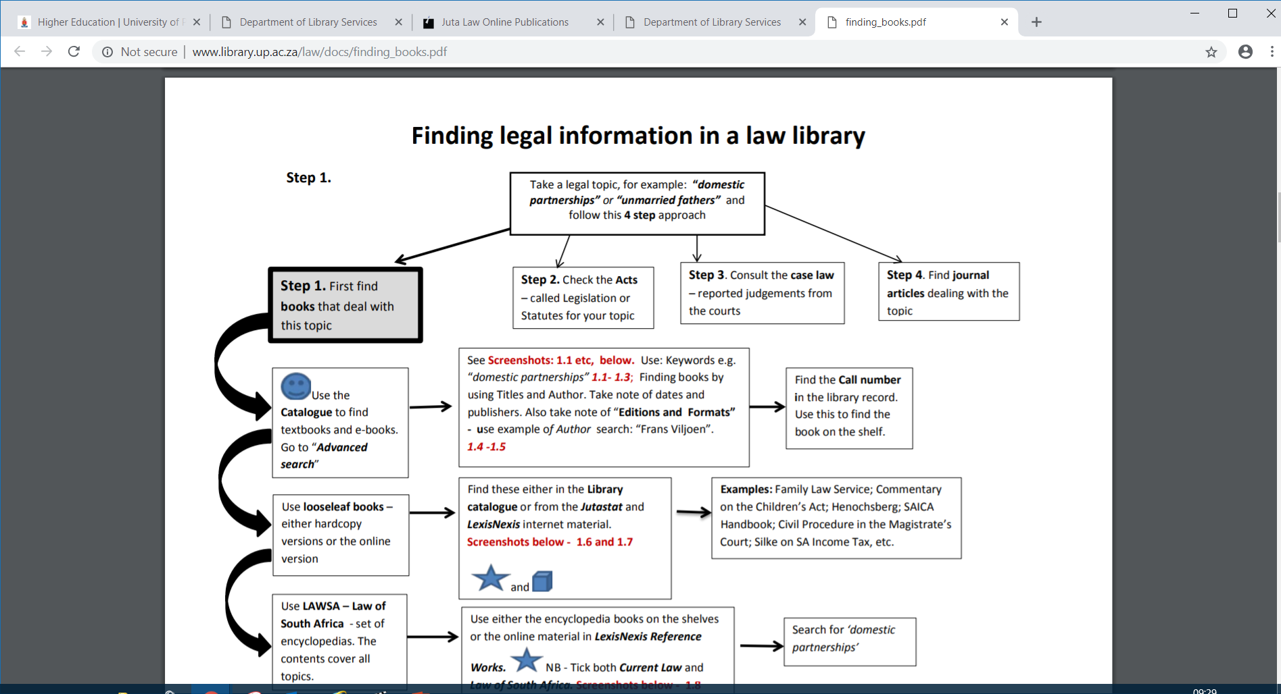

Slide 3
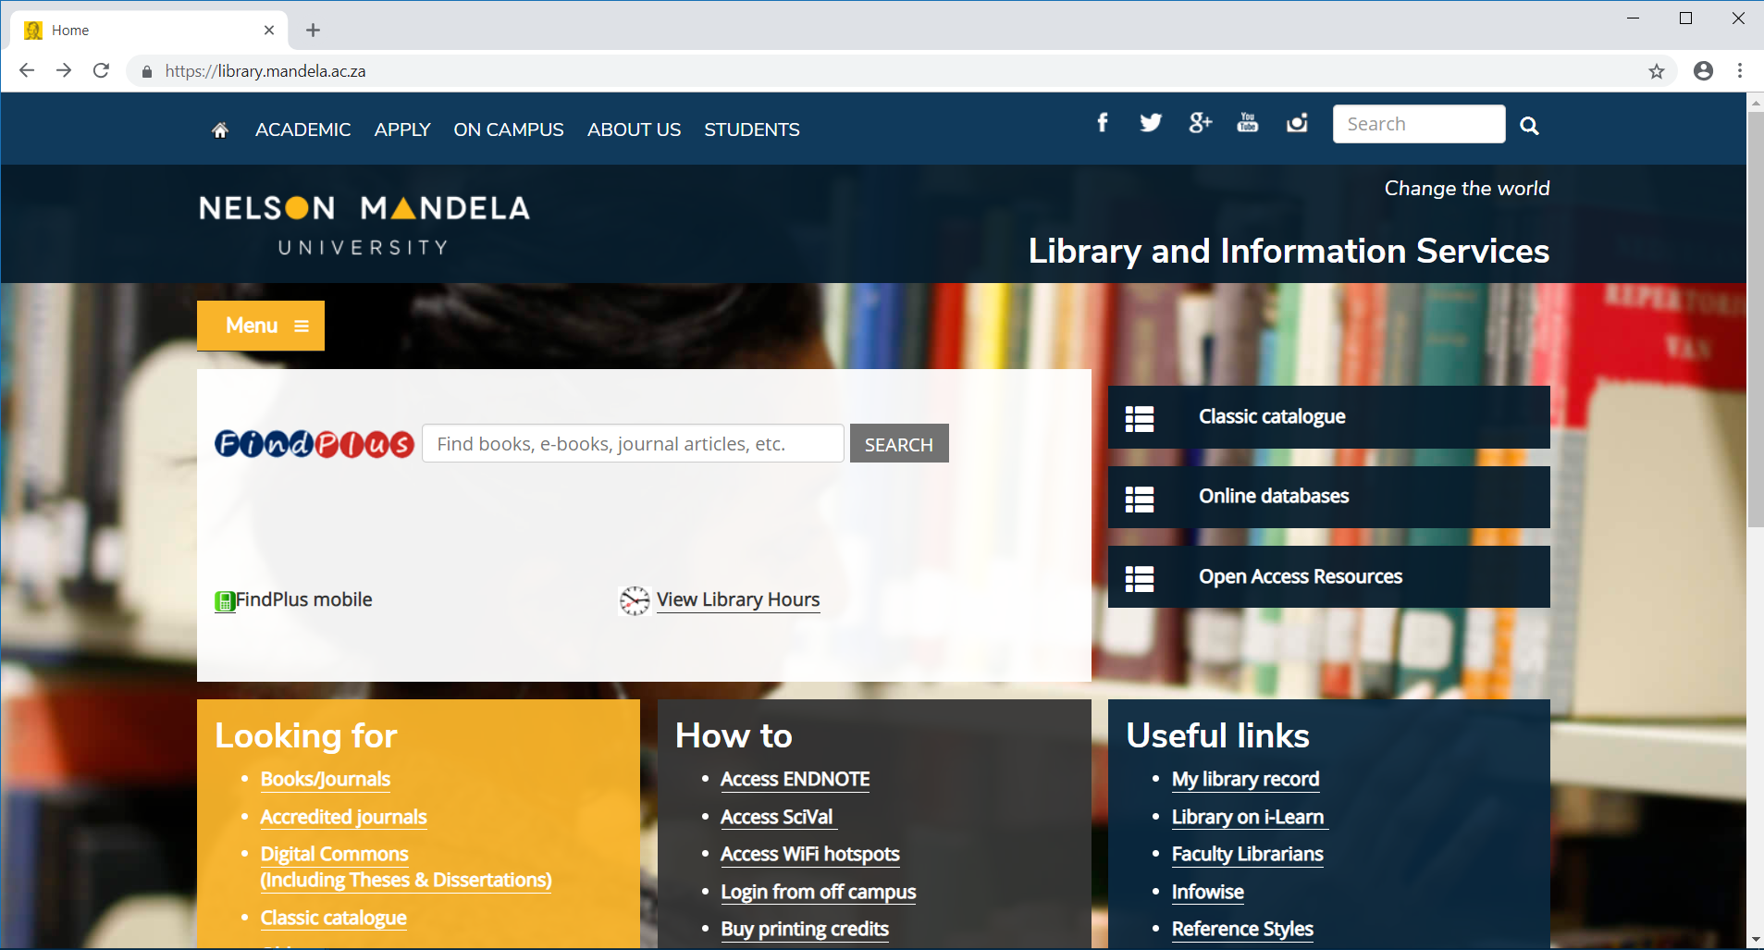

Slide 4
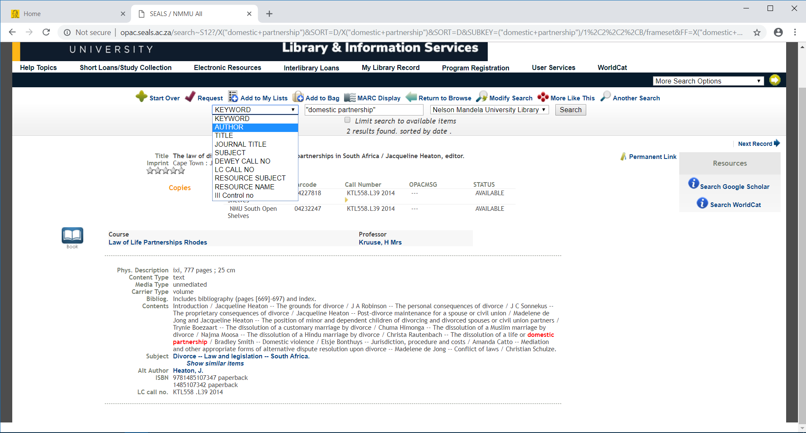

Slide 5
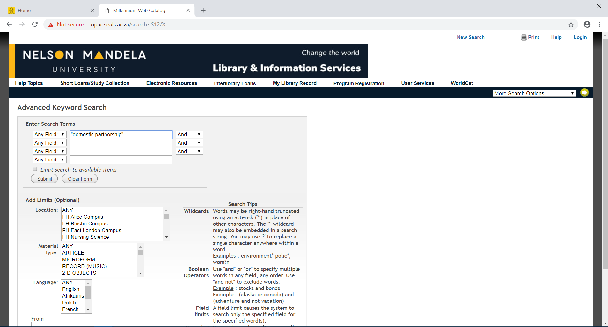
Screenshot 1.1 Catalogue – Advanced search - Search for the phrase “domestic partnerships”
Keyword search, use “… “ for a phrase

Slide 6
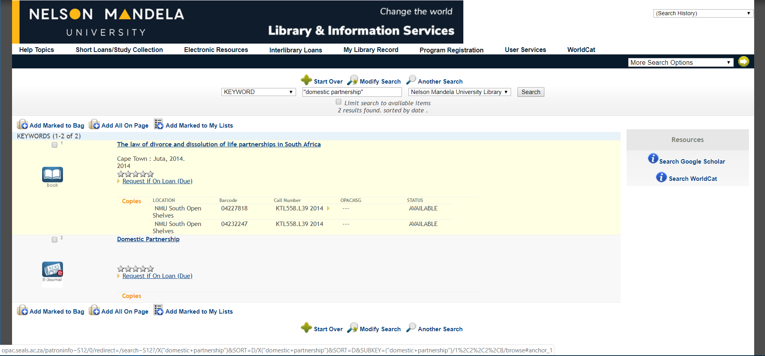
Two results found.
Publication
Location
Call Number

Slide 7
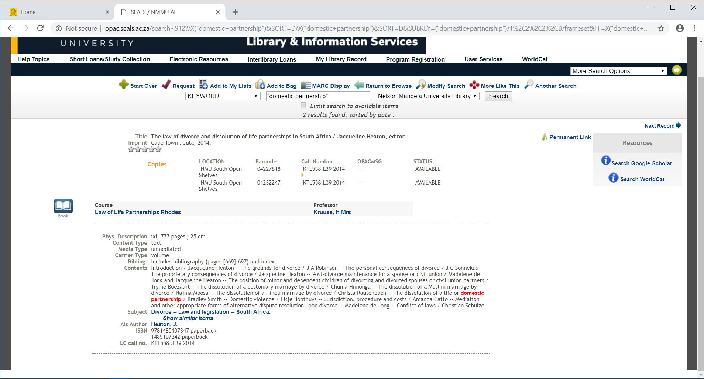
Title,Author,Edition, Publisher and year of publication

Slide 8
Search by author’s name

Slide 9
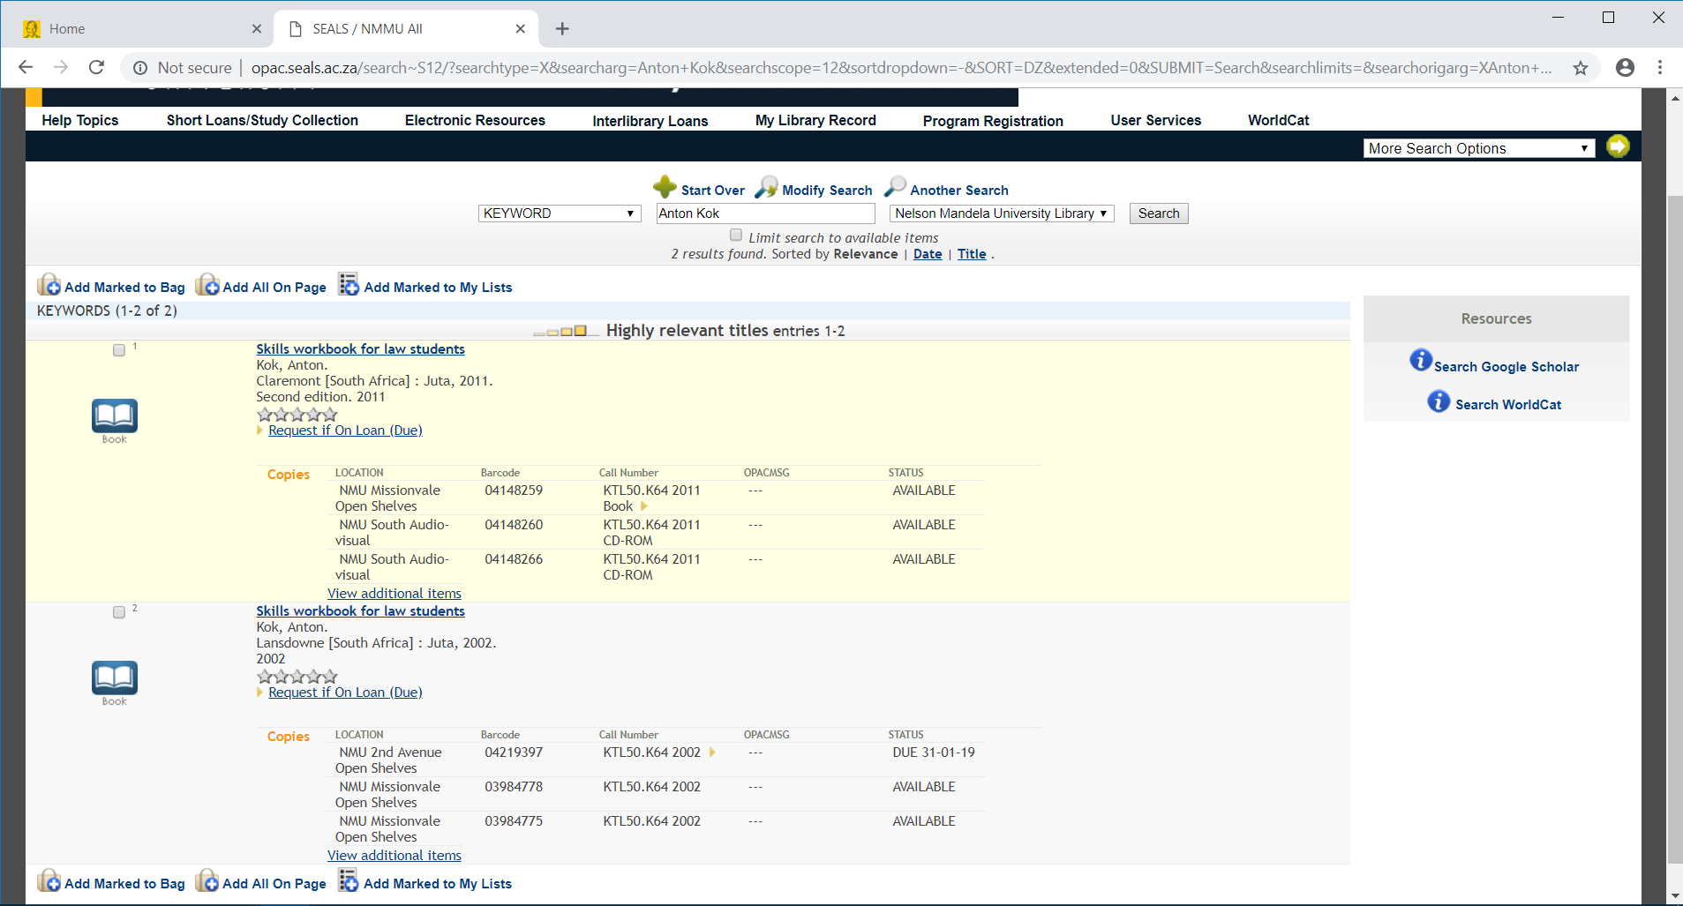
Type in the name of the
Results found

Slide 10
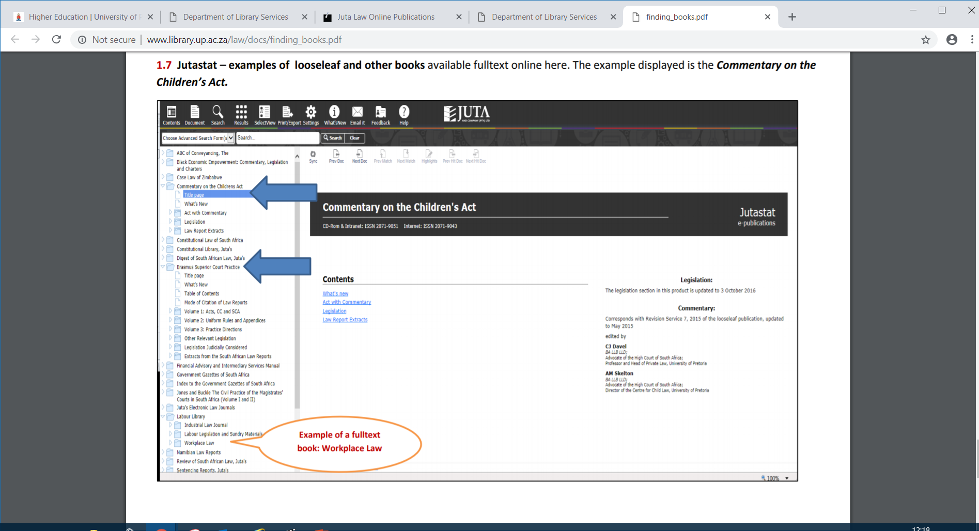

Slide 11
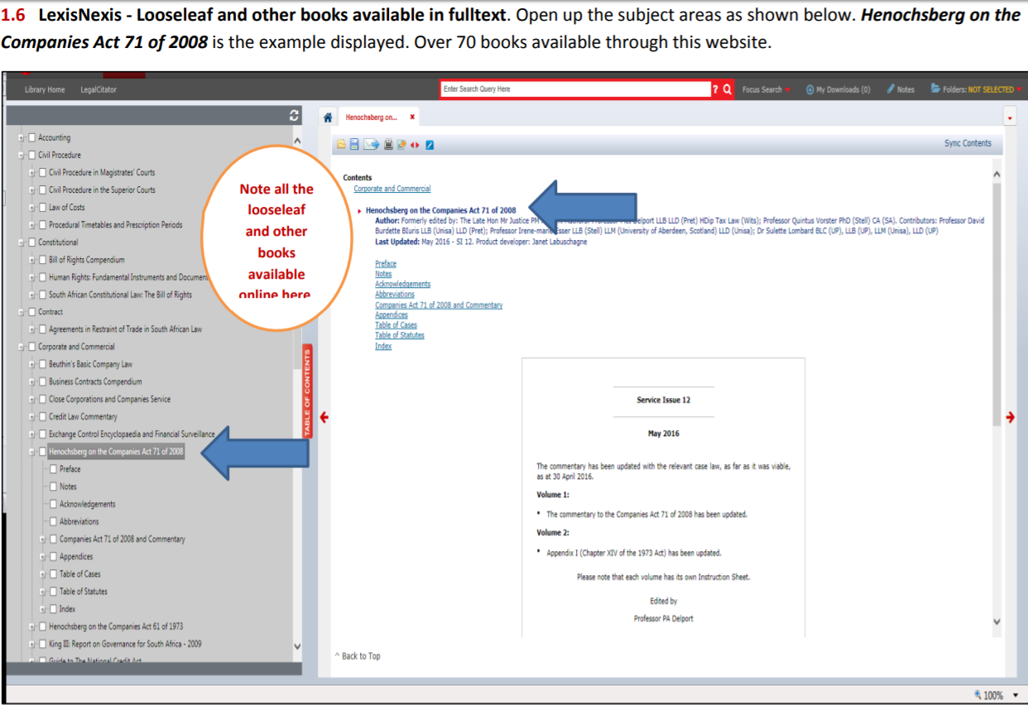

Slide 12
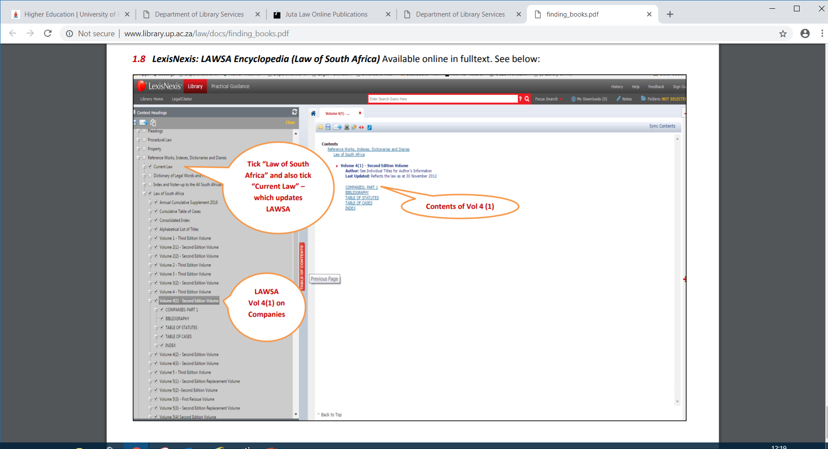

Slide 13
Thank you.
Contact Details:
Sithenjisiwe Nyaningwe
Faculty Librarian: Law
Summerstrand (South) Campus
LIASA Convener for ICT & MAIG
Tel: +27 (0)41 504 2391
Fax: +27 (0)41 504 1094
Cell: 0717539555
Sithenjisiwe.Nyaningwe@mandela.ac.za

