Slide 1
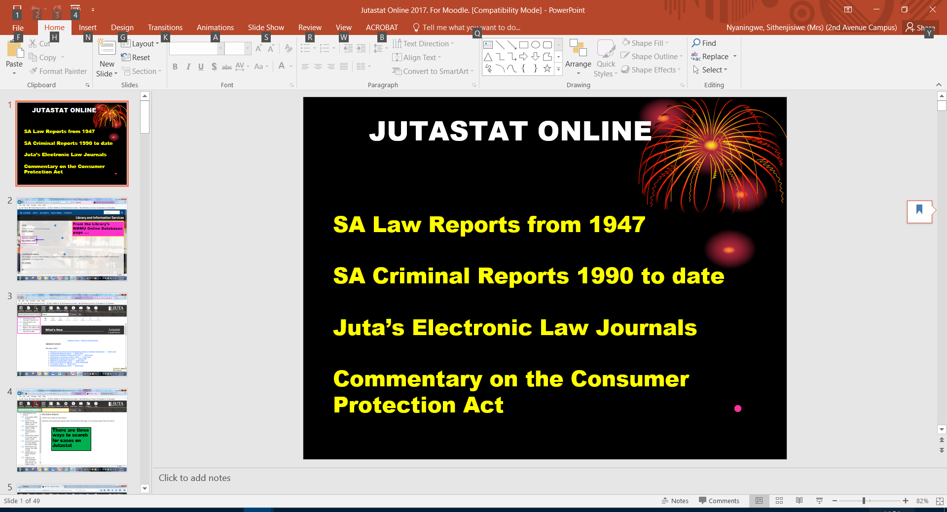

Slide 2
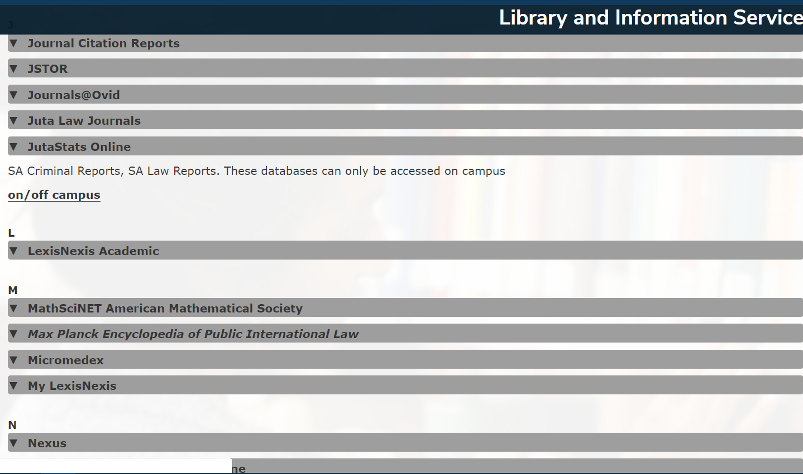
JutaStats Online from the Library website

Slide 3
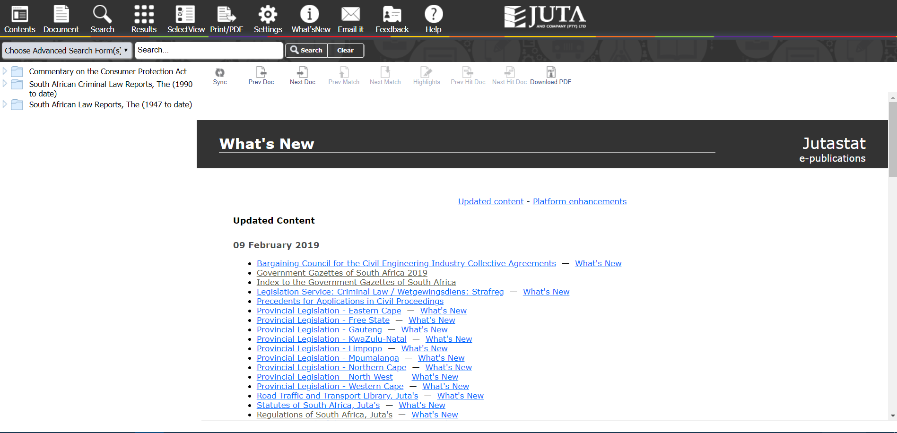

Slide 4
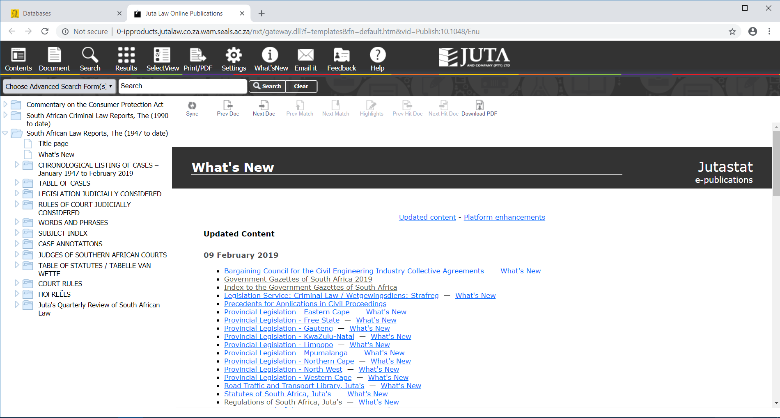
Three ways to search for legal information

Slide 5
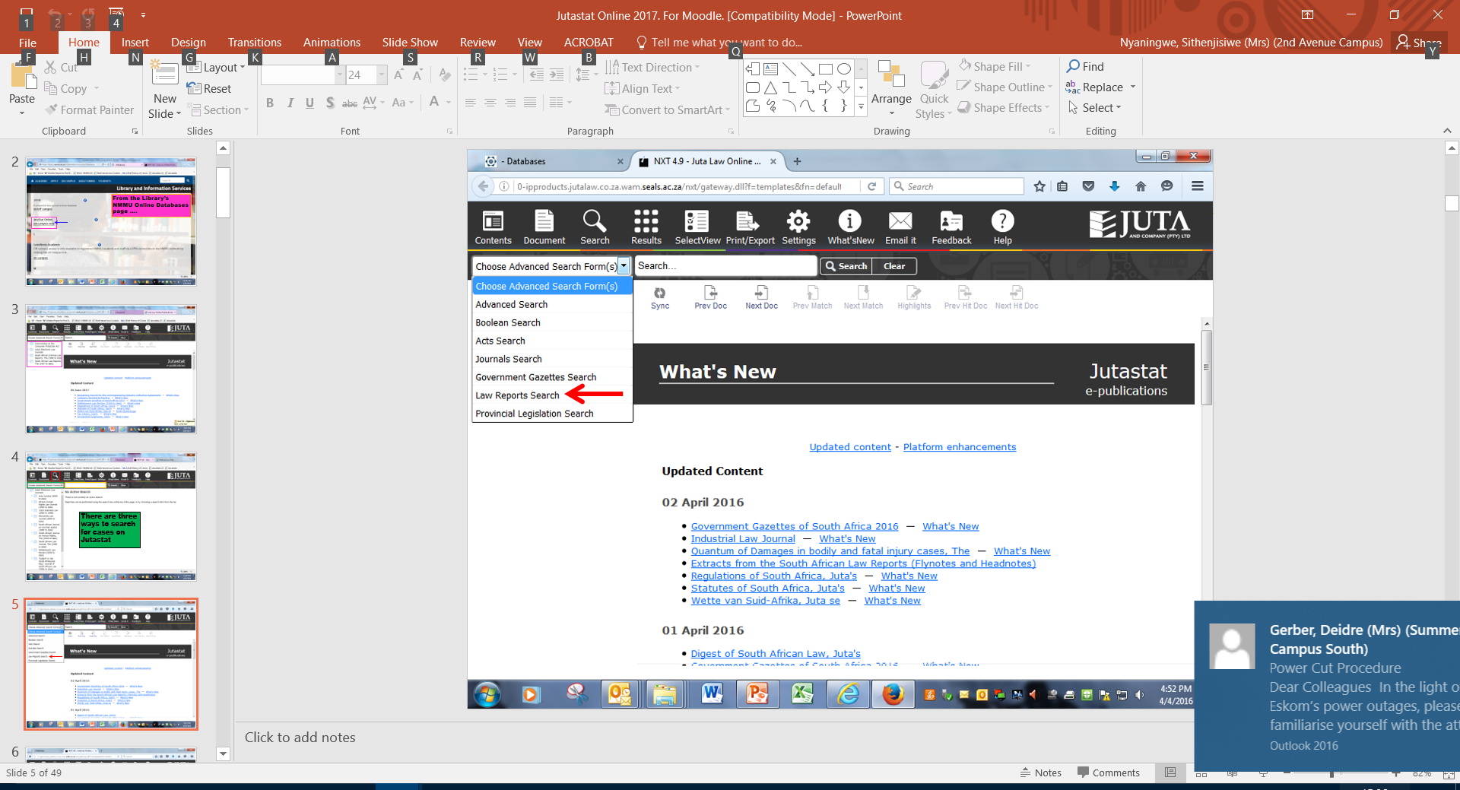

Slide 6
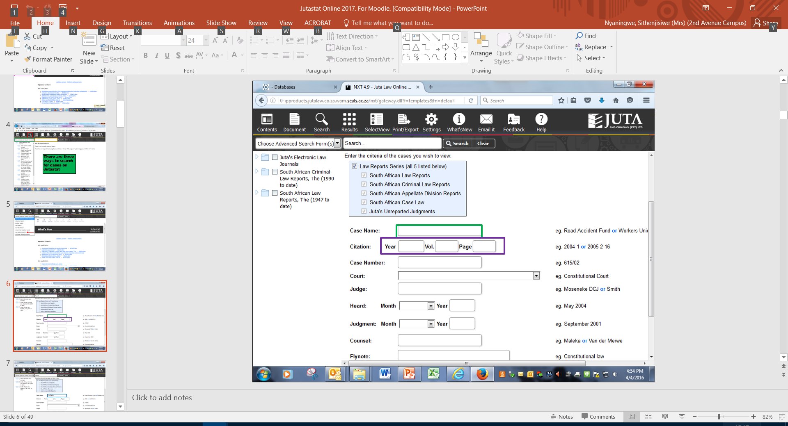

Slide 7
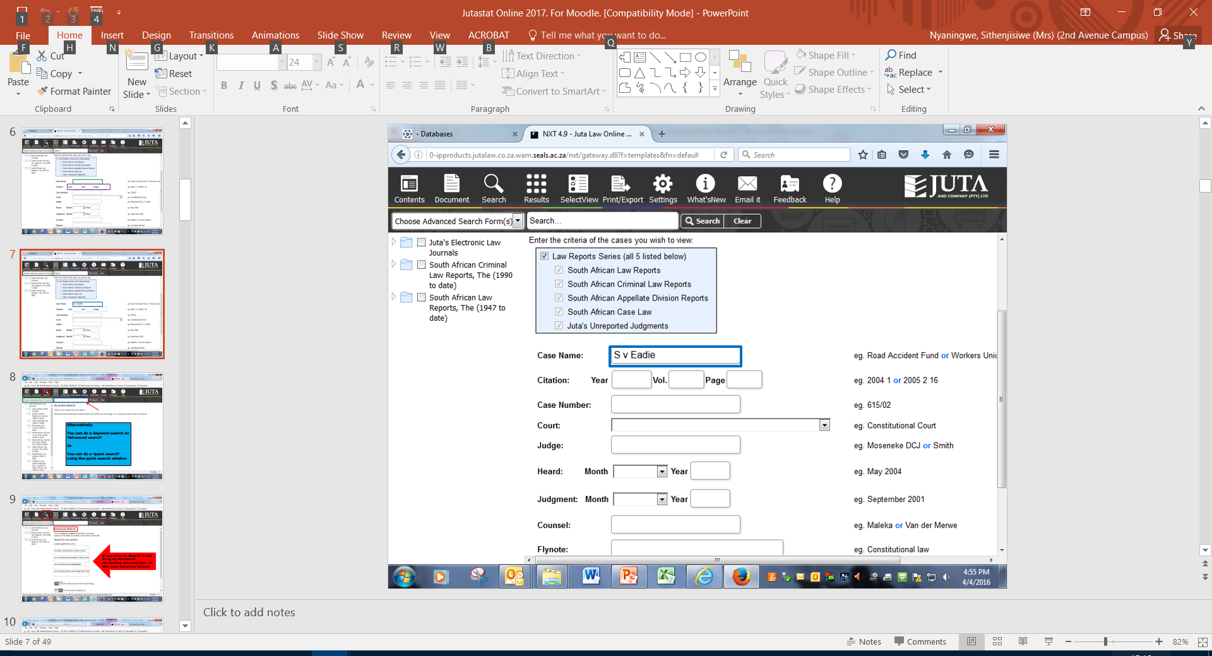

Slide 8
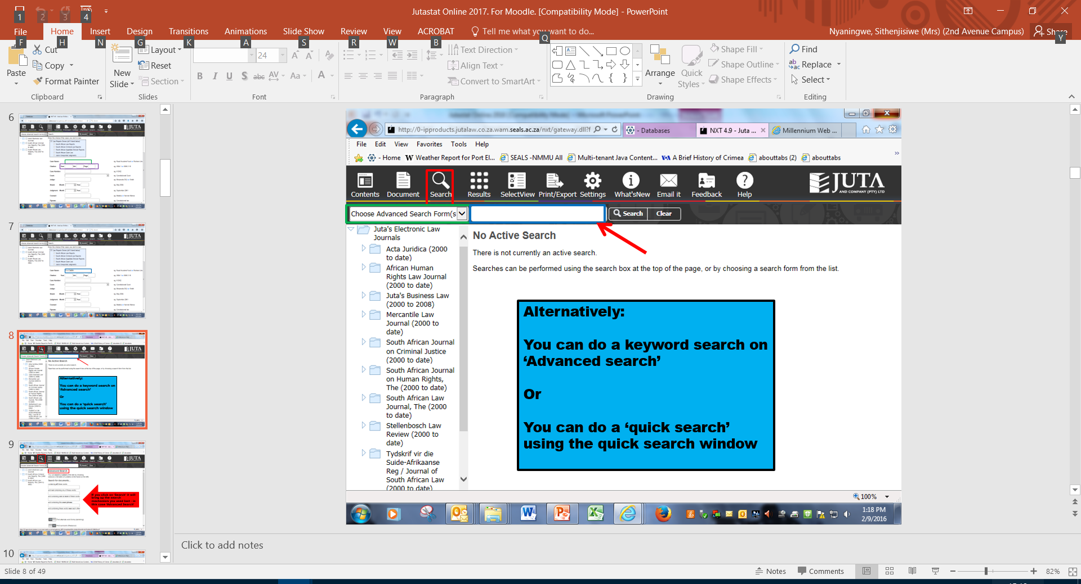

Slide 9
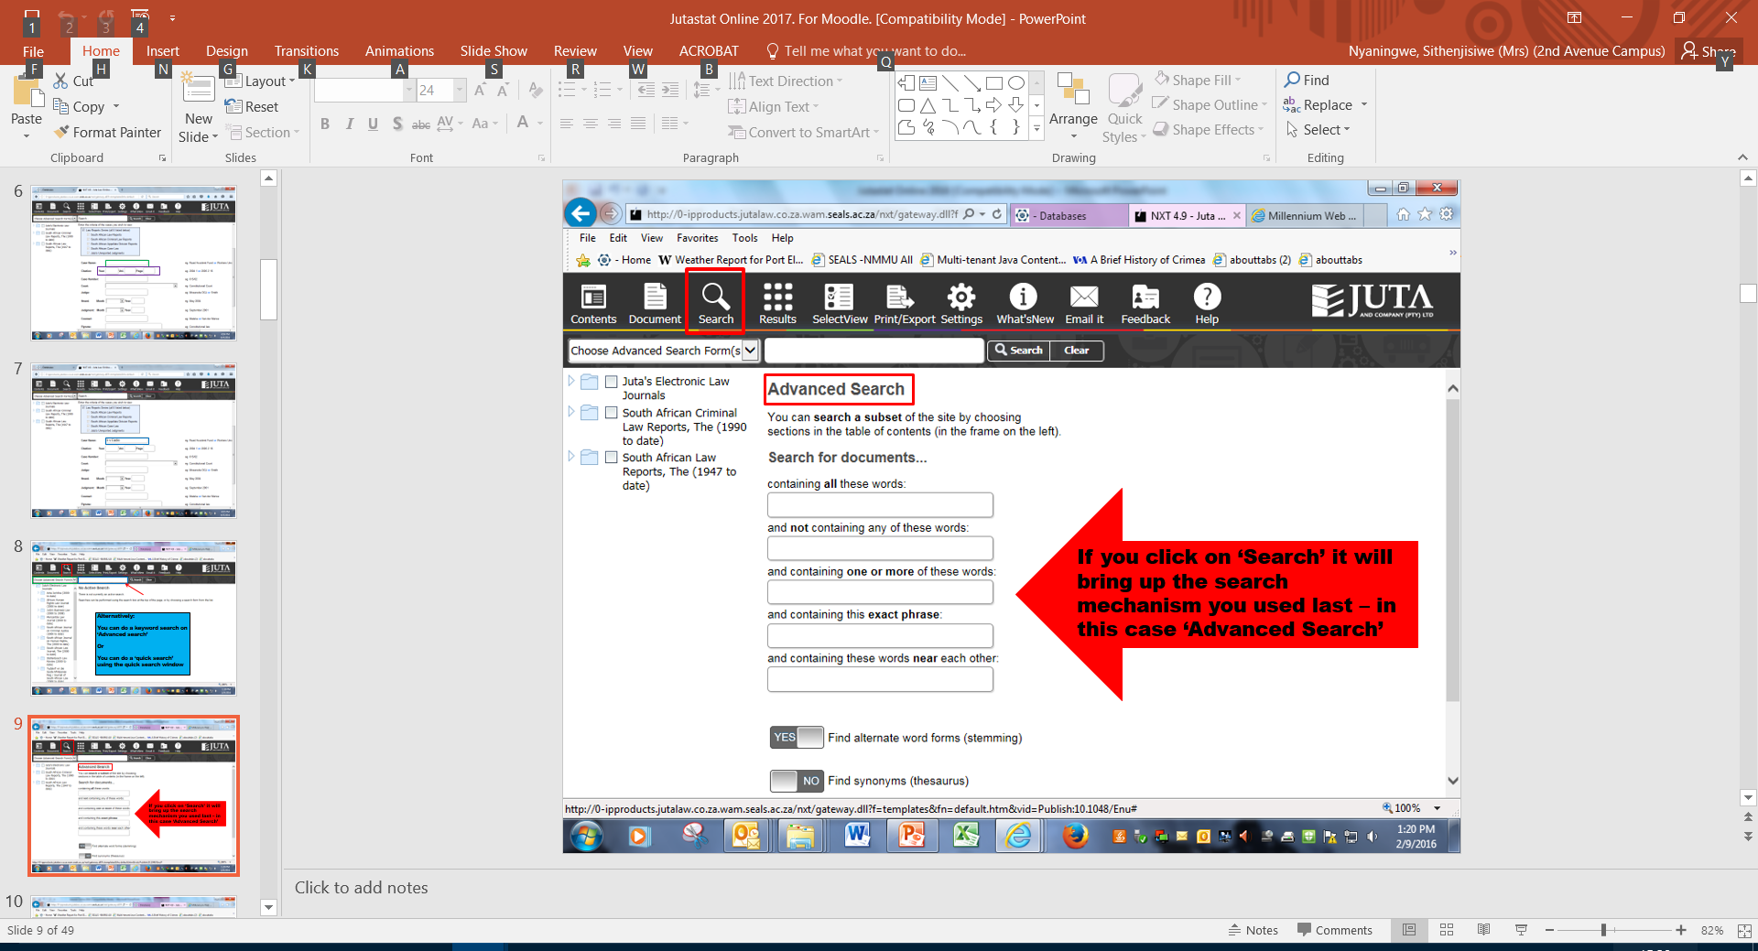

Slide 10
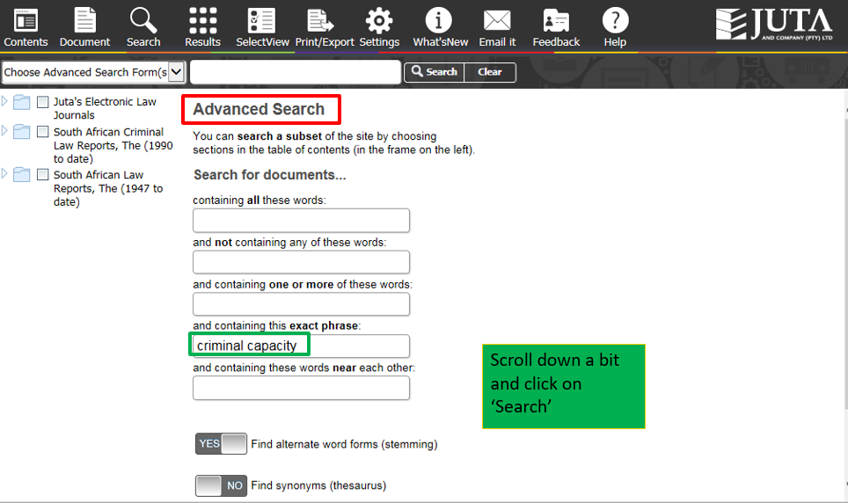

Slide 11
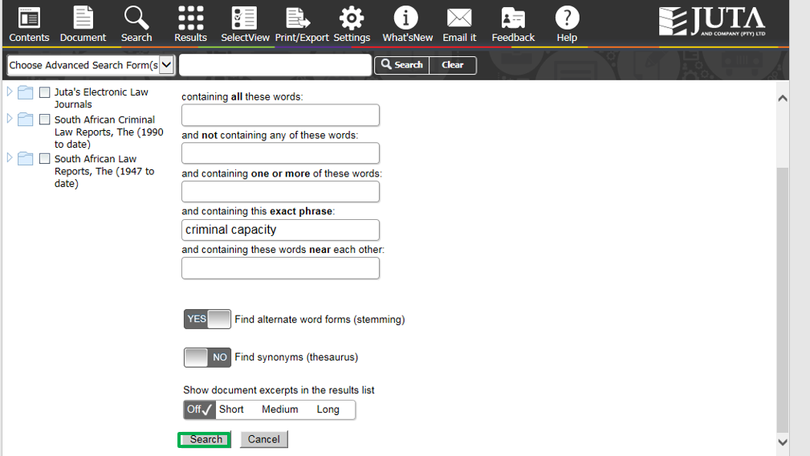

Slide 12
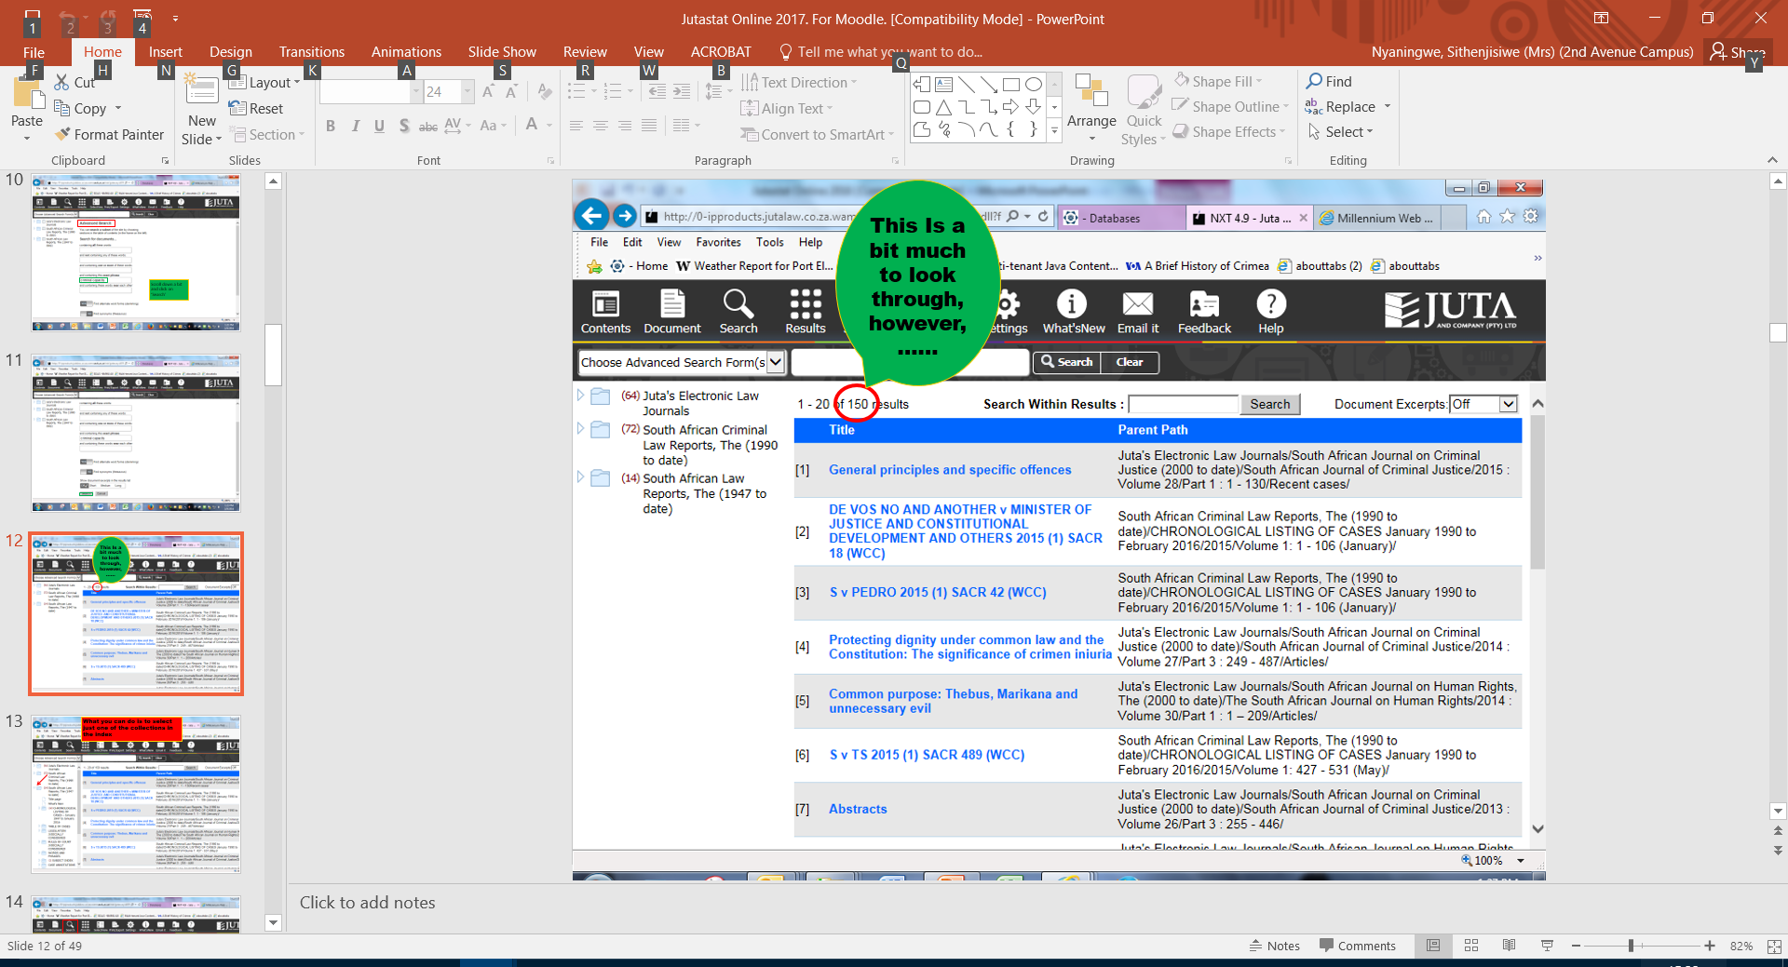

Slide 13
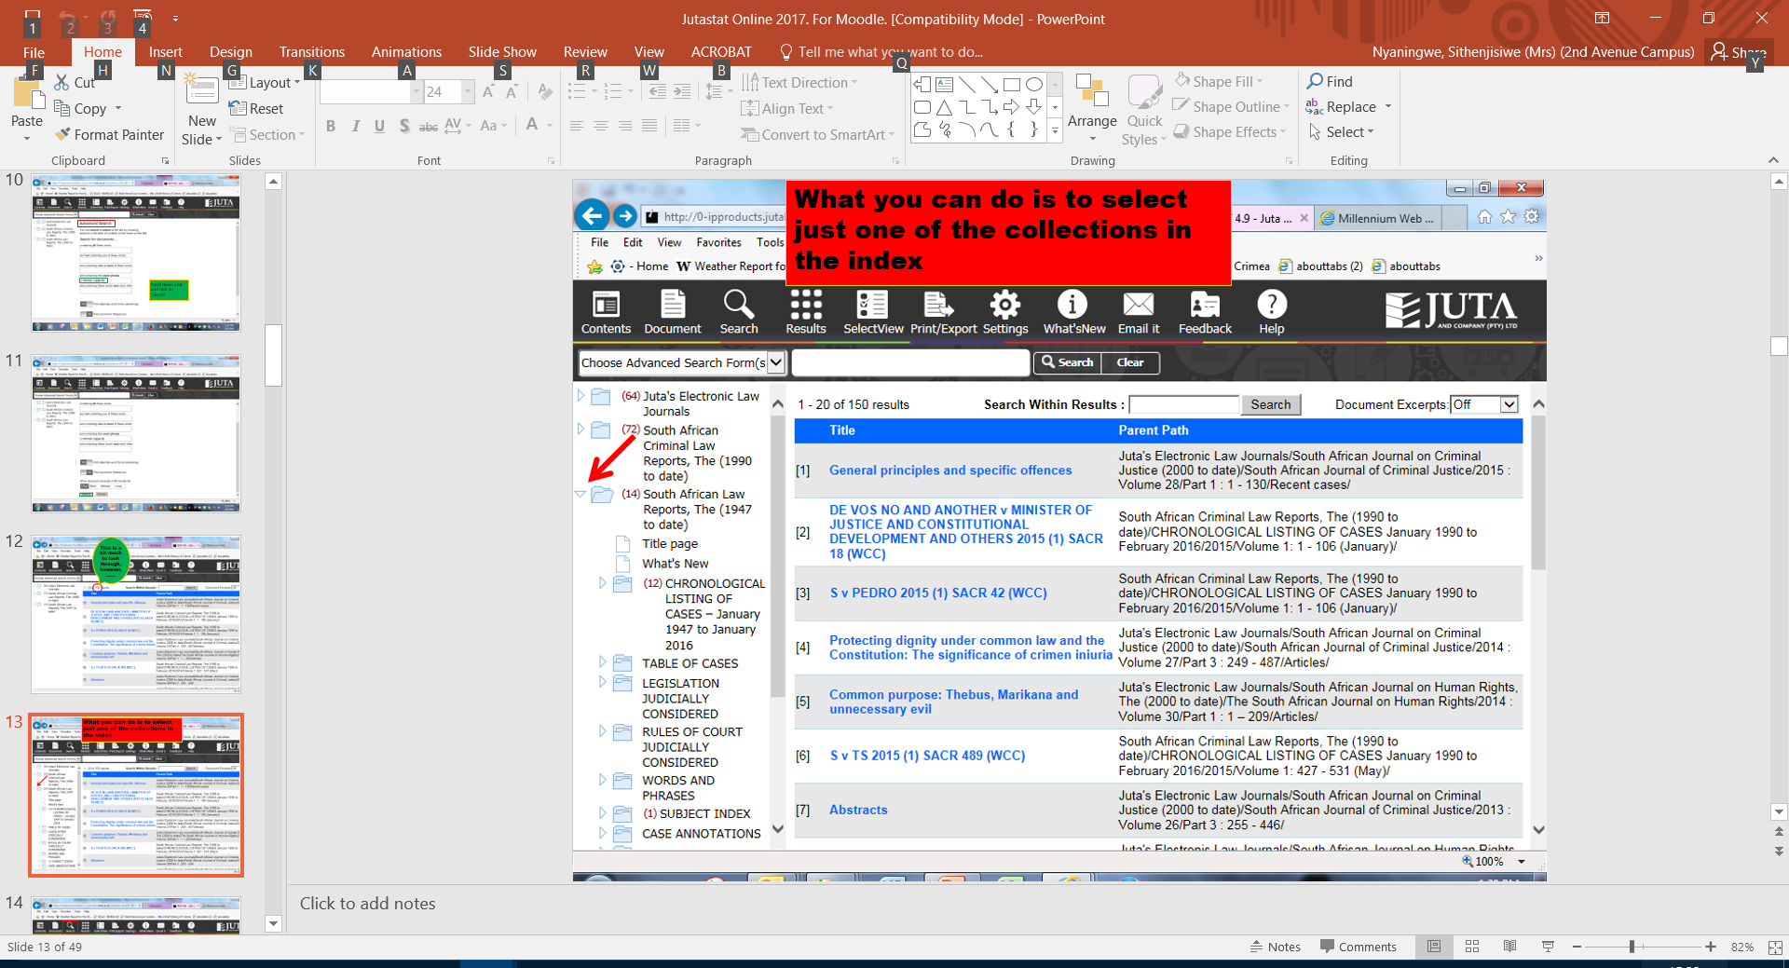

Slide 14
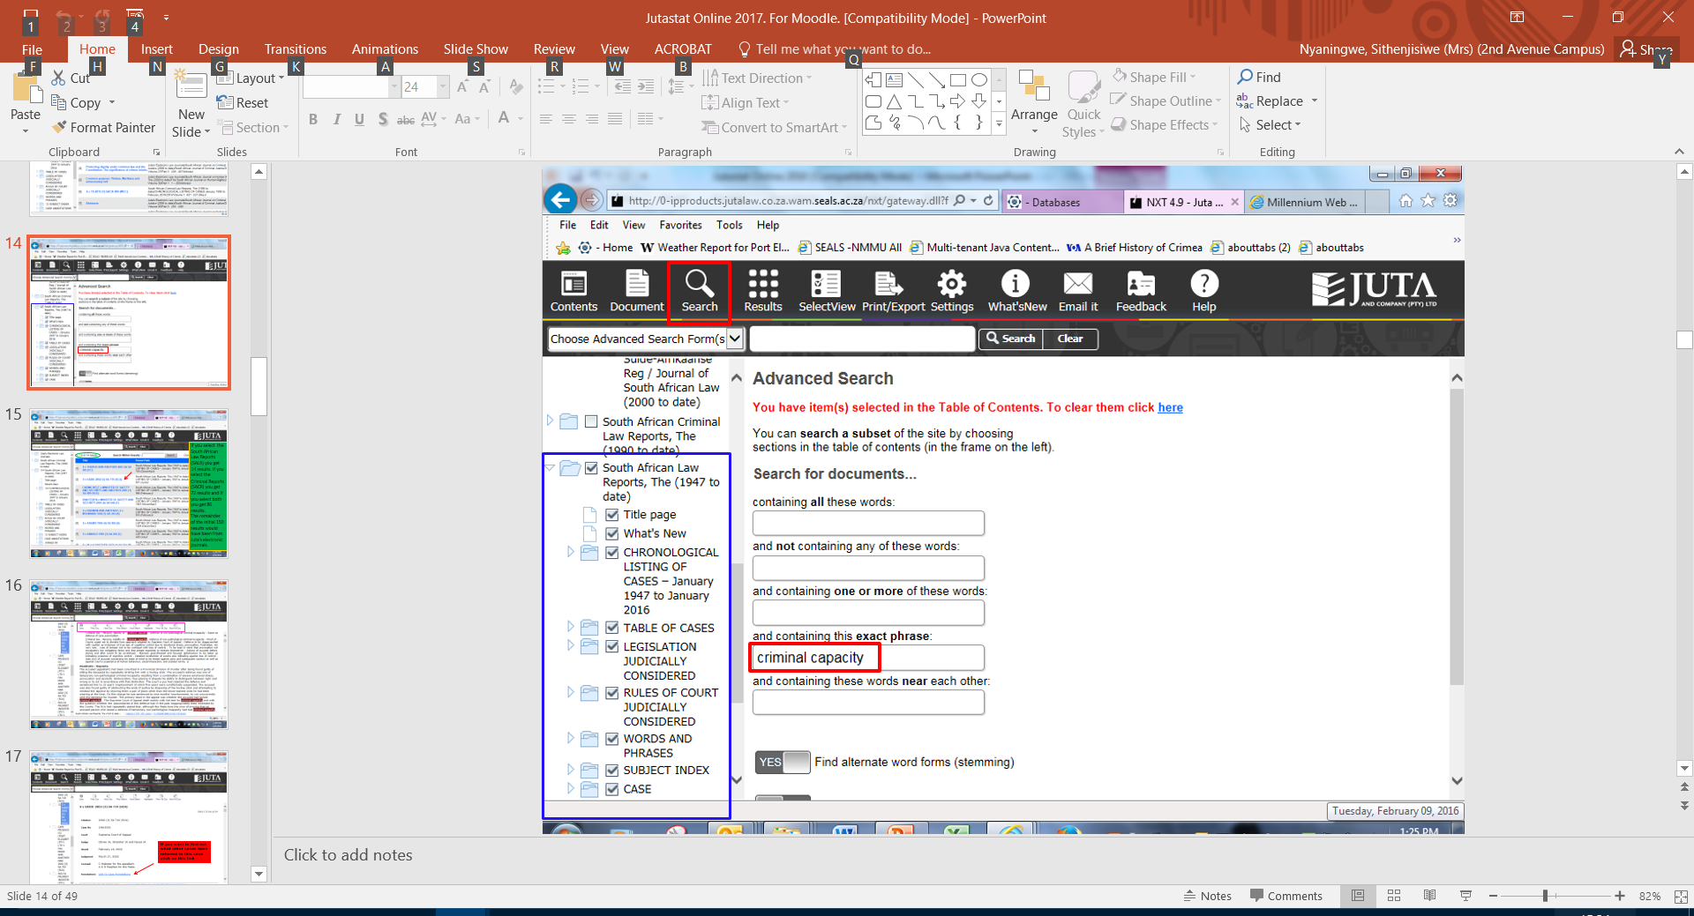

Slide 15
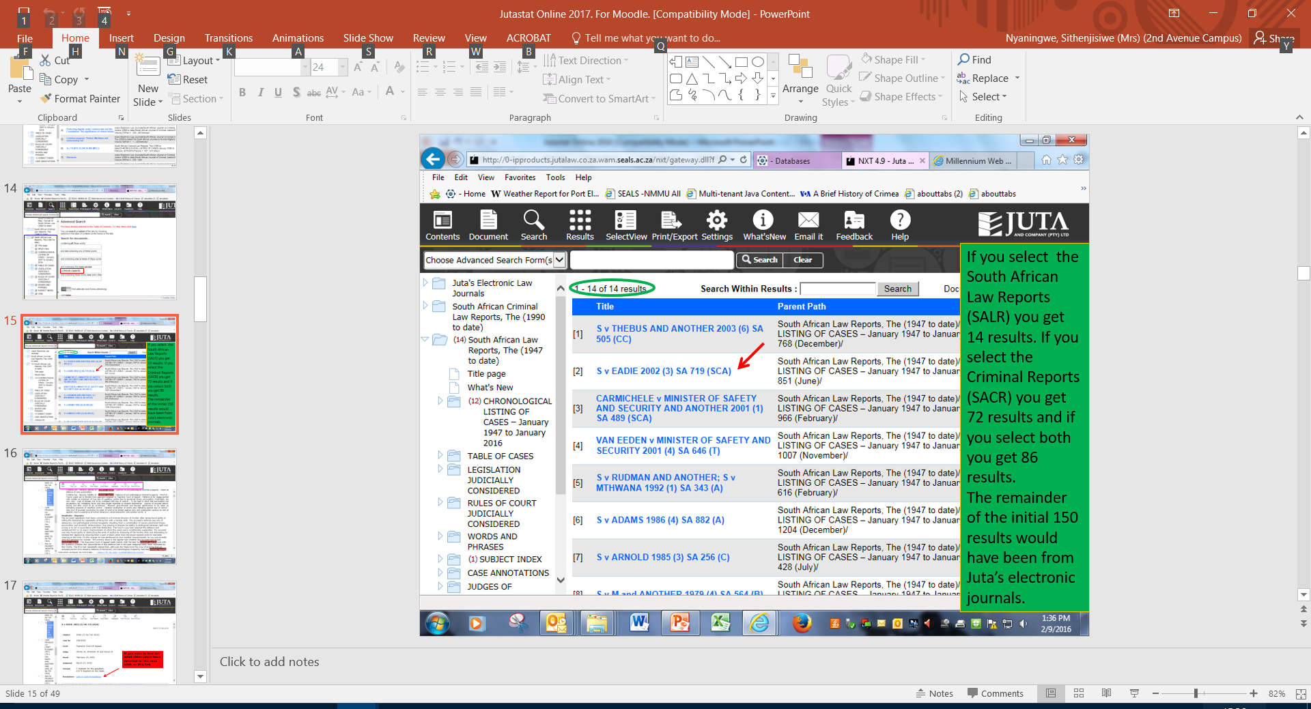

Slide 16
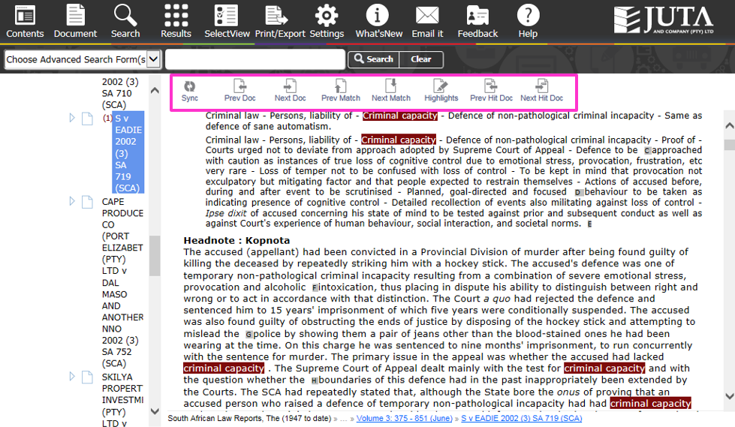

Slide 17
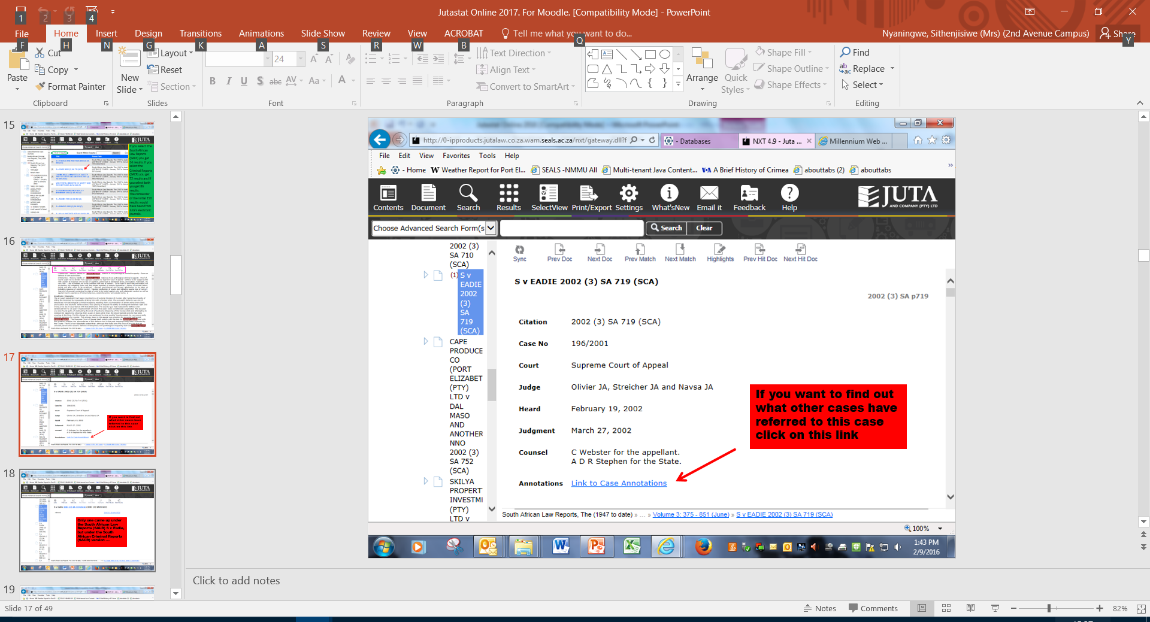

Slide 18
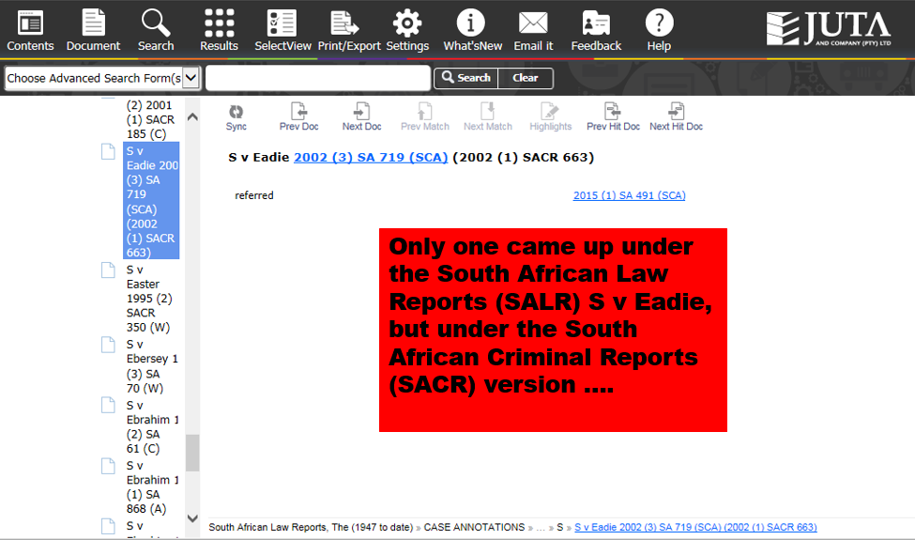

Slide 19
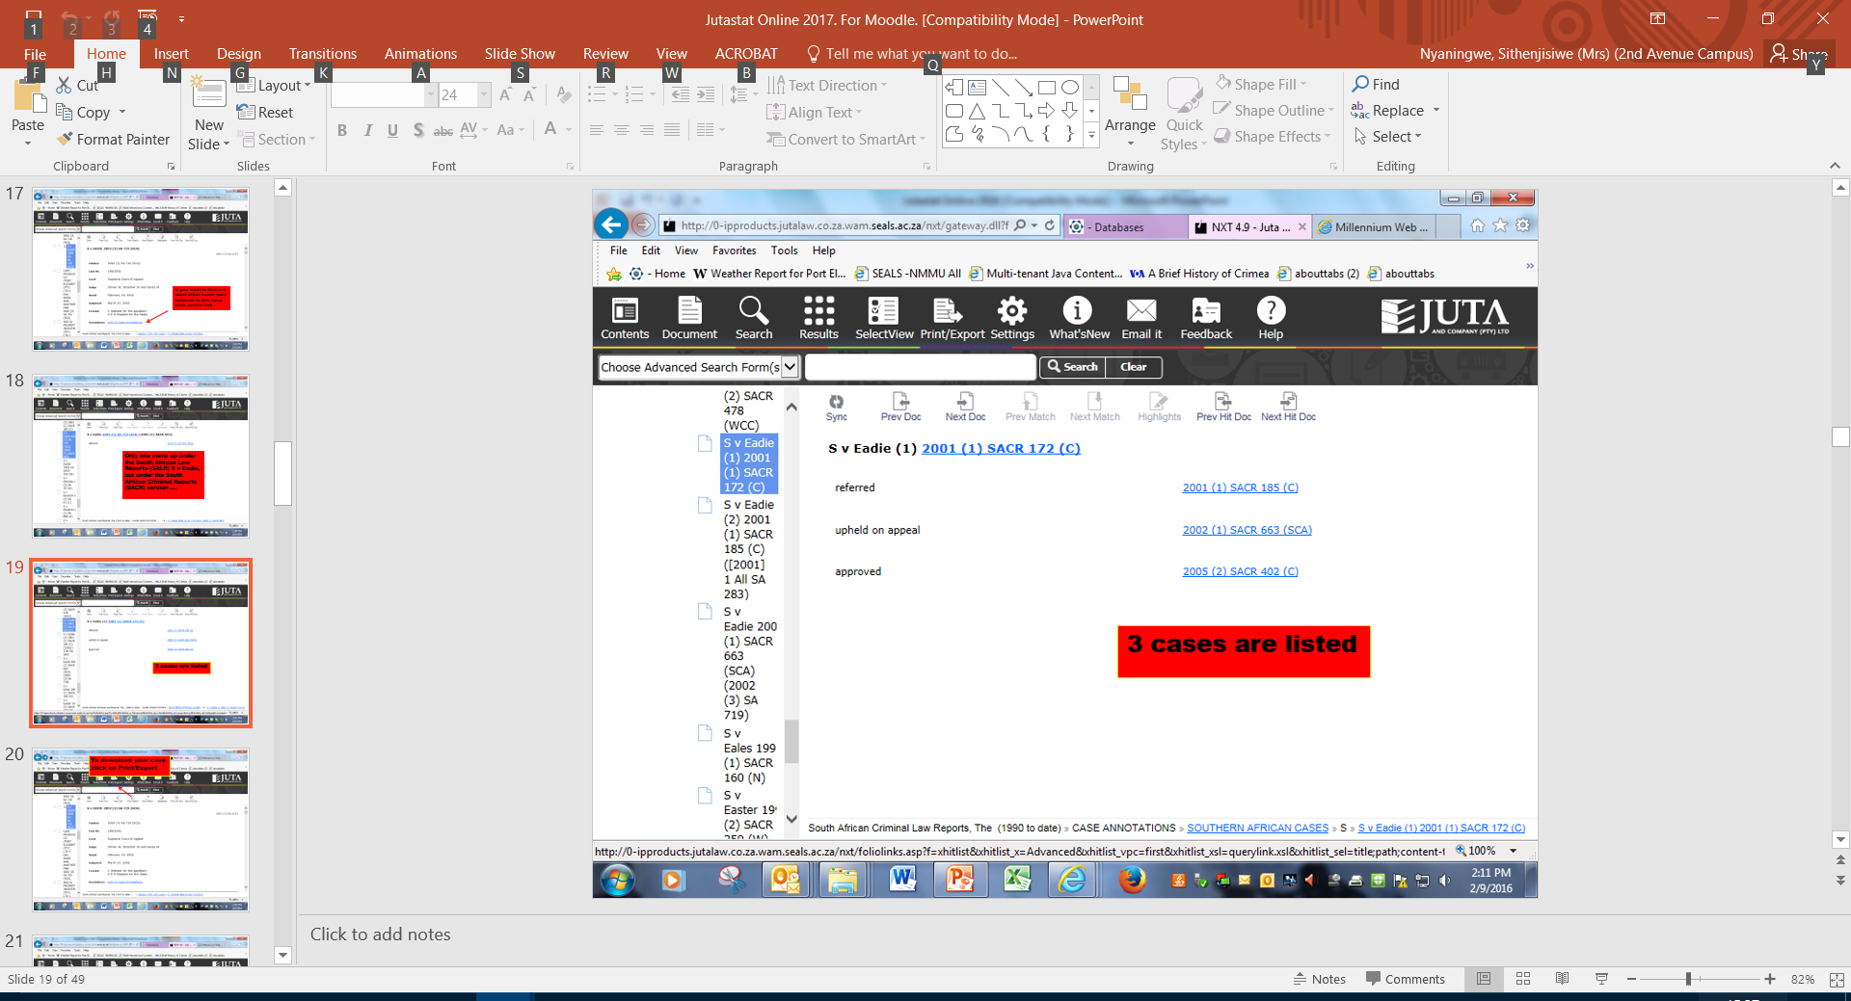

Slide 20
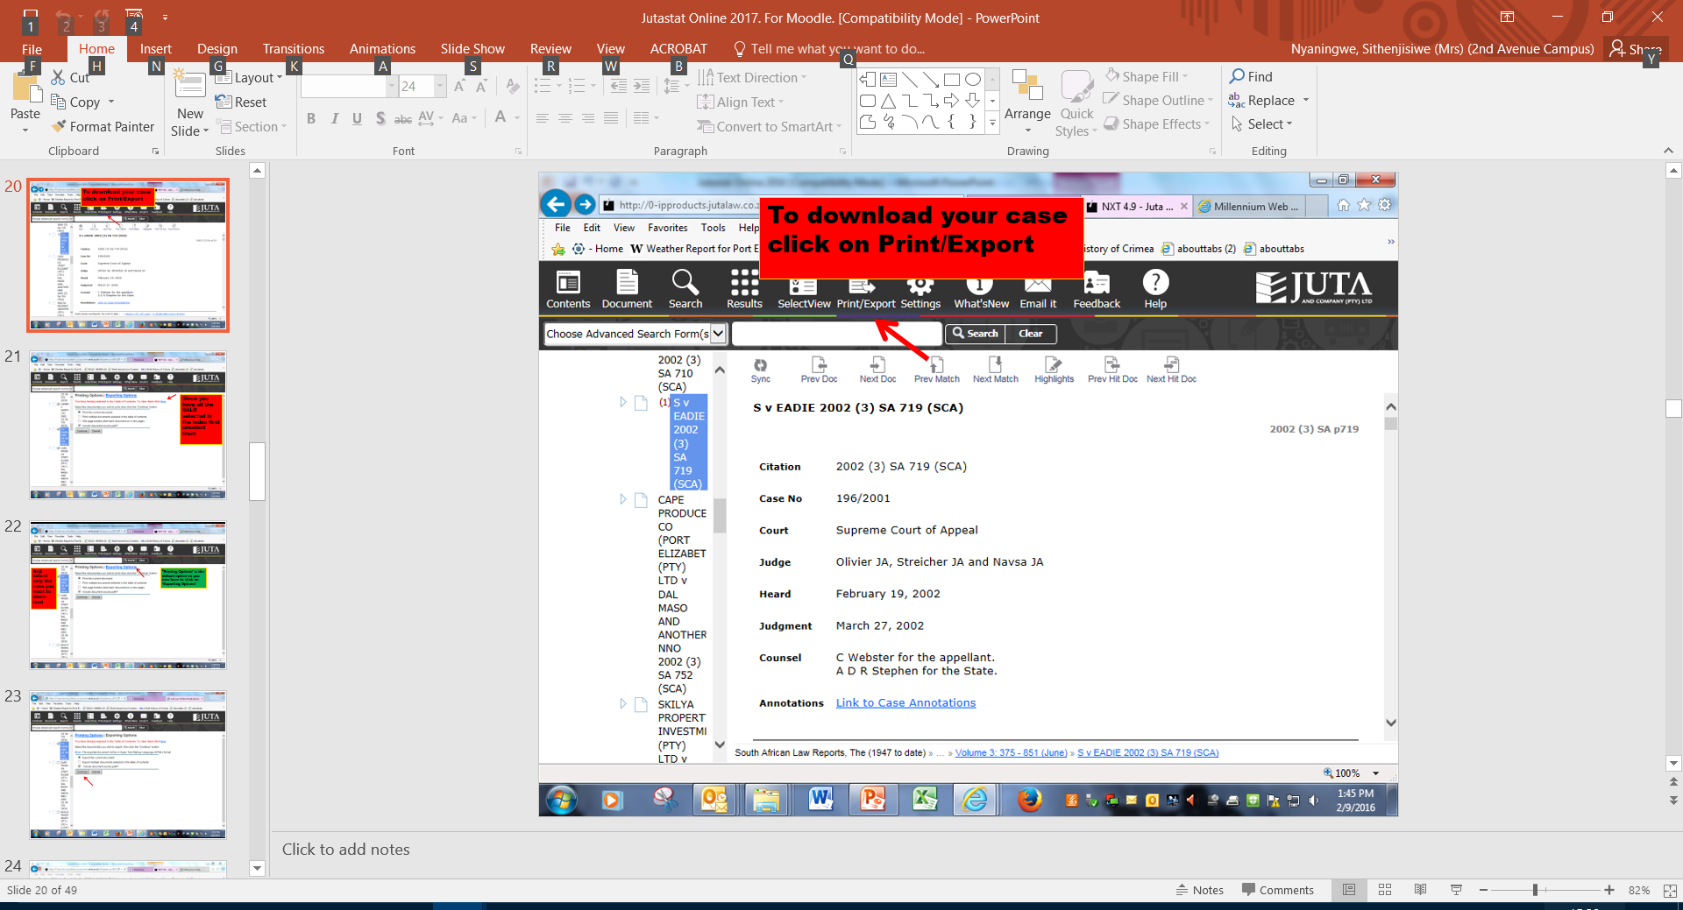

Slide 21
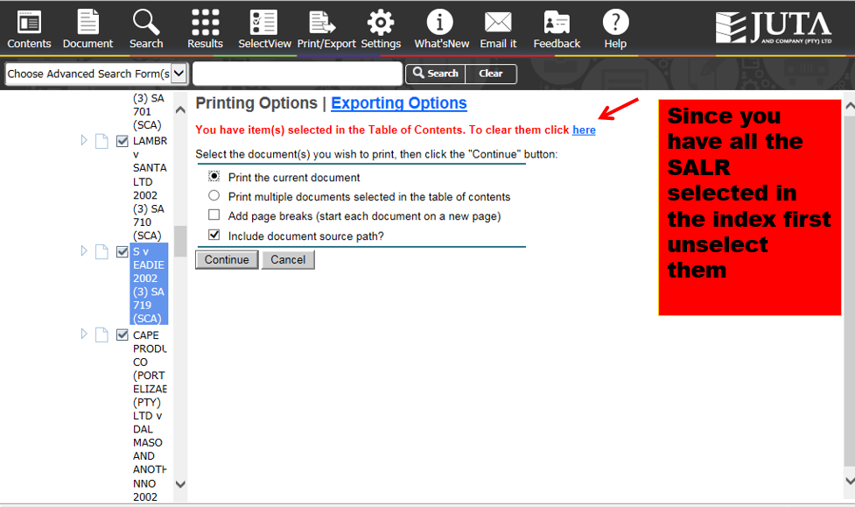

Slide 22
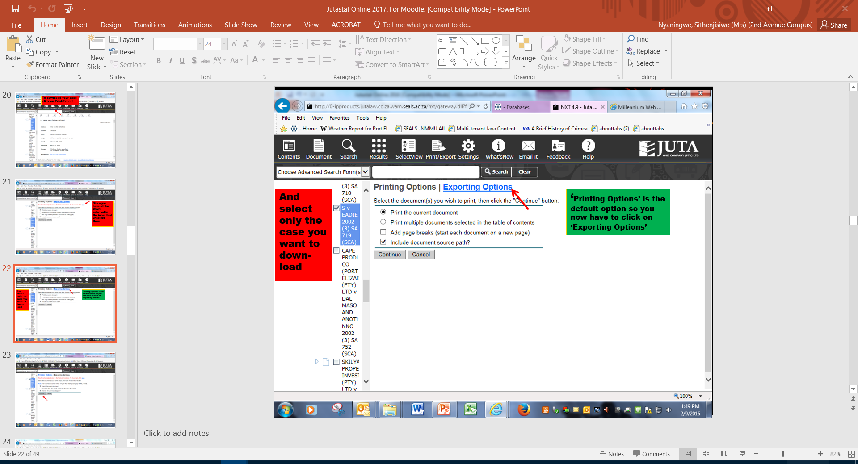

Slide 23
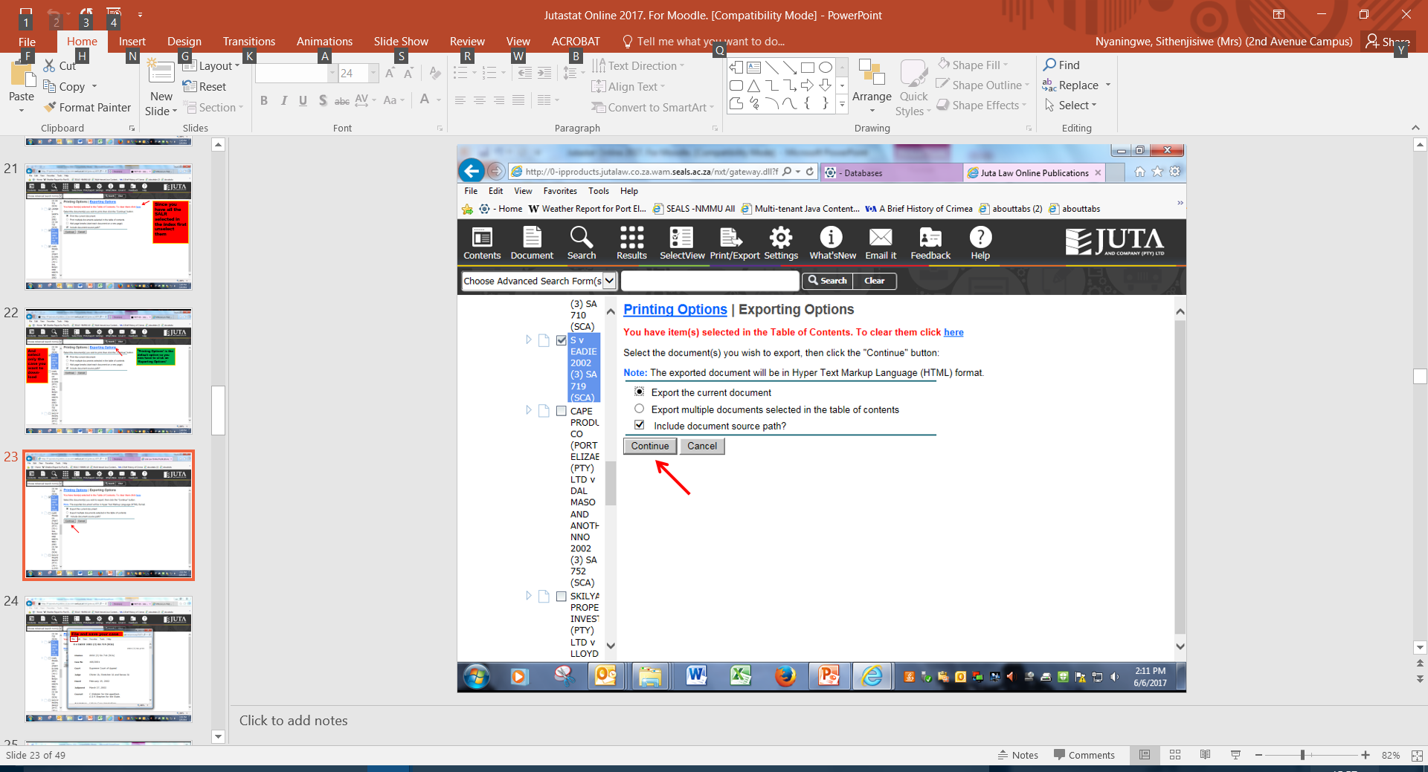

Slide 24
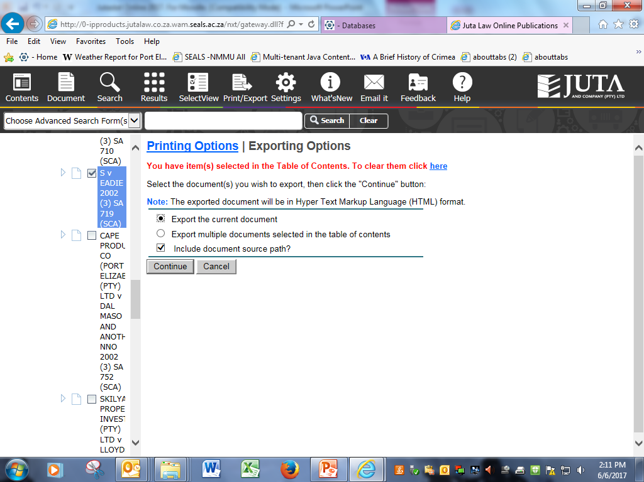

Slide 25
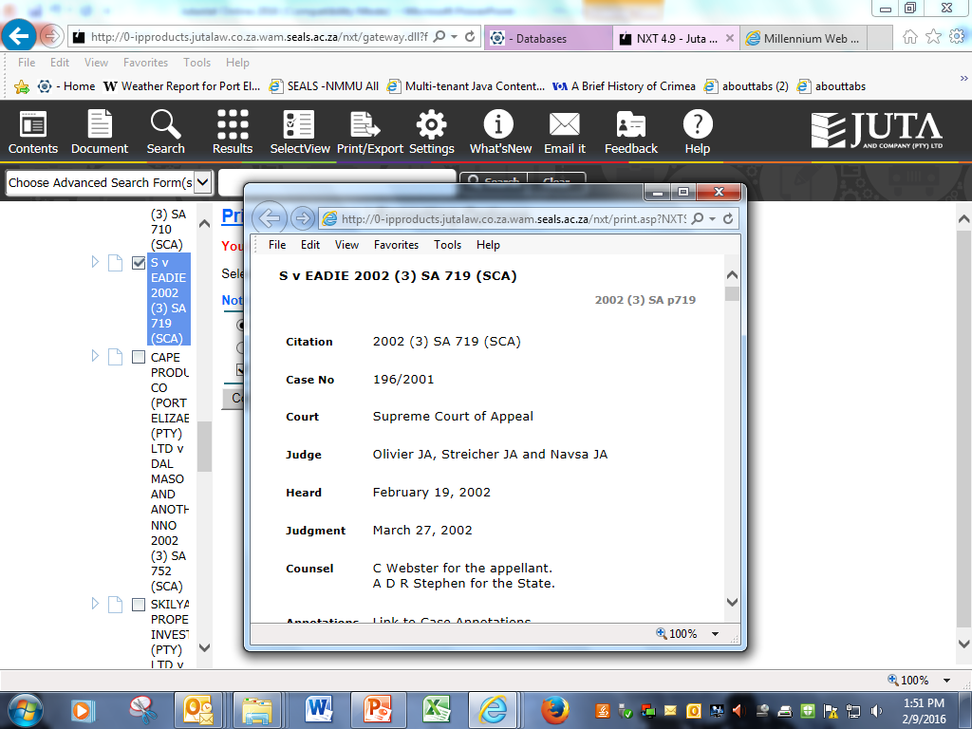
File and save your case

Slide 26
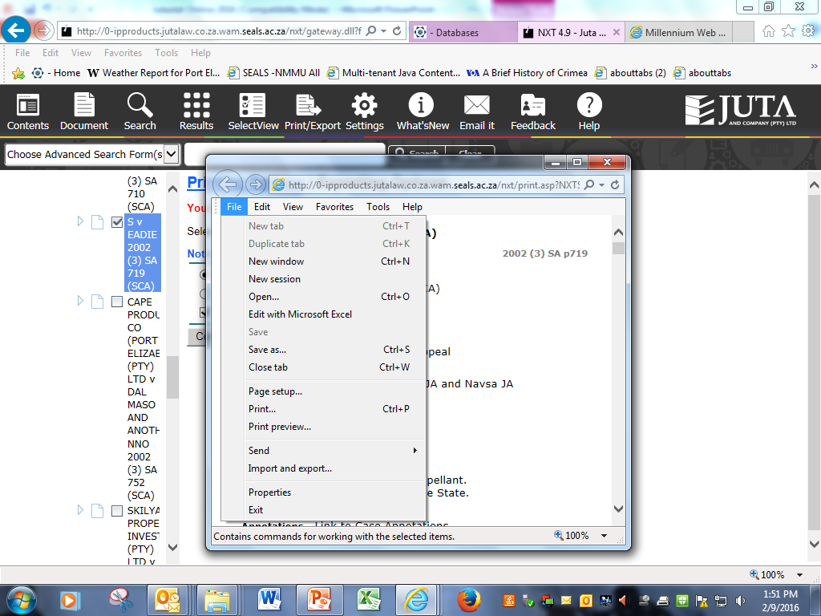
And the Results tab will take you back to your results list
Then don’t forget to untick your case

Slide 27
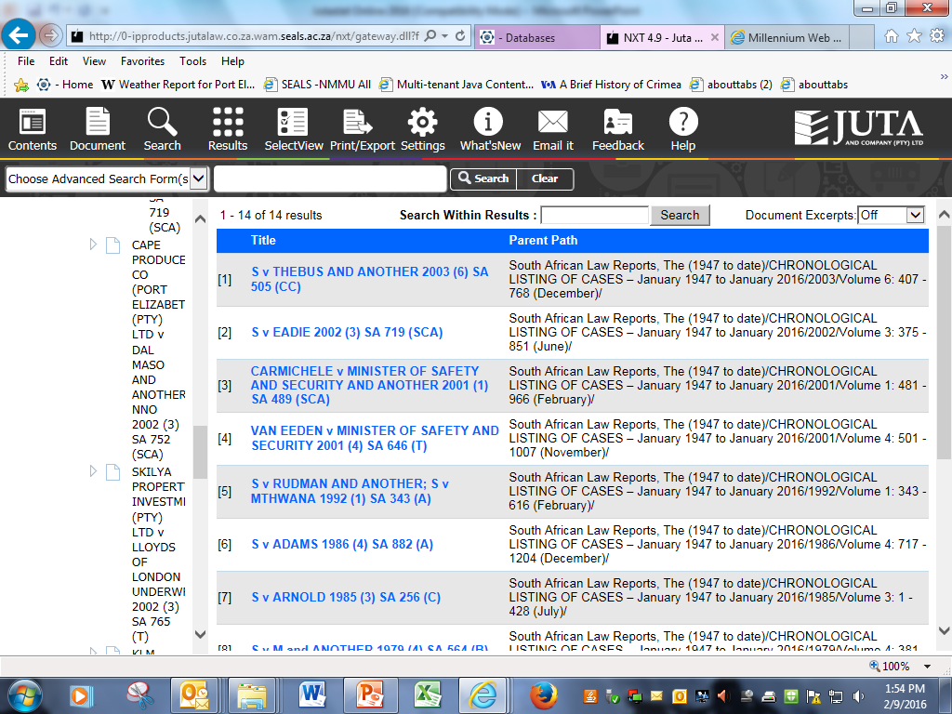

Slide 28
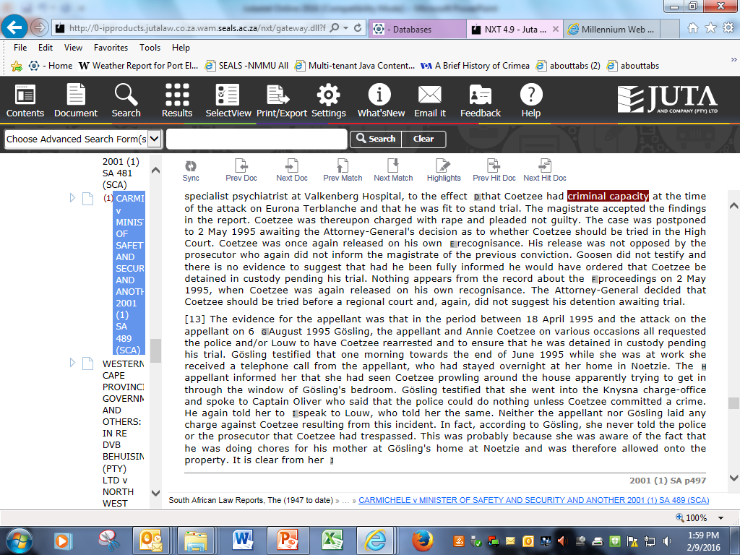
If there are no selection boxes open in the index click first on ‘sync contents’

Slide 29
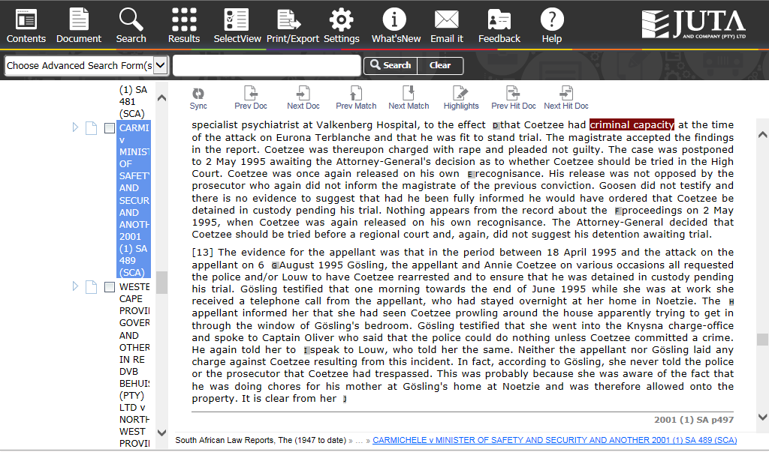
Click on Print/Export
Selection boxes will then appear

Slide 30
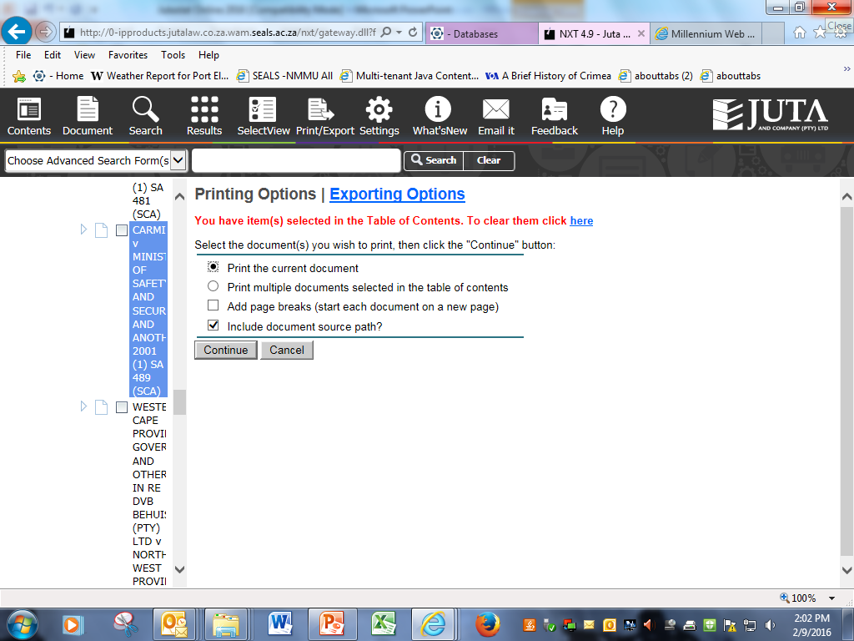
If this message is there before you have selected your item it means something else is still selected. Unselect previous items by clicking on here, and then select anew

Slide 31
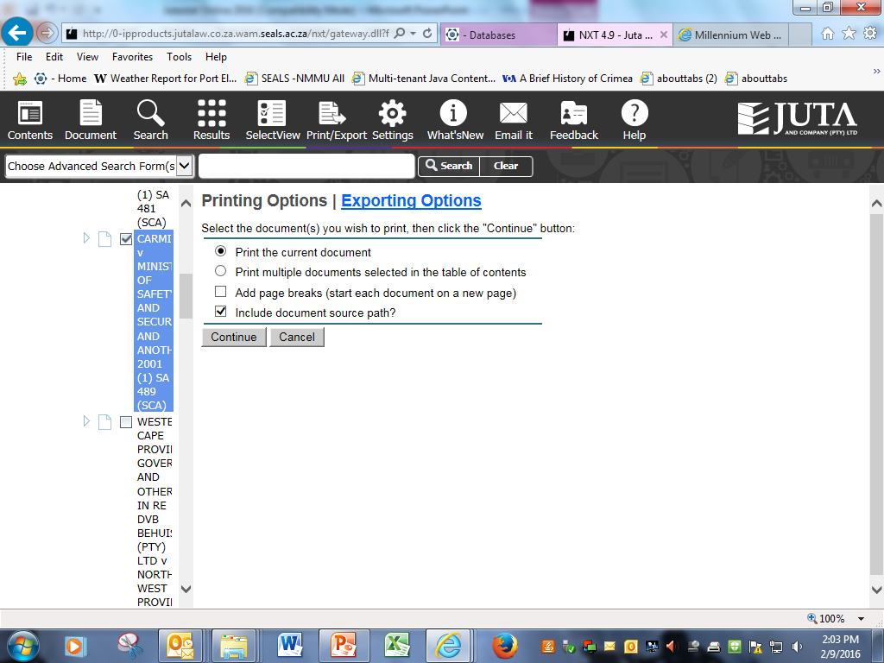

Slide 32
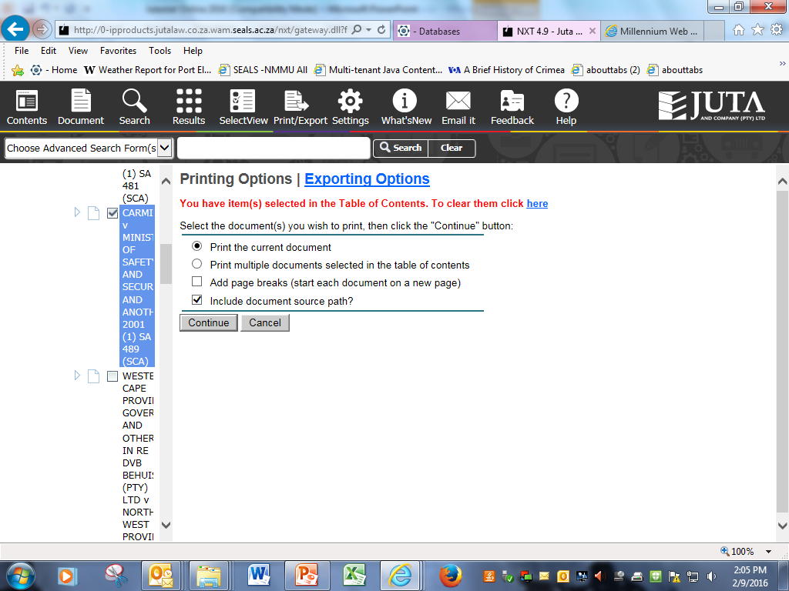
Continue and File and Save/Print your case

Slide 33
DOWNLOADING from JUTASTAT ONLINE
Sync Contents
Print/Export
(select item) and Export Options
Continue
File and Save/Print

Slide 34
E-mailing cases
The e-mail envelope does work, but you are e-mailing the link to the relevant case, not the actual case.
As our access to Jutastat databases is ‘On-campus only’ this link will not work off campus.

Slide 35
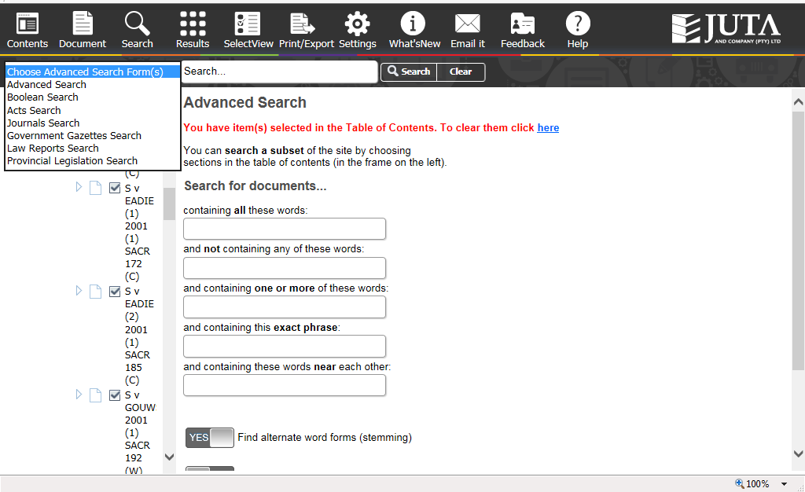
Advanced Search is the default mode, if that is the mode you used last, but there are other options

Slide 36
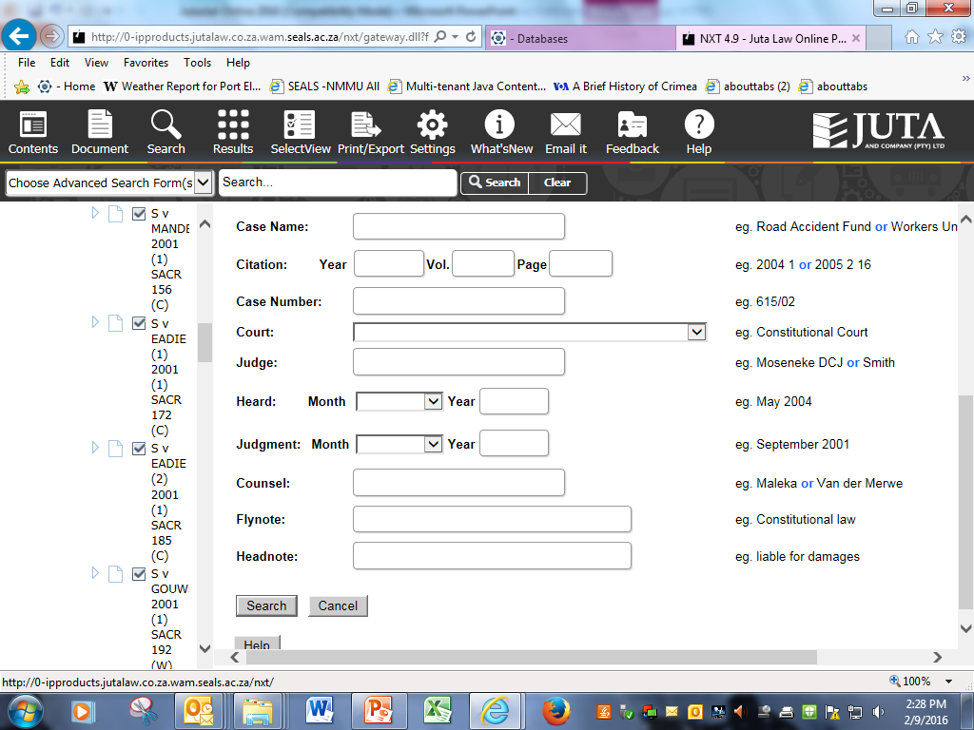

Slide 37
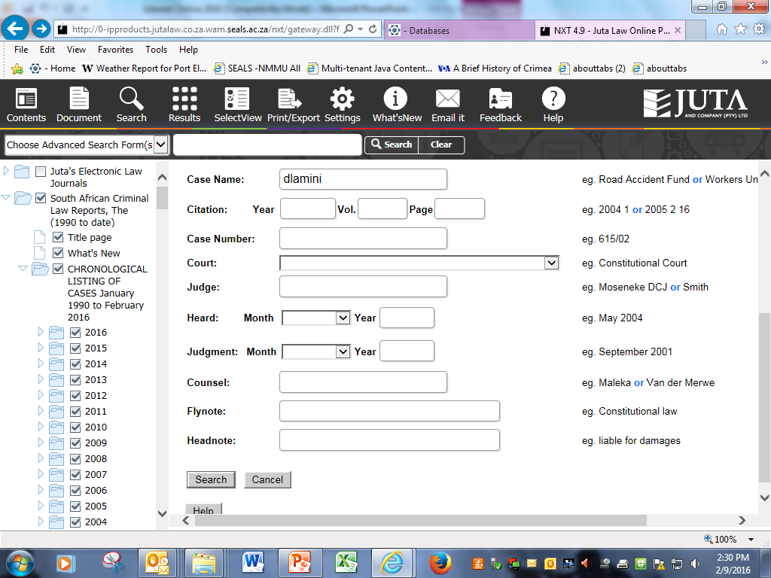

Slide 38
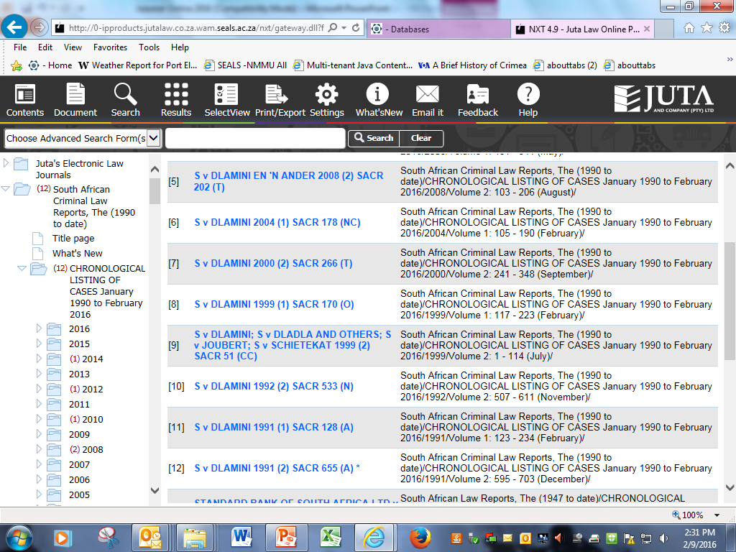

Slide 39
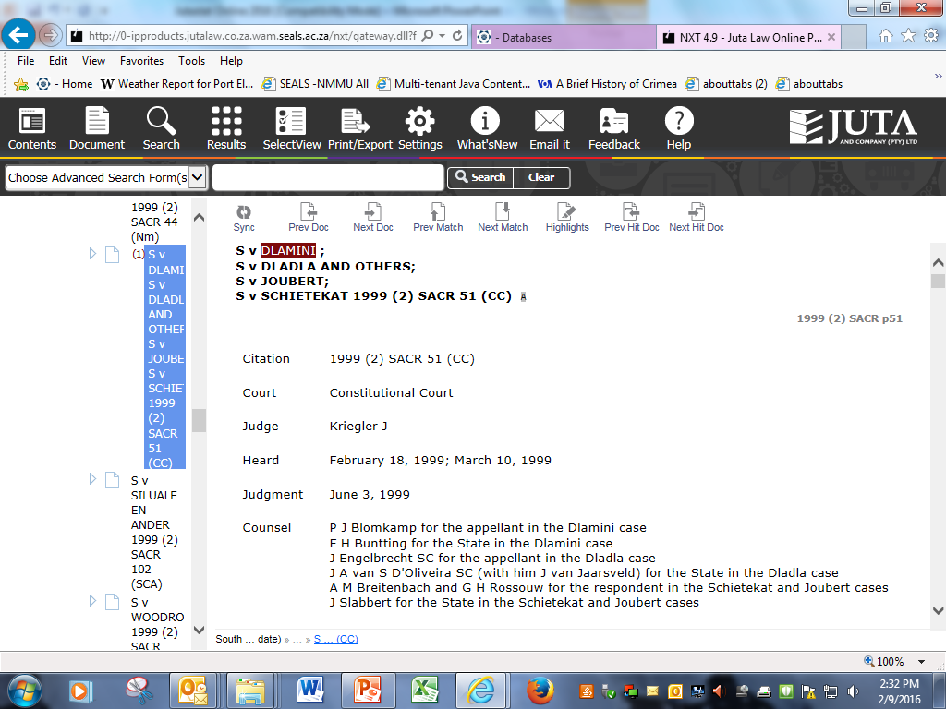

Slide 40
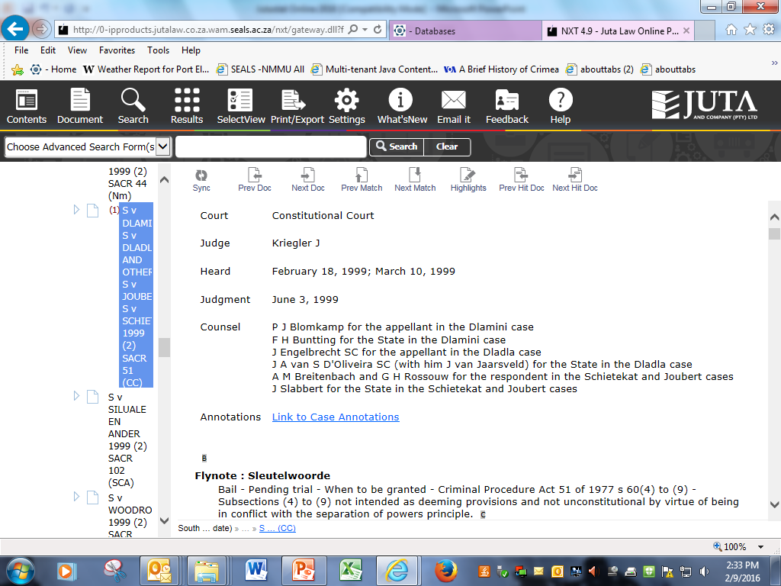

Slide 41
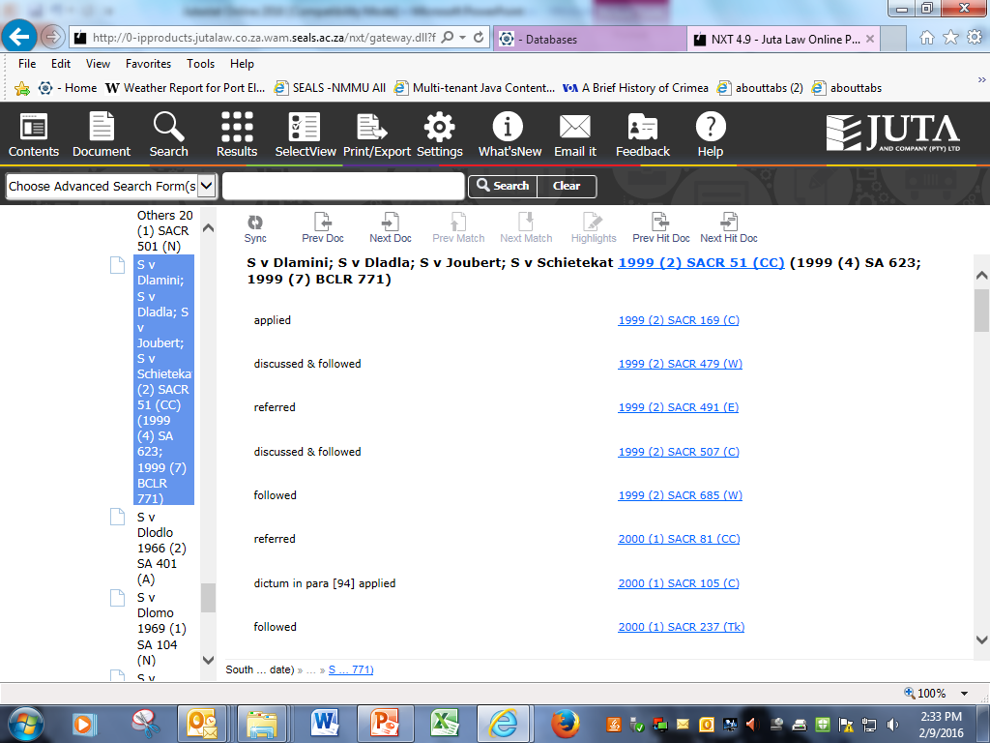
This case was clearly an important one because there are dozens of citations
Scrolling down ……

Slide 42
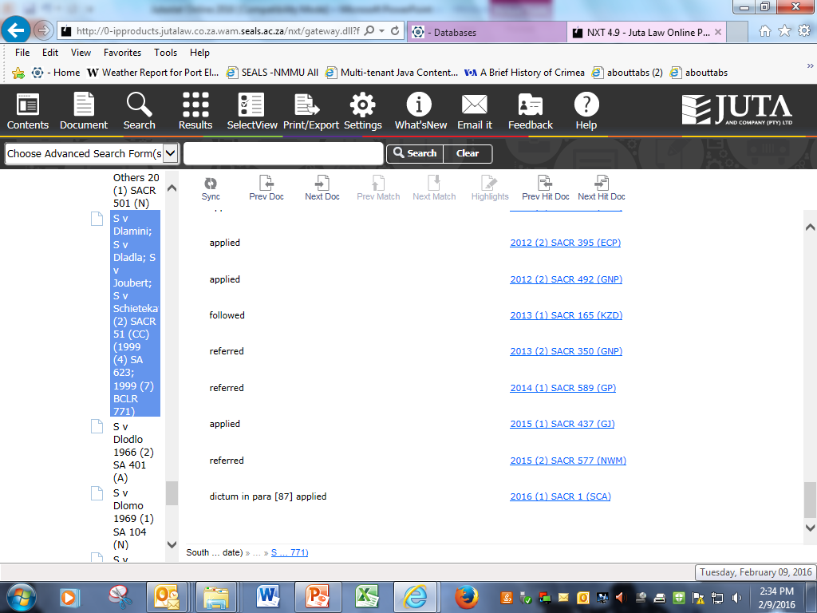

Slide 43
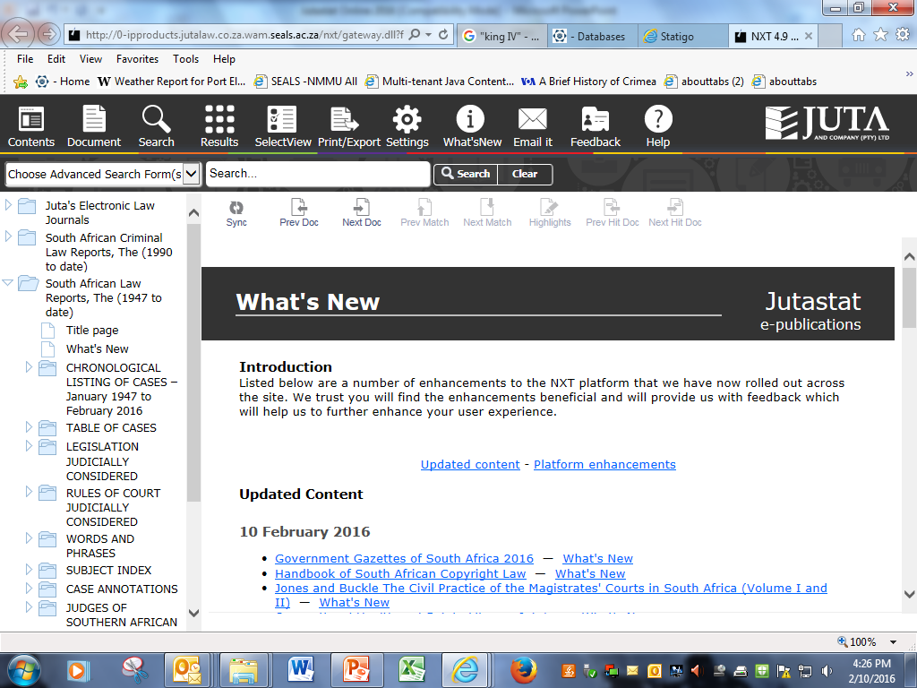
Access to a lot of useful materials and functionality via the index

Slide 44
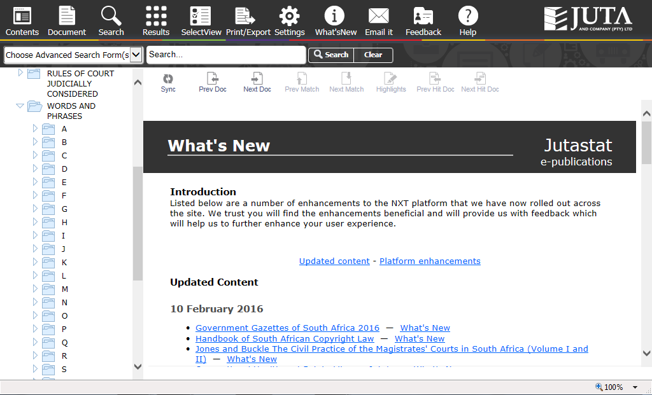

Slide 45
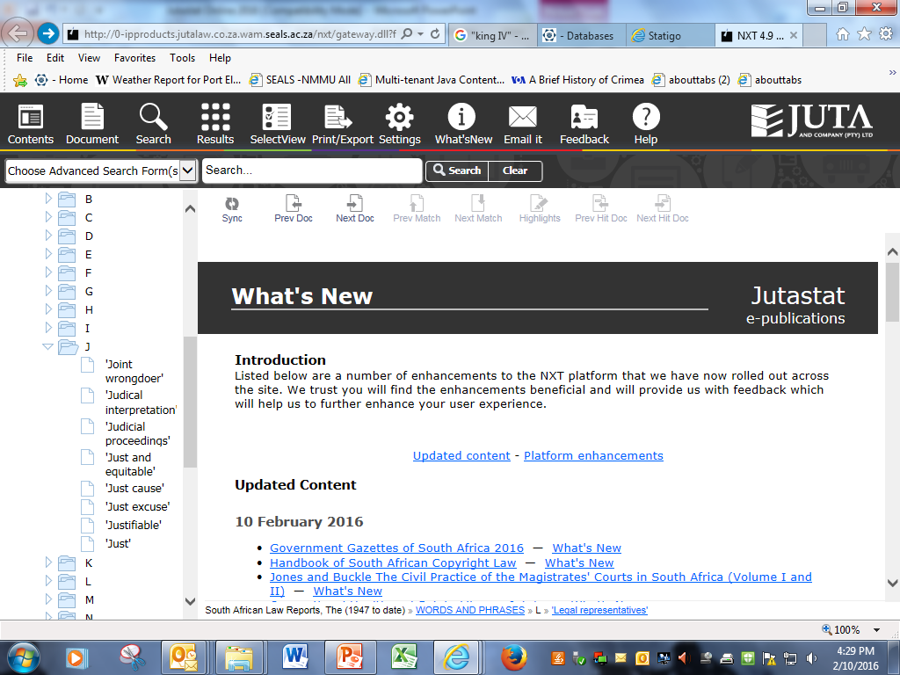

Slide 46
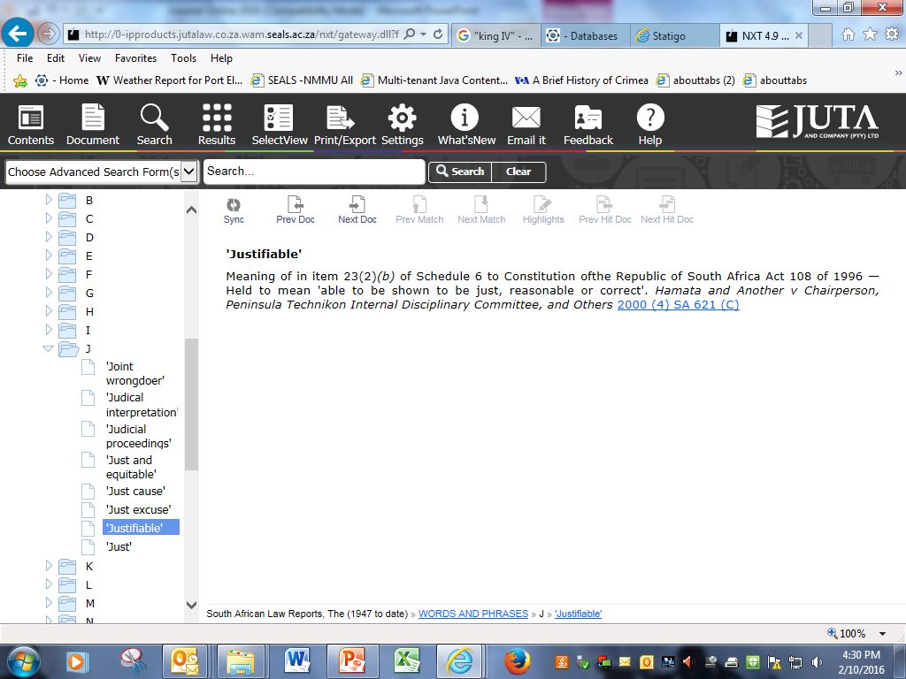
Link to the full case in which the concept was defined

Slide 47
Most recent acquisition via Jutastat
Commentary
on the
Consumer Protection Act

Slide 48
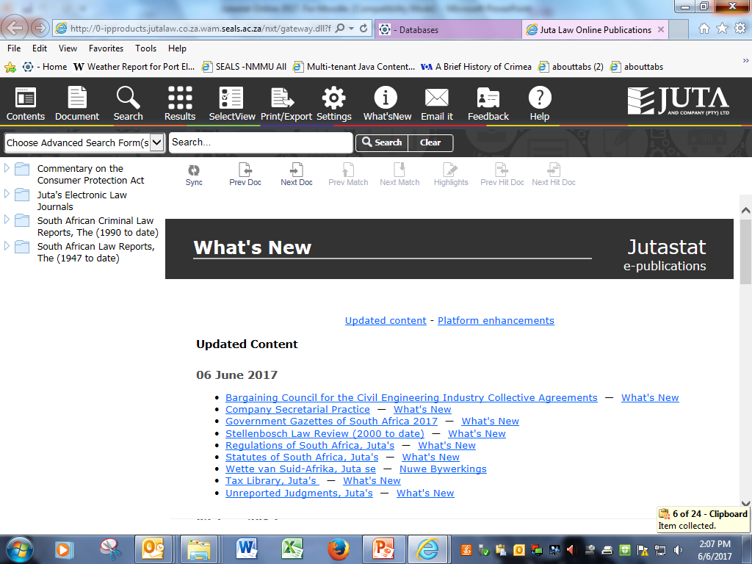

Slide 49
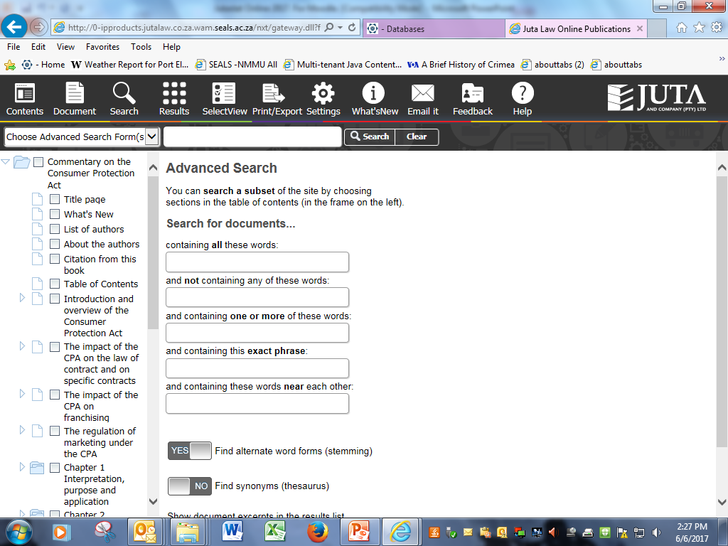

Slide 50
THANK YOU

