Slide 1
Library starter
kit
Compiled by Thenji Nyaningwe

Slide 2
Contents of Starter Kit
Library Training sessions
Library membership: borrowing, registration
Facilities: Wi-Fi, photocopiers, computers
Online presence: Social media, webpage
Information resources: Classic Catalogue,
Online databases:Sabinet Legal, LexisNexis Butterworth, Jutastat- Juta’s Electronic Law journals and other international databases

Slide 3
Why is it important to attend the library training sessions?

Slide 4
Library training programme benefits
Classroom scenario:
You need to find information for an assignment
the articles may not be found in Wikipedia
the articles should be of an academic nature
WHERE DO I START??
You will find all your answers at the library training
sessions starting soon!

Slide 5
Taking a leap to “information freedom”
“Education is the key to self-development and empowerment” ― Lailah Gifty Akita
The library training program includes:
How and where to start with your research (topic & keywords)
How to create your own pin
Finding journal articles (Jutastat :Juta’s Electronic law Journal, Sabinet Legal)
Finding books ( Classic Catalogue)
Referencing

Slide 6
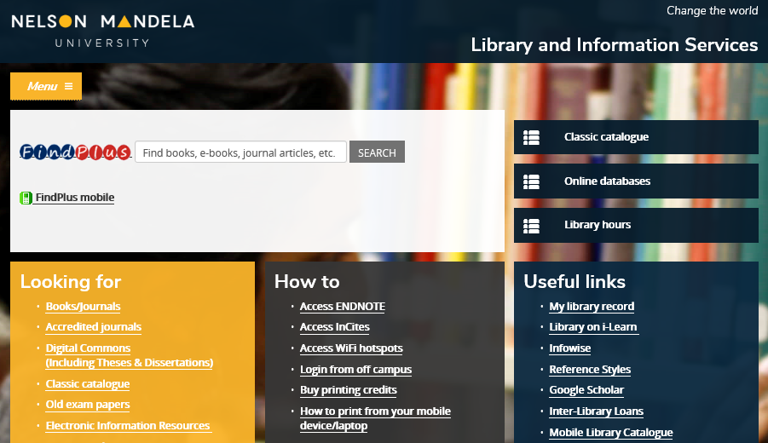
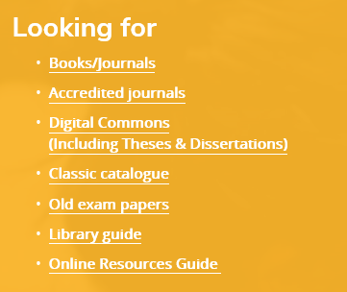
Finding library guides on library webpage
Provides information about services available at all LIS campuses

Slide 7
LIBRARY MEMBERSHIP

Slide 8
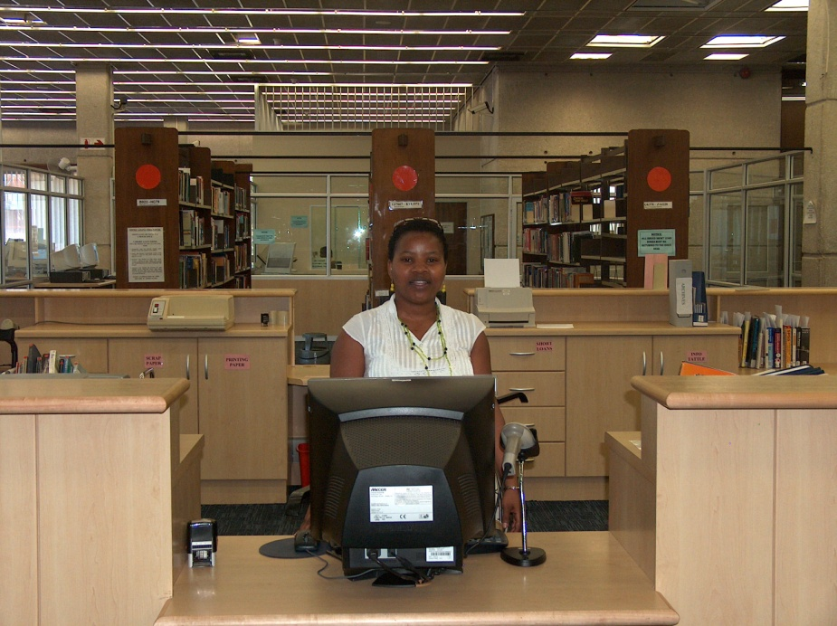
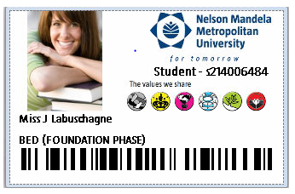
Library Membership requirements
Register as a LIBRARY USER
at the Circulation Desk in the library
Provide 2 different contact numbers
NO CARD
= No Library entrance
= No books on loan
= No computers
= No Services
Please do not let other students use your student card
You are responsible for all items issued on your card

Slide 9
Borrowing from library
Patron type | No. of items | Loan period
1st-3rd year students | 10 | 14 days
Renewing of items
Patrons may renew library material
by phone,
online via the Classic Catalogue or
in person at the Circulation Desk
Library material can be renewed twice unless another patron has booked the item

Slide 10
Overdue book charges
Items | Charges
Books | R1.00 per item per day
Hourly loans (Short Loans) | R2.00 per item per hour
3-day loans (Study Collection) | R3.00 per item per day

Slide 12
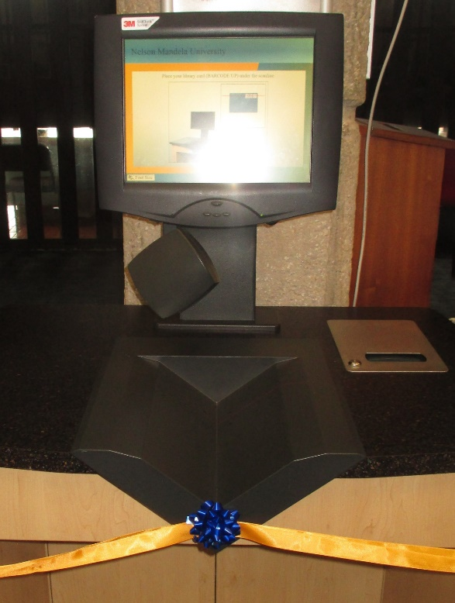
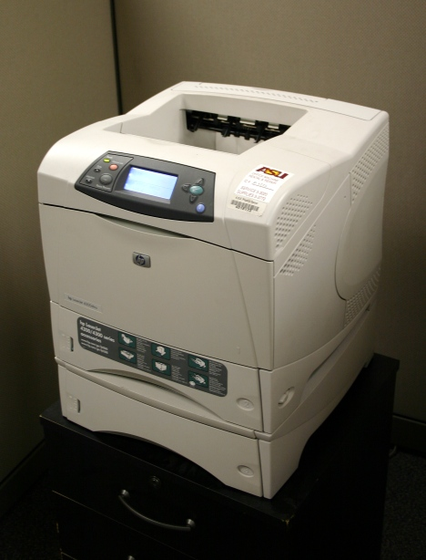
Use Self-check unit to check out books. Available at South Campus library only
Facilities
Copiers/printers on ground floor and first floor. Operate on same system as labs
Special needs
4 dedicated (wheelchair friendly) workstations
Magnifier
Zoom Text software
Special keyboards with large icons, a dedicated scanner and printer
Computer Work Stations issued 1 hour at a time on first floor

Slide 13
PRESENCE

Slide 14
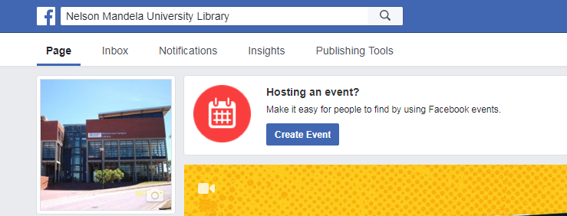
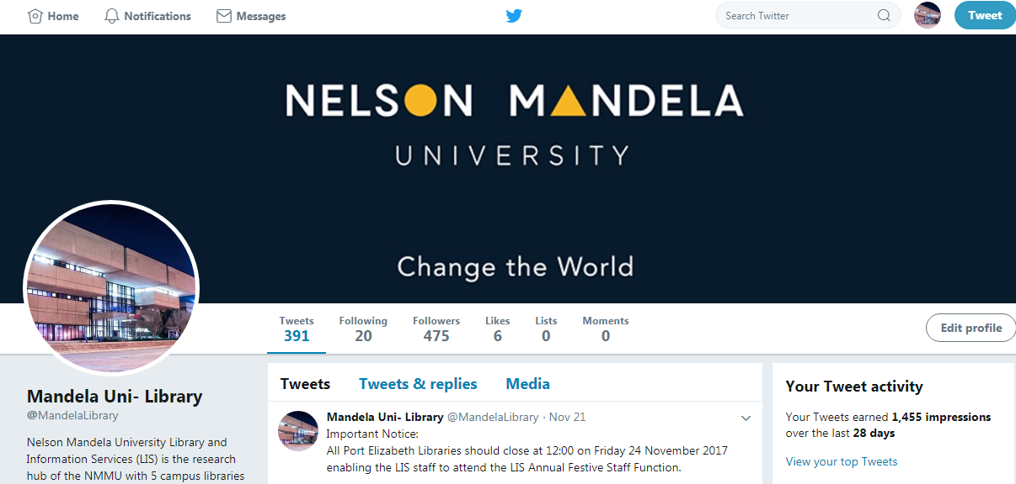
Facebook
https://www.facebook.com/NelsonMandelaUni.Library
Social media
Youtube https://www.youtube.com/channel/UCTtBPgDumiITeQ-pEQTwrAg
Twitter
https://twitter.com/MandelaLibrary

Slide 15
Library webpage

Slide 16
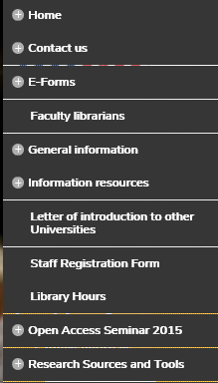
Library webpage:
http://library.mandela.ac.za
Quick links
Click on menu
Additional information like contact details, general information, services etc. are also found in the drop down menu

Slide 17
Library webpage includes
Links to
Information Resources:
Classic Catalogue
Online Databases
Library on i-learn
Google Scholar
FindPlus
Old Exam Papers
Mobile Library Catalogue, etc.
Menu:
Library Hours
Library training sessions
Information Commons
E-forms
Photocopying and Printing
Inter-Branch Loans, etc.

Slide 18
Finding library guides on library webpage
Provides information about services available at all LIS campuses

Slide 19
Classic Catalogue
Online Databases
Location of Information resources

Slide 20
Information resources: starter kit
Search for books, articles and class notes placed on Short Loan/Study Collection and the open shelves in the Classic Catalogue
Find access to online legal databases here
You can search multiple Library resources (books, journal articles) all at once with a “Google-like” search

Slide 21
Online law databases:
Sabinet Legal (netlaw)
LexisNexis Butterworths
Jutastat: Juta’s Online journals
Other Online Law databases

Slide 22
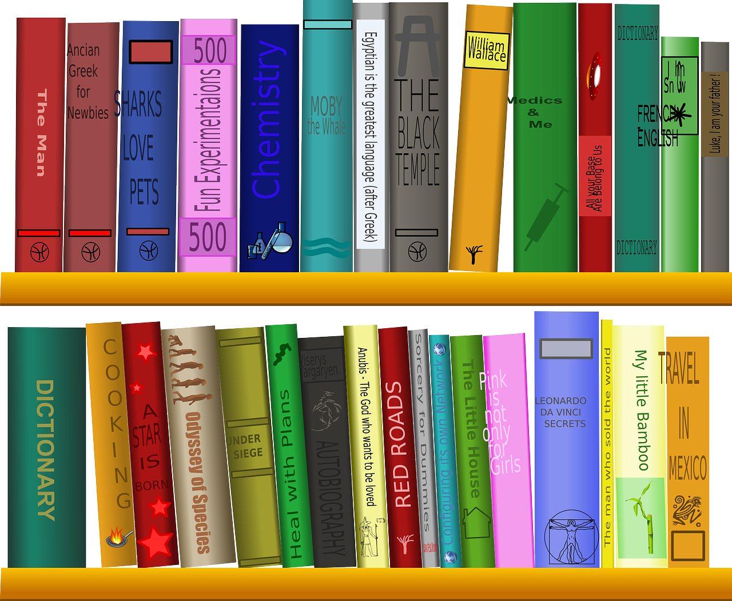
What is a
Short loan/
study collection
Book?

Slide 23
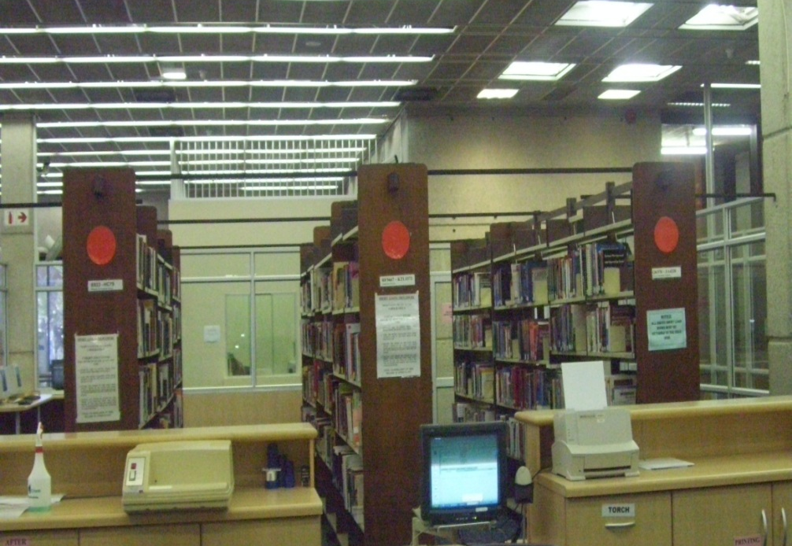
SHORT LOANS collection
Books, articles or class notes placed on short loans by the lecturer
Identified by red dot on spine
You need:
Student card
Shelf no. of the item, located in Classic Catalogue
Items can be used for 1 hour at a time
One renewal in person per item, provided another student has not booked the item
Enclosed section behind the Circulation Desk on the Ground Floor

Slide 24
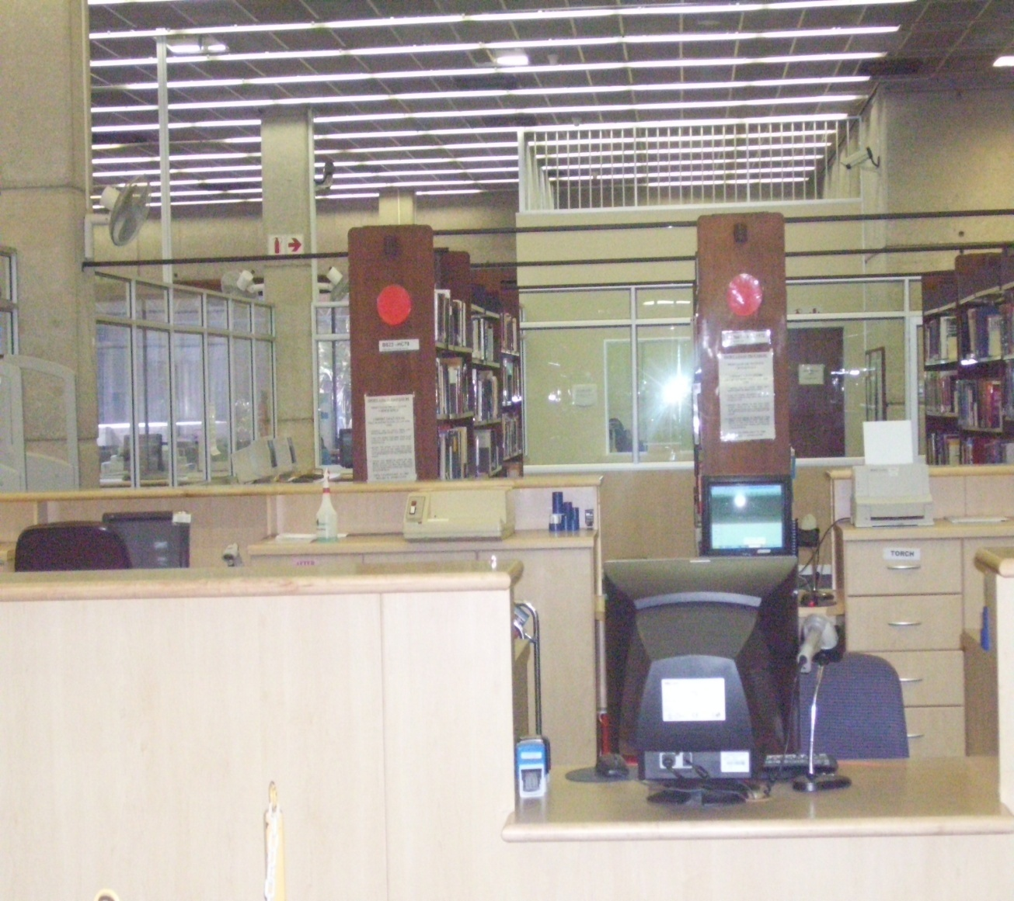
STUDY COLLECTION
Copies of prescribed books
Identified by a yellow dot on spine
May be borrowed for 3 days
No renewals or reservations for this collection
Study collection books are only issued out for 1 hour during exams
Study Collection is also behind the Circulation Desk on the Ground Floor

Slide 25
Locating Short loan/
Study collection books

Slide 26
Library webpage:
http://library.mandela.ac.za

Slide 27
Accessing Short Loans/ study collection material
You can either search by course code or by lecturer’s name

Slide 28
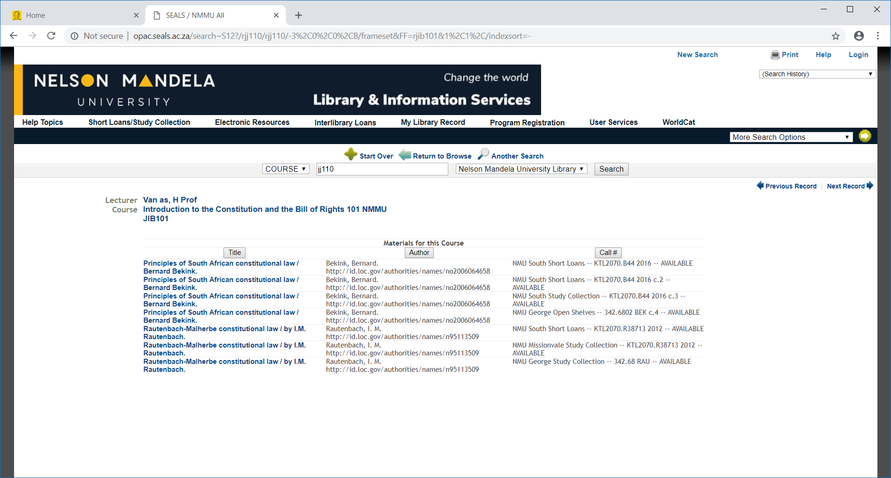
Example-Short Loan items

Slide 29
Locating a book on the shelf with the call number...

Slide 30
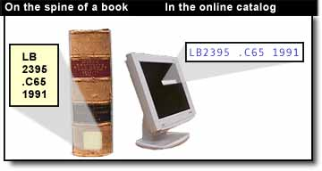
Library of Congress Classification System
LB2395.C65 1991B
Attend follow-up training sessions in the library to get a more detailed explanation of how to find a book on the shelf

Slide 31
PLEASE Remember!
Register at the Library 24 hours after receipt of your student
card
Attend free Library training sessions to help you with your
assignments
Make use of the following information resources on Library Page:
(Classic Catalogue, Sabinet Legal (netlaw), LexisNexis Butterworths, Jutastat: Juta’s Online journals, FindPlus, Library on i-learn and Faculty of Law Website
Short Loan or study collection books can be located in the
Classic Catalogue
Library guides are available online on the library webpage

