Slide 1
Sabinet Online (Pty) Ltd enables users to obtain
relevant information according to their specific
information needs from South African databases.

Slide 2
Sabinet’s New Platform Search Techniques
Exact phrase: “ “ e.g. “marine living resources” “fishing industry”
Truncation symbol *
Not case sensitive: “marine living resources act” except for
AND, OR and NOT (in capitals): (abalone OR perlemoen) AND poaching AND illegal

Slide 4
Click Sabinet

Slide 5
Searching for JOURNAL ARTICLES on Sabinet Databases

Slide 7
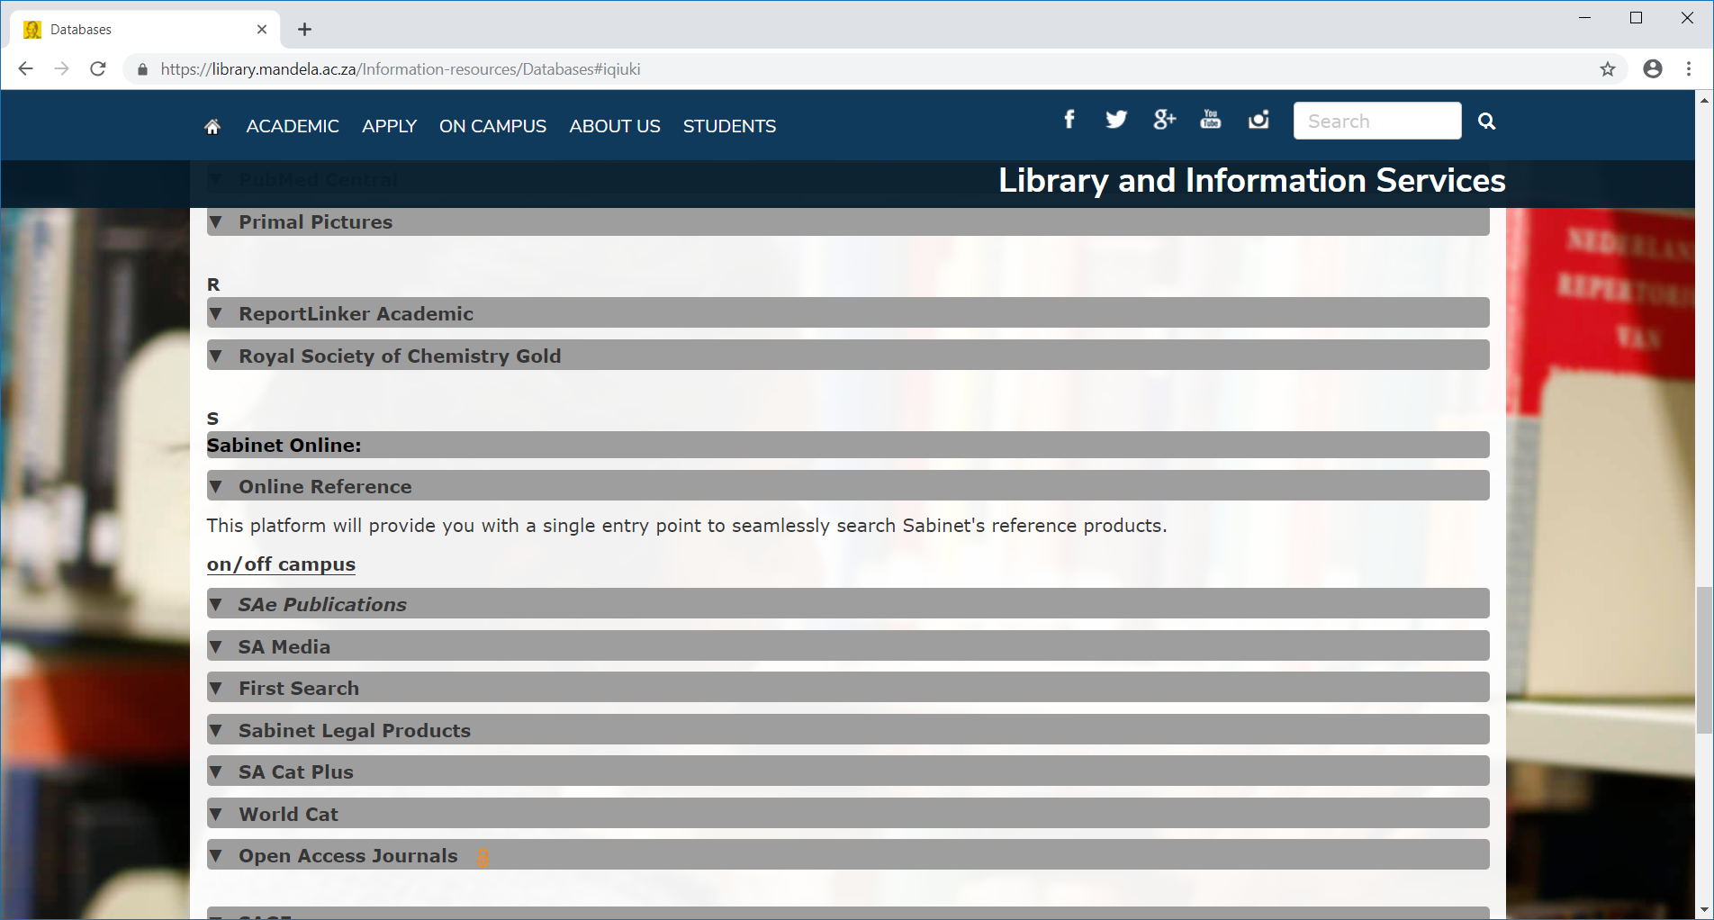
Click SAe Publications

Slide 8
Search using Advanced search

Slide 9
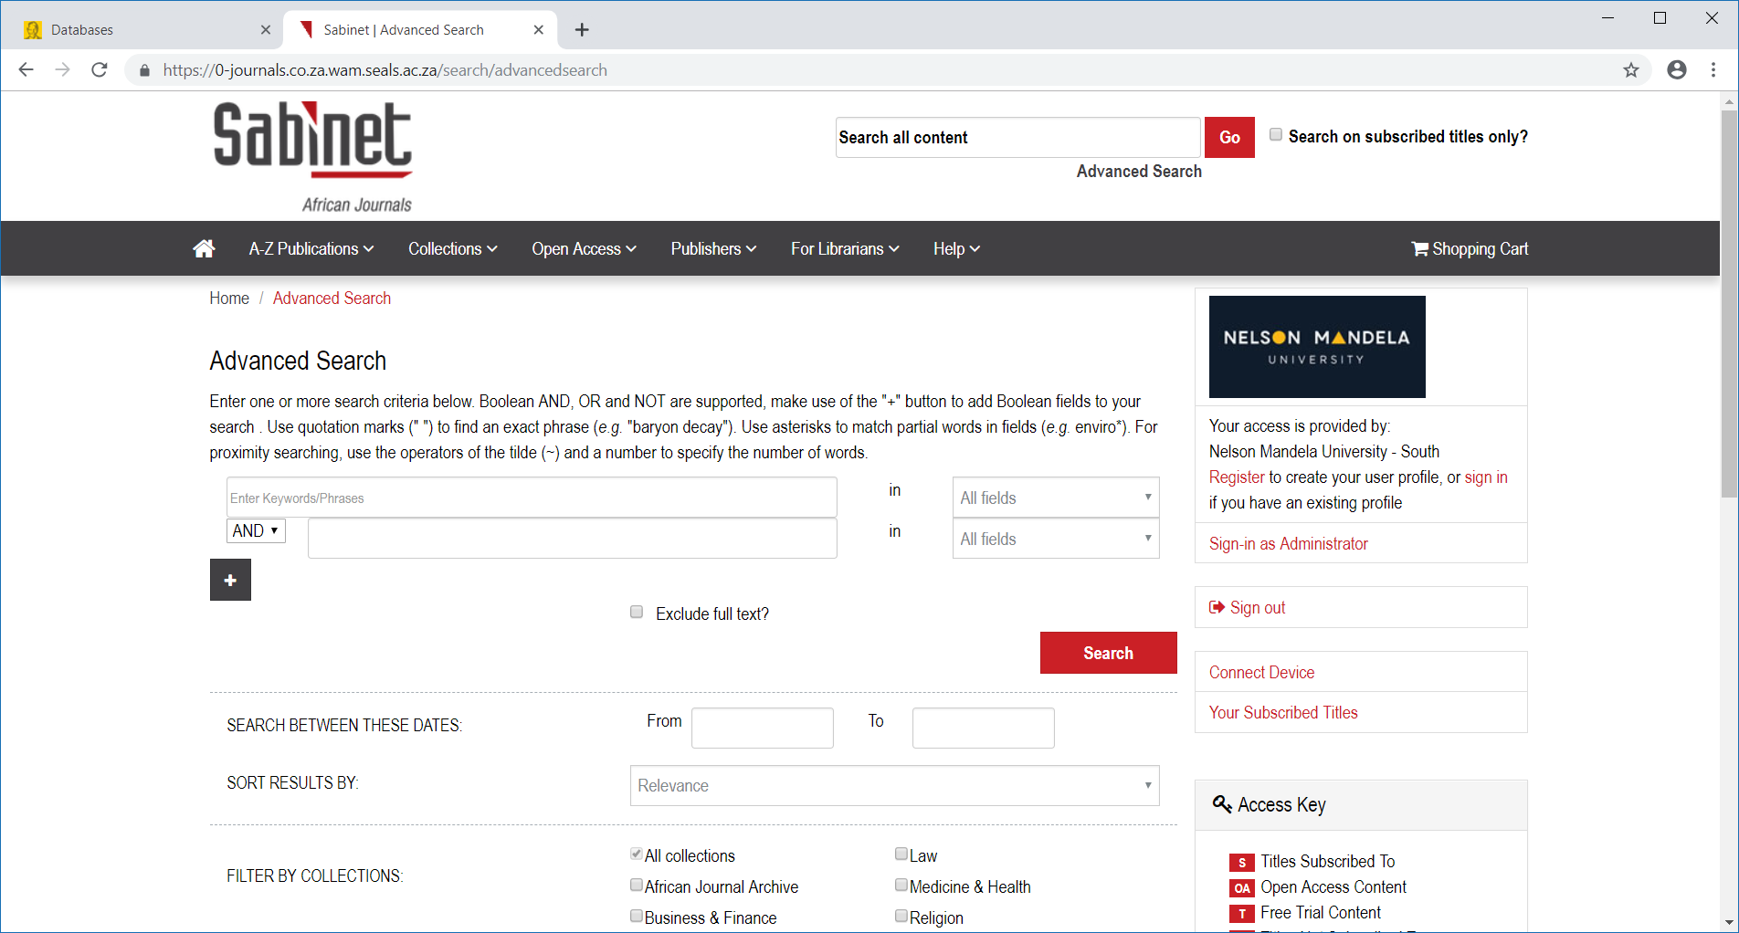

Slide 10
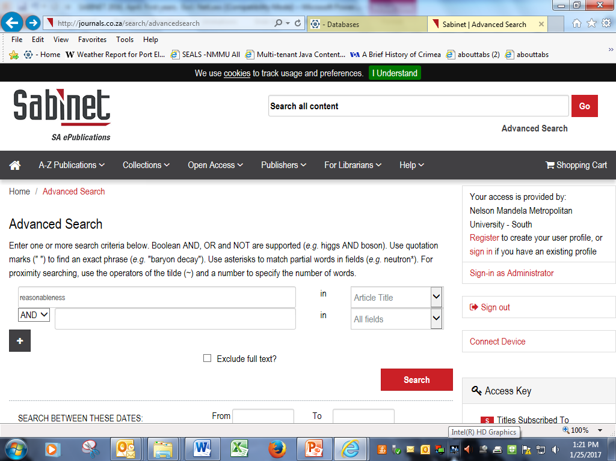

Slide 11
Click search

Slide 12
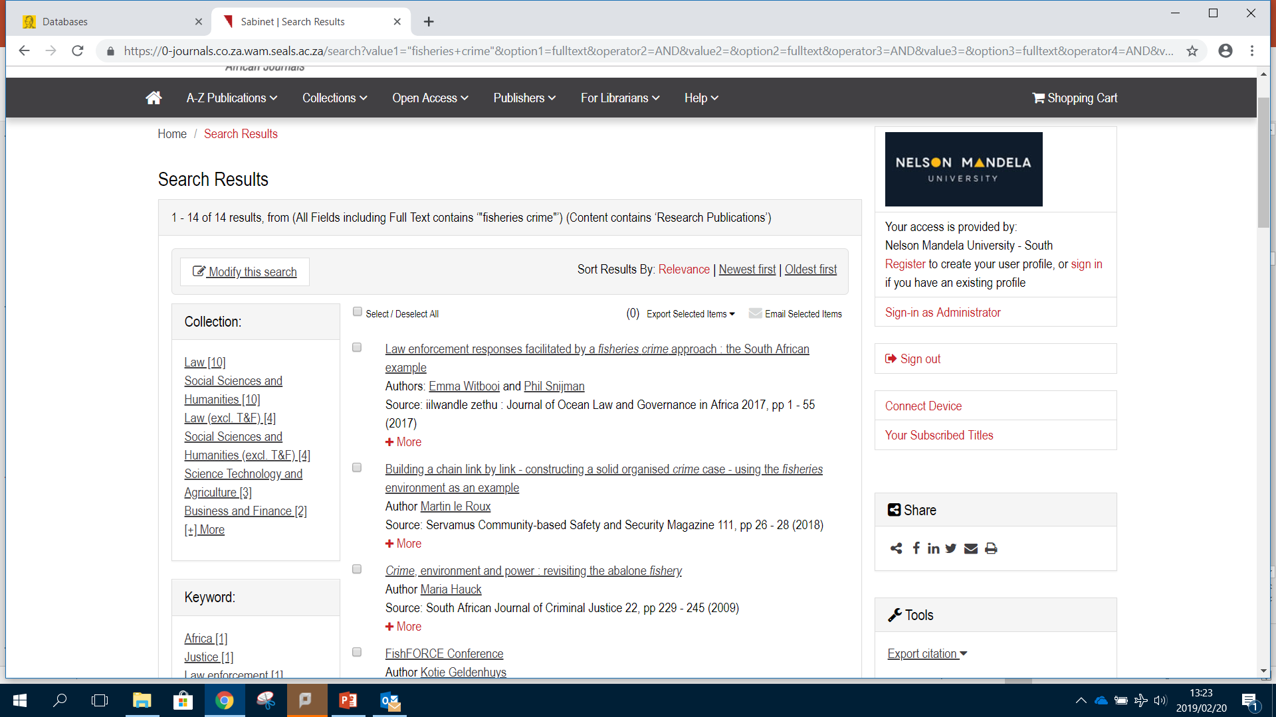
Filter your search by

Slide 13
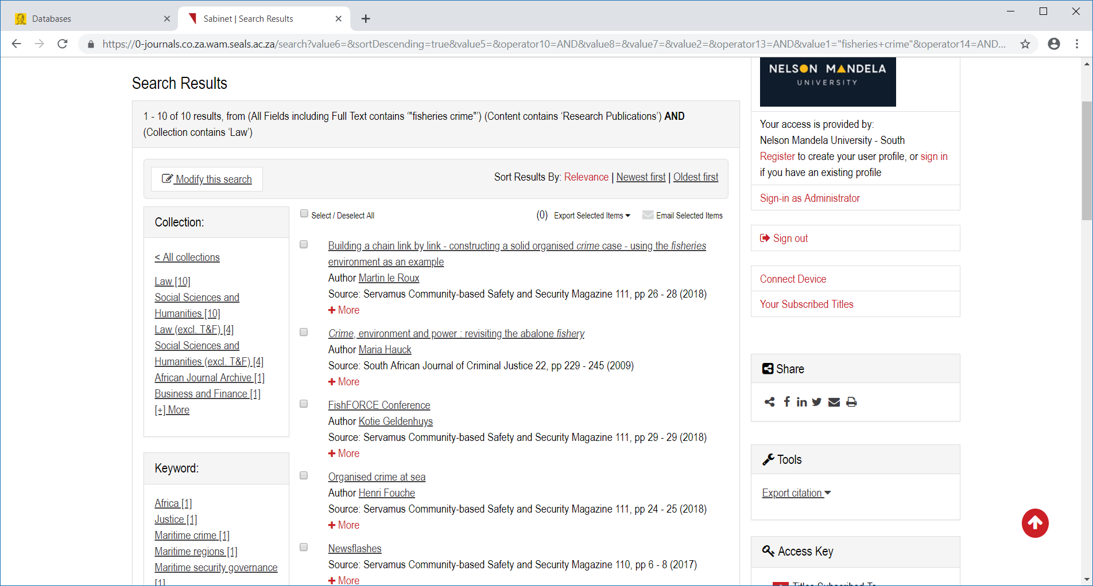
Selected law

Slide 14
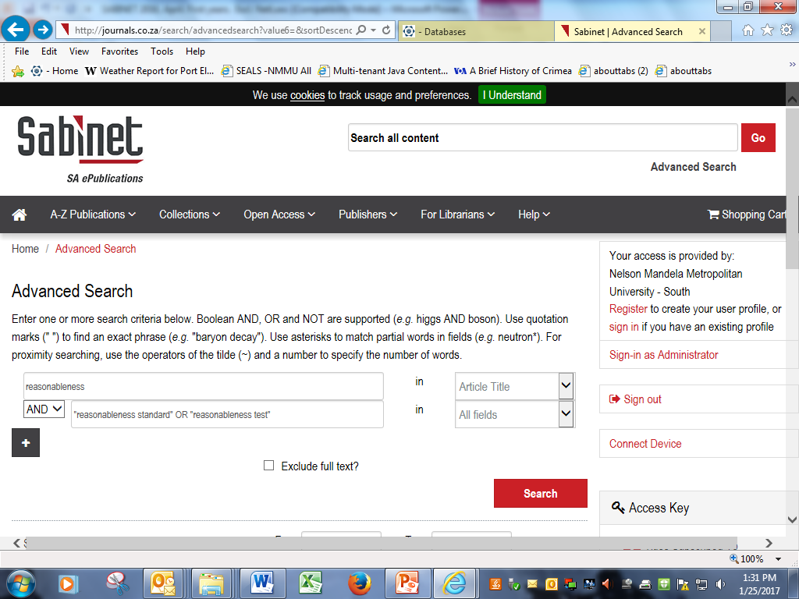
… perhaps by adding additional keywords or phrases:

Slide 15
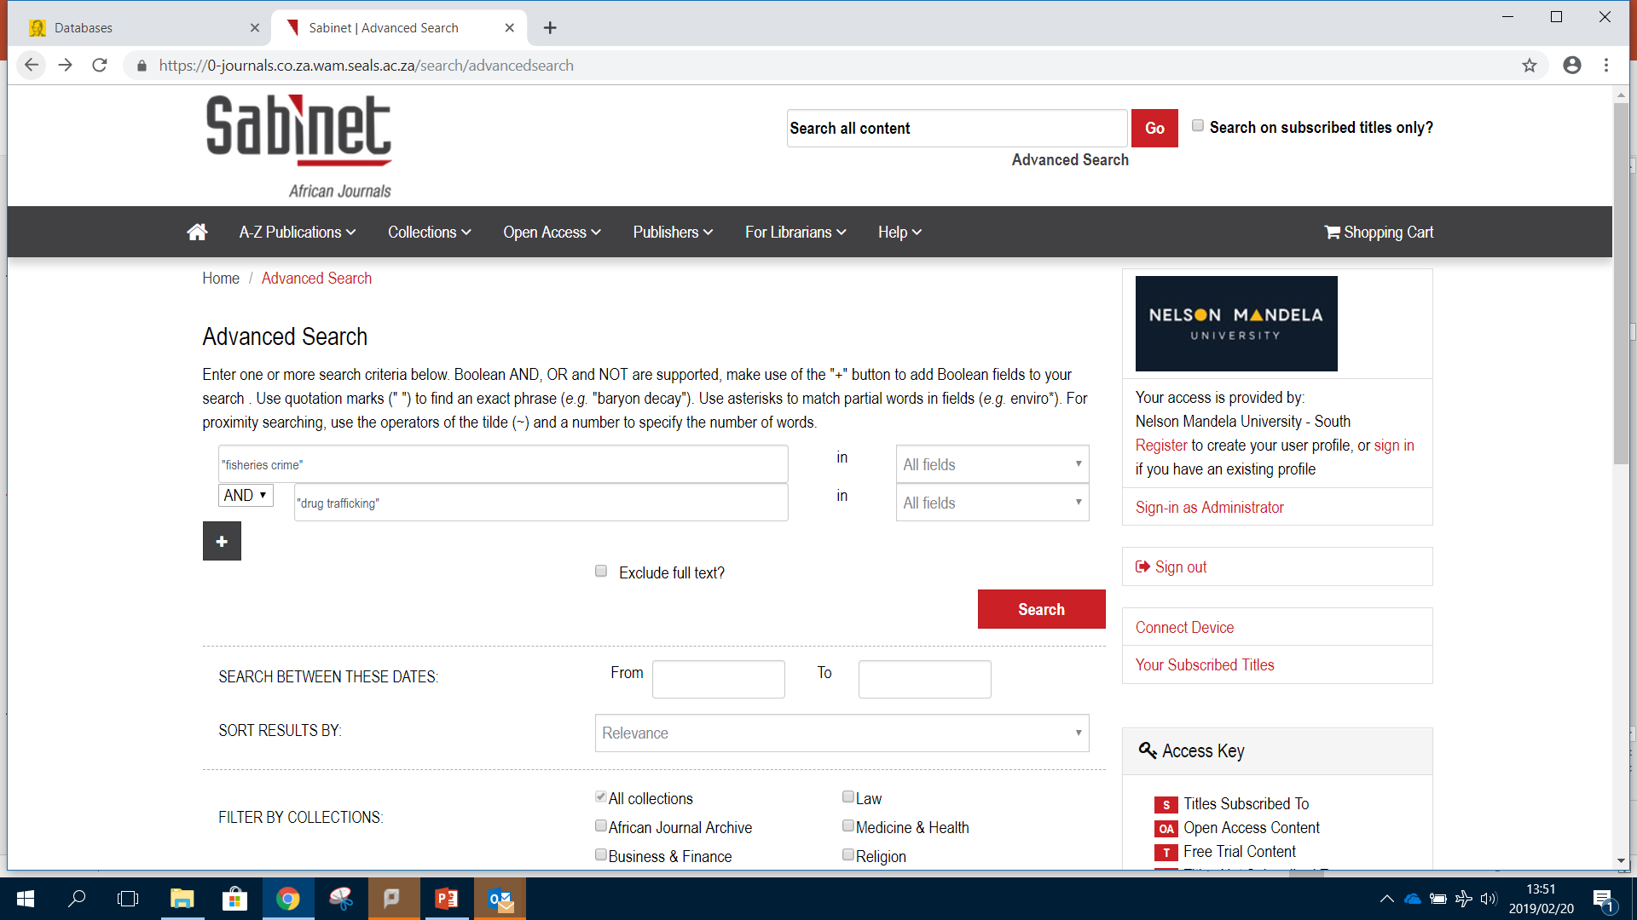

Slide 16
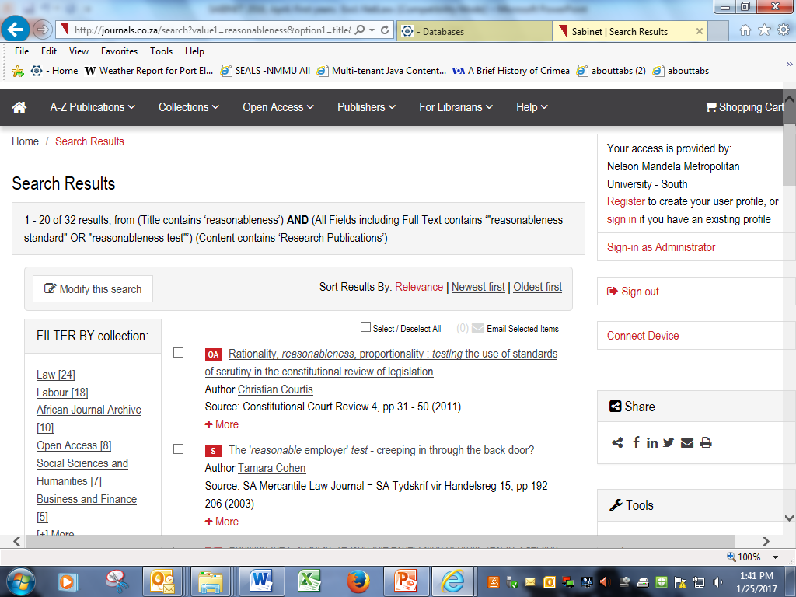

Slide 17
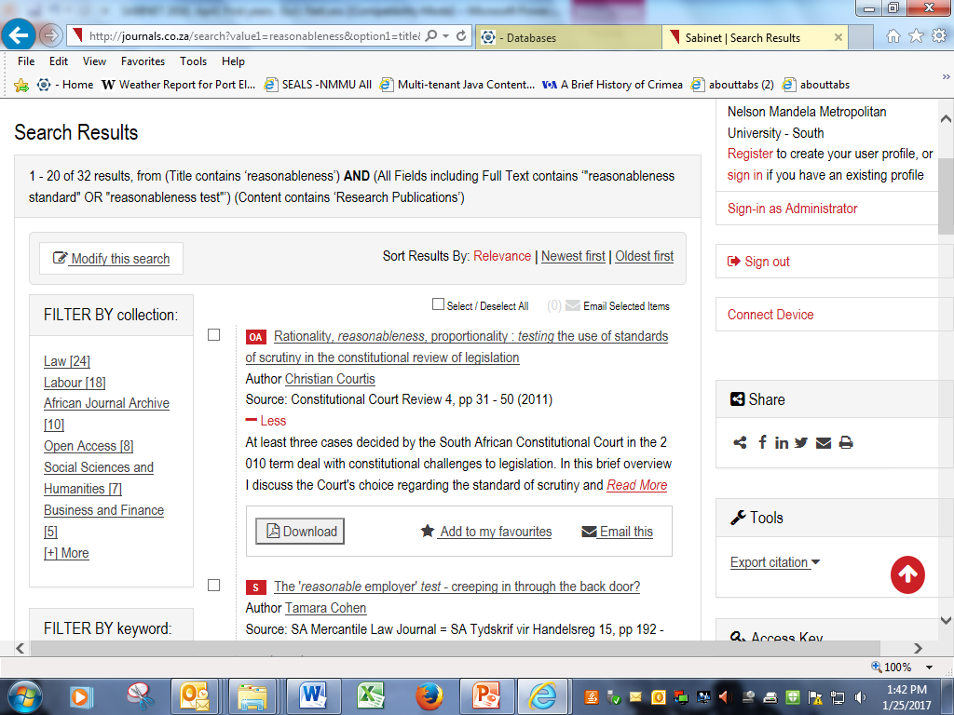

Slide 18
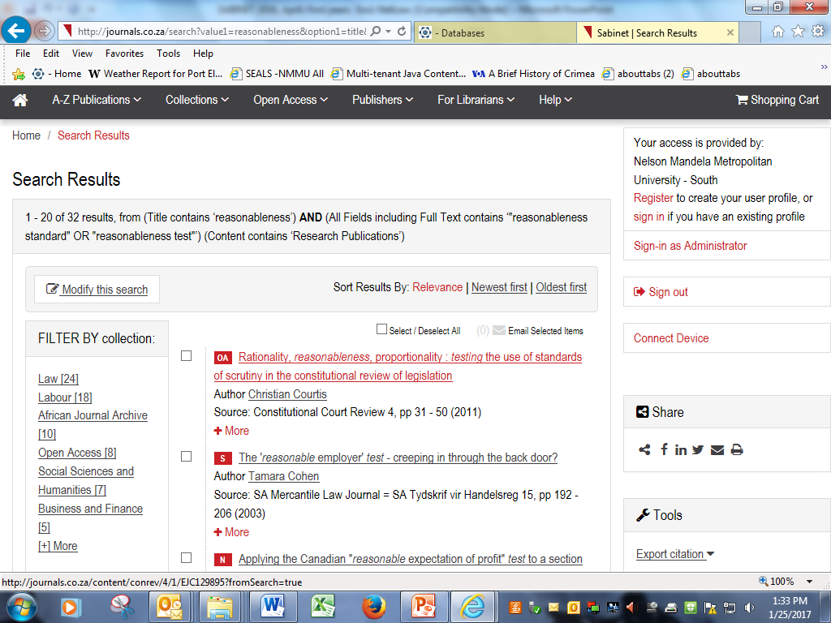
If you click on a title …

Slide 19
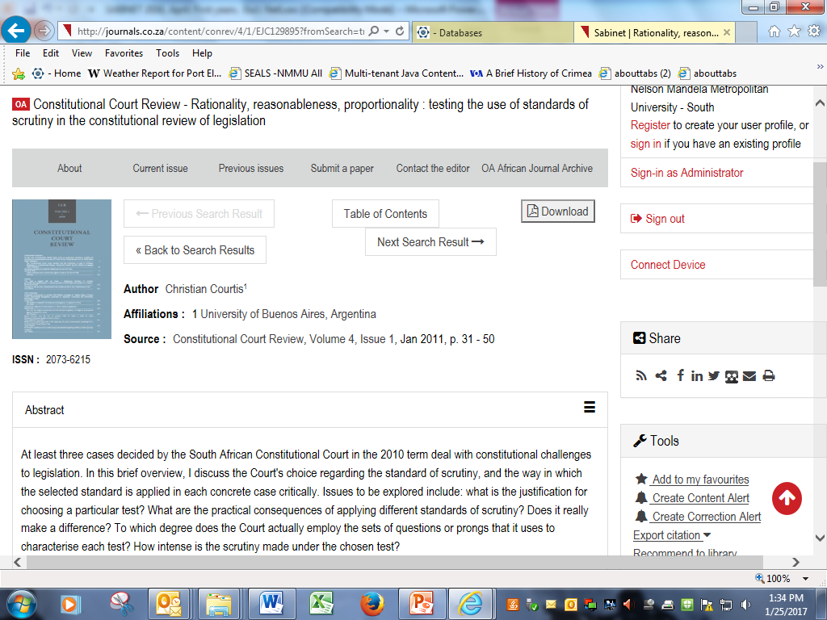
It takes you to a fuller record of the article with a very useful abstract:

Slide 20
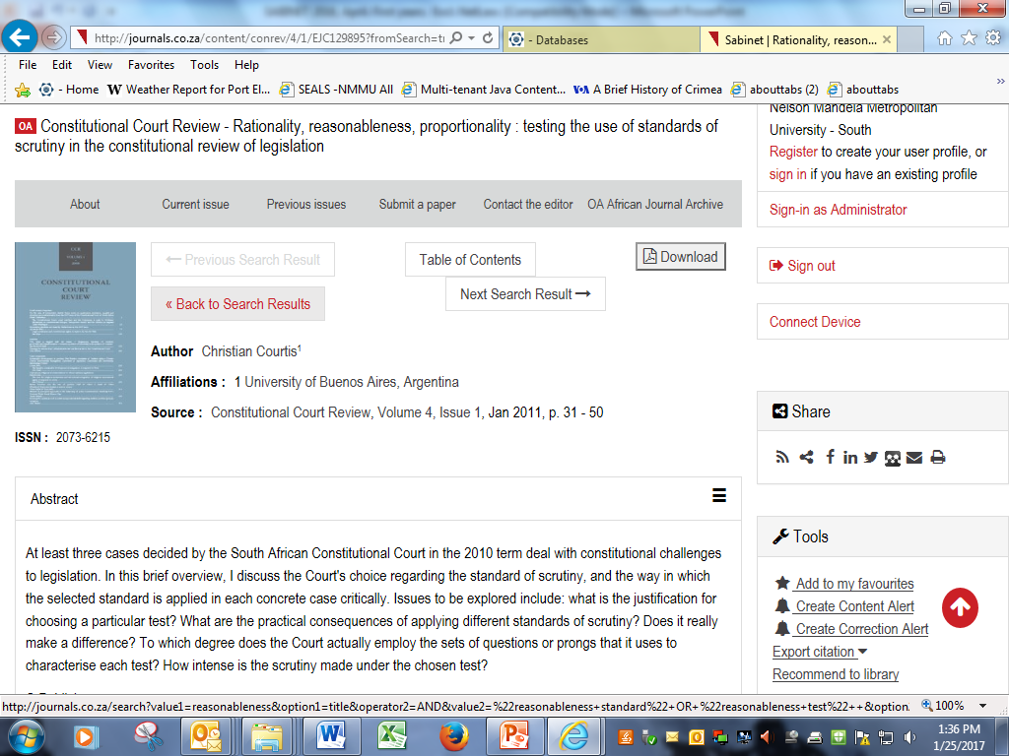

Slide 21
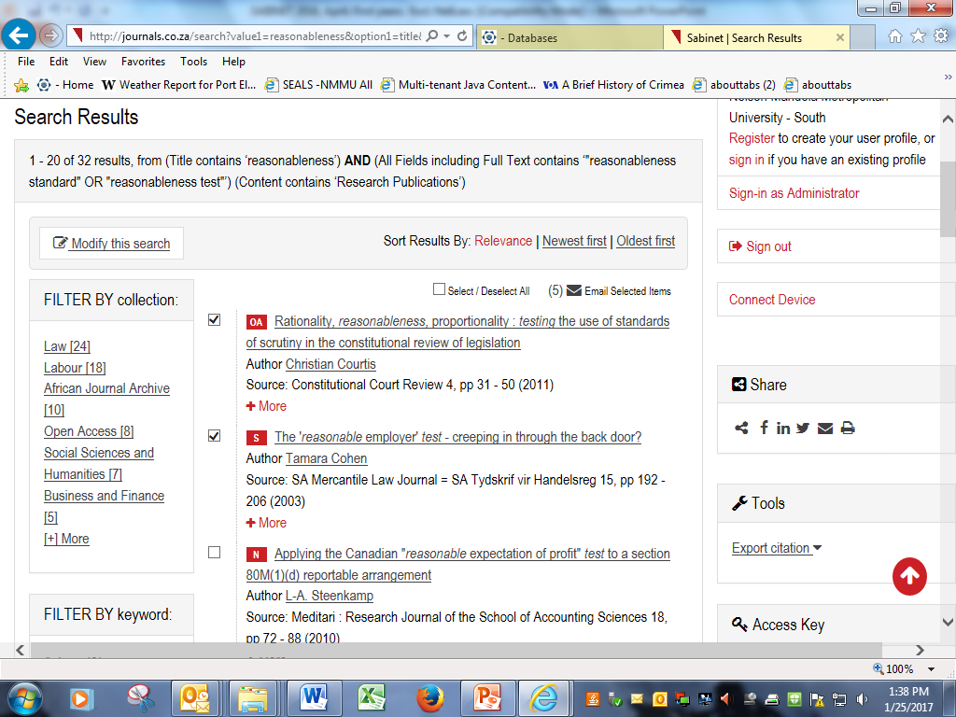
Further Problems:
2. The titles are not numbered. Neither are the articles on the selected list you may send yourself
3. Once you have started selecting if you click on the ‘Back to Search Results’ button to get back to this page your selections will have vanished
4. If you change your search your selections are lost
5. There is no folder to save selections from several searches, so you have to send yourself several mini-lists
6. And there is the perennial problem that results lists sent or forwarded to off- campus addresses contain only links to the full text and these links do not work off- campus

Slide 22
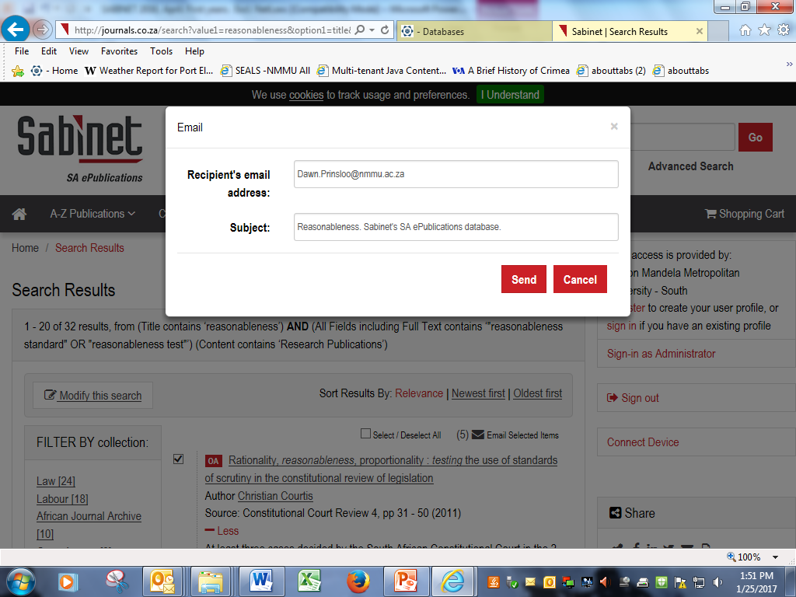

Slide 23
Sabinet Legal
Bill Tracker
Government Gazettes
Parliamentary Documents
Provincial Gazettes
Provincial Legislation
South African Legislation (NetLaw)

Slide 25
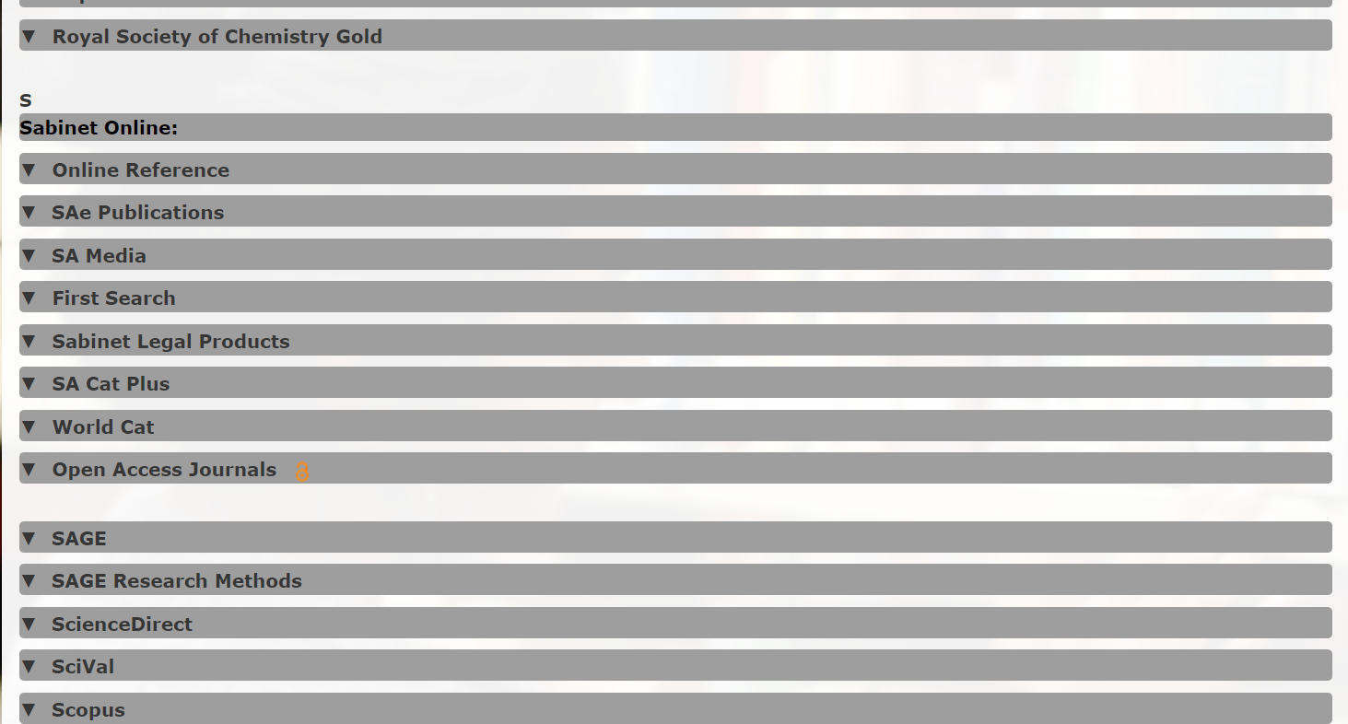

Slide 27
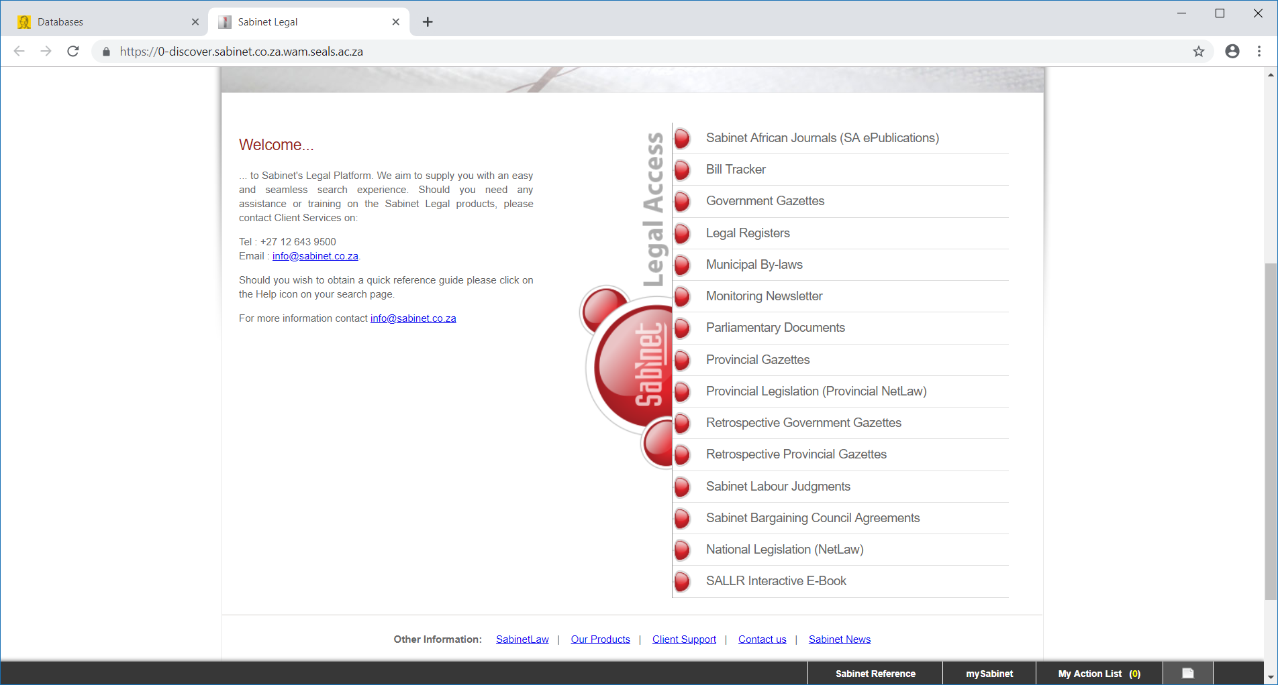

Slide 28
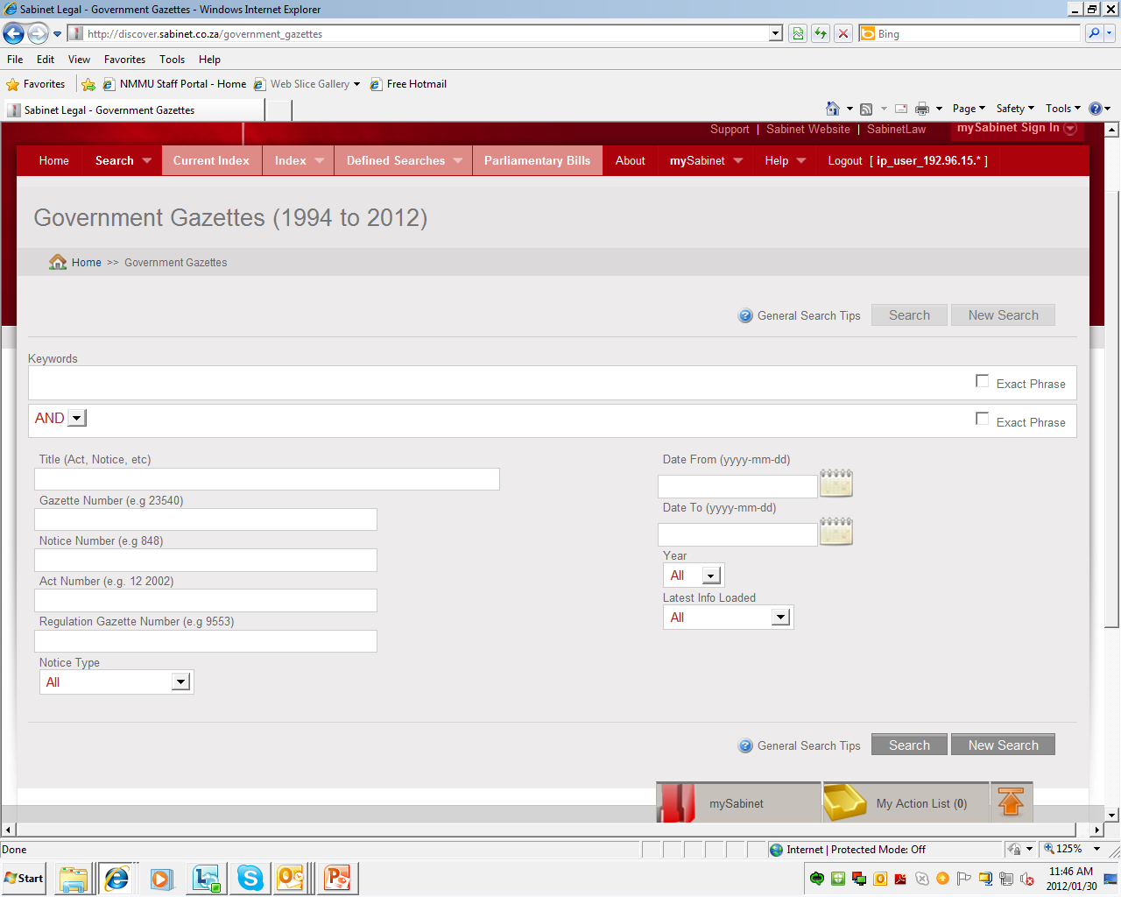

Slide 29
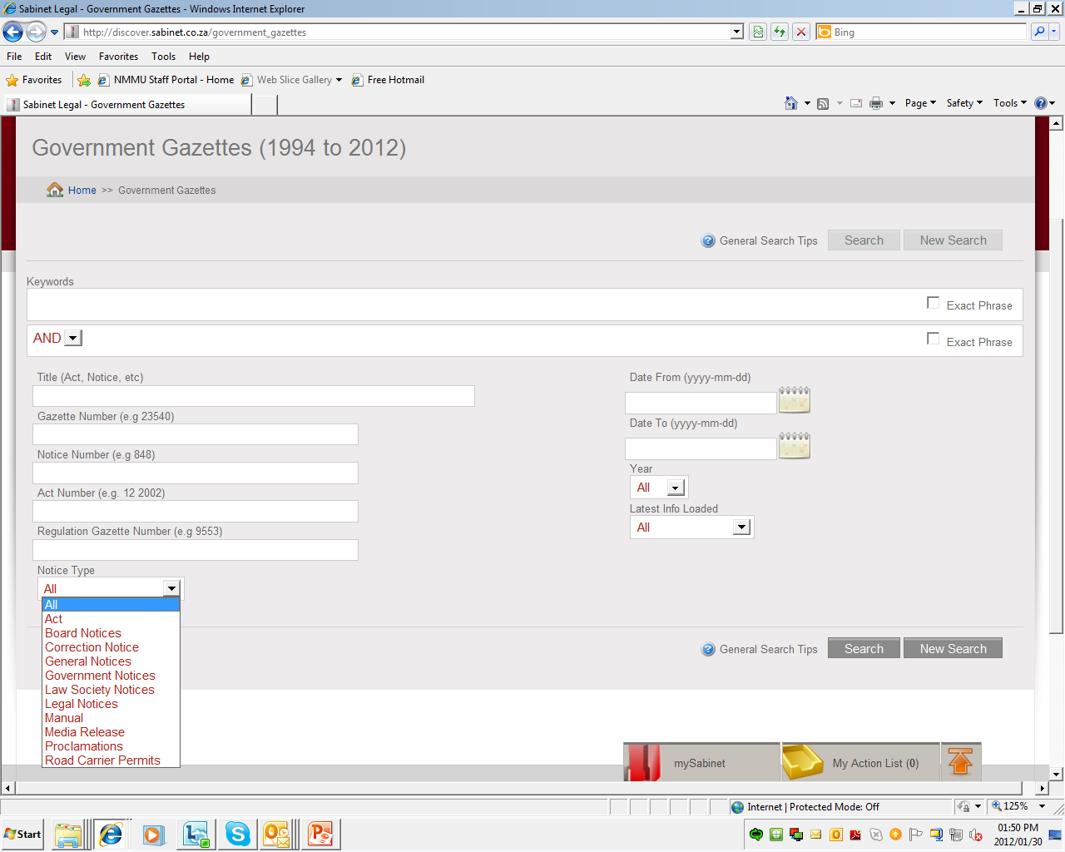

Slide 30
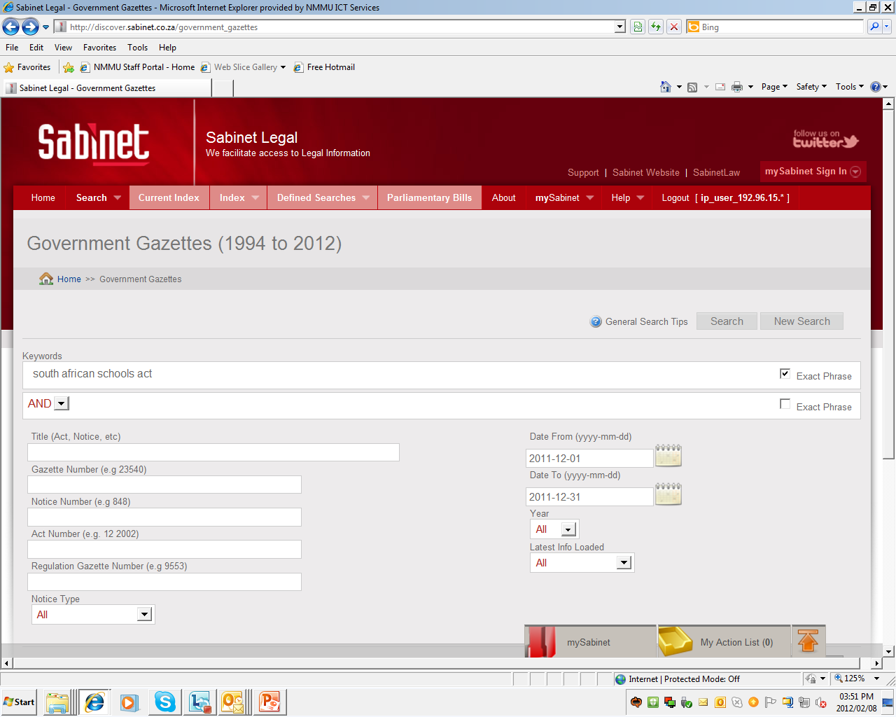

Slide 31
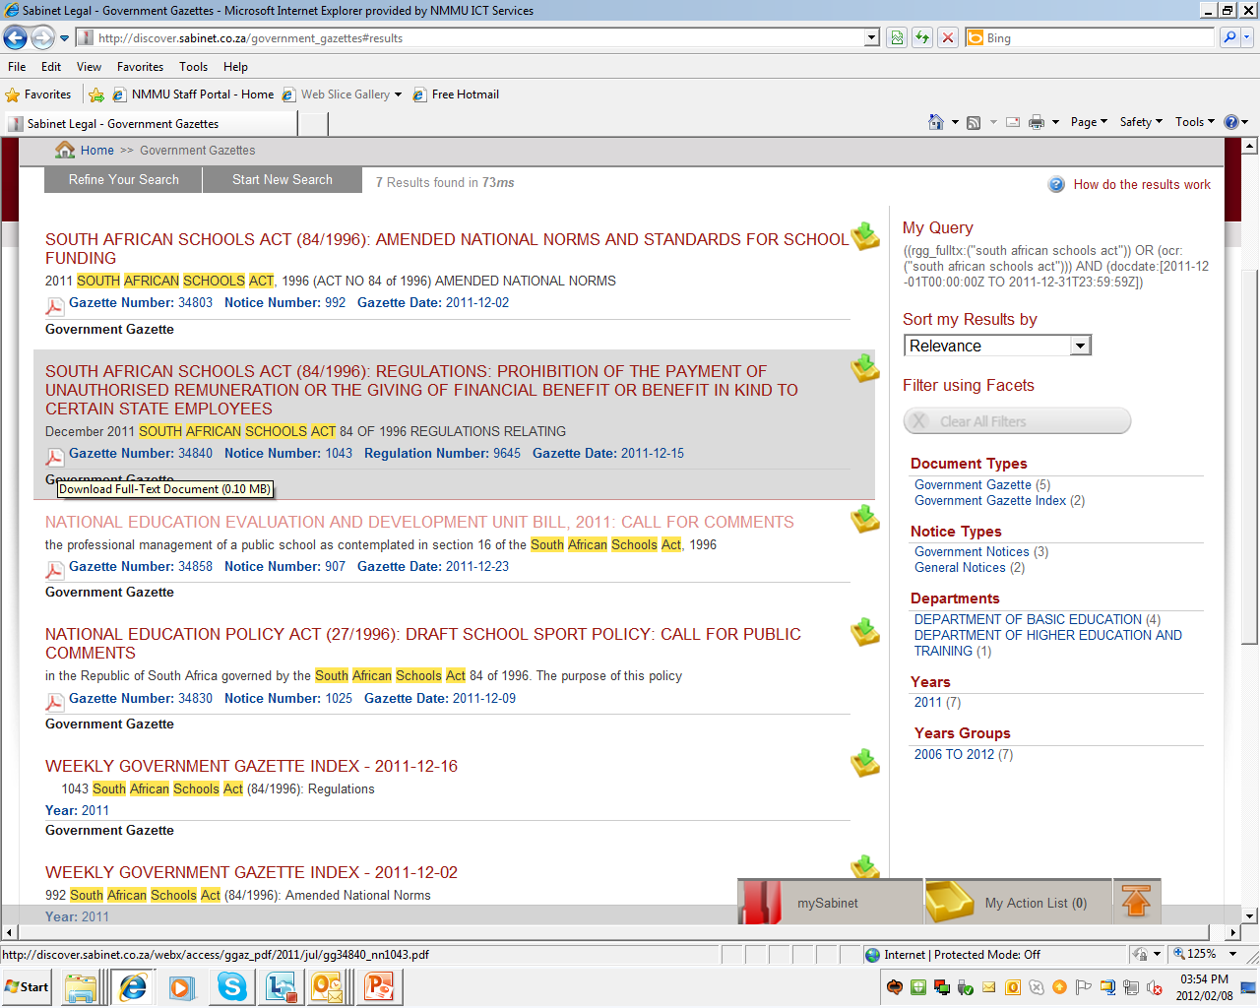

Slide 32
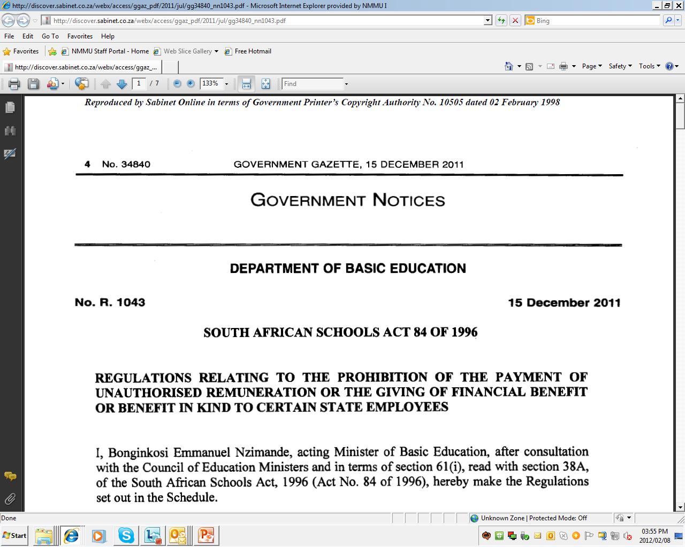

Slide 34
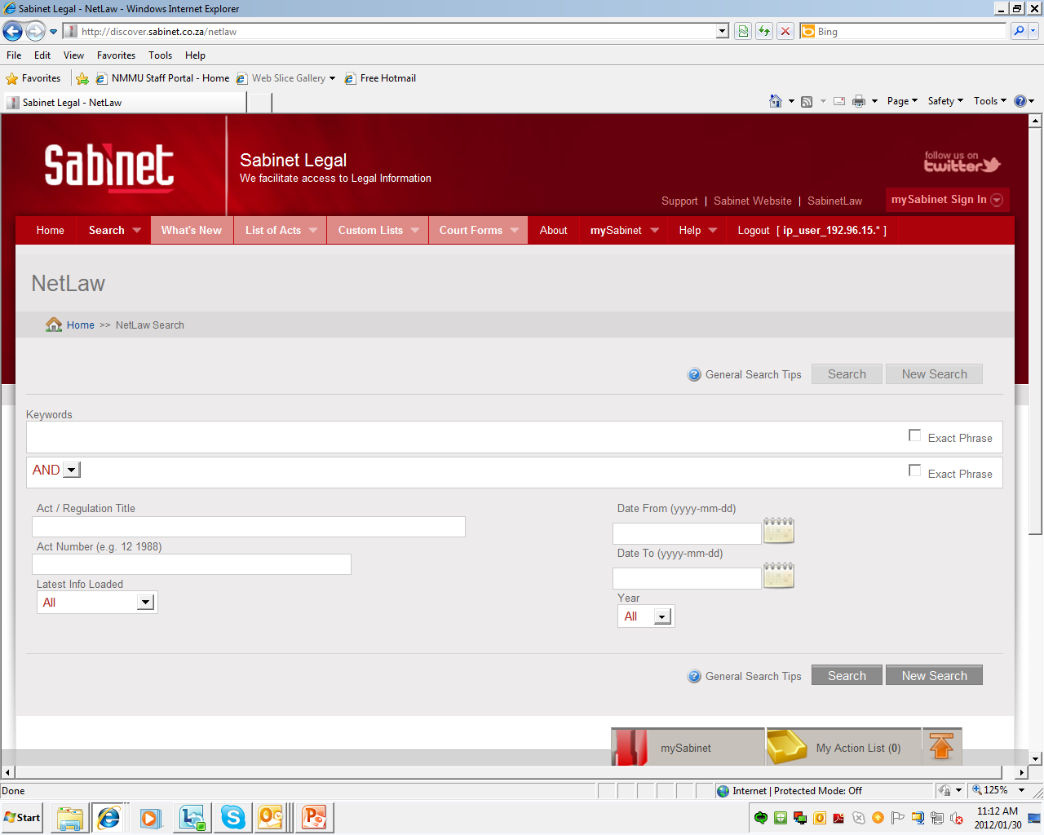

Slide 35
A search in the title field will pick up any item with the words Marine Living Resources in the title

Slide 36
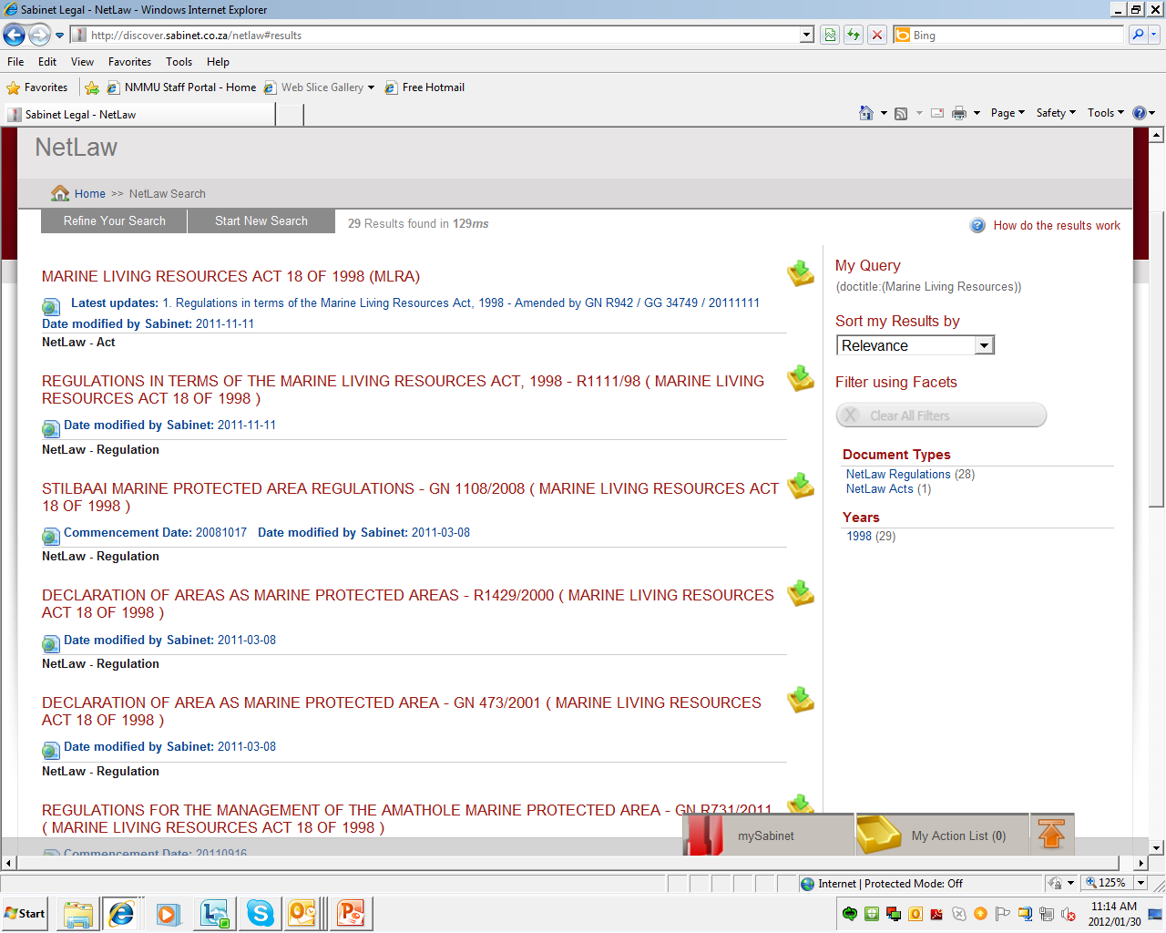

Slide 37
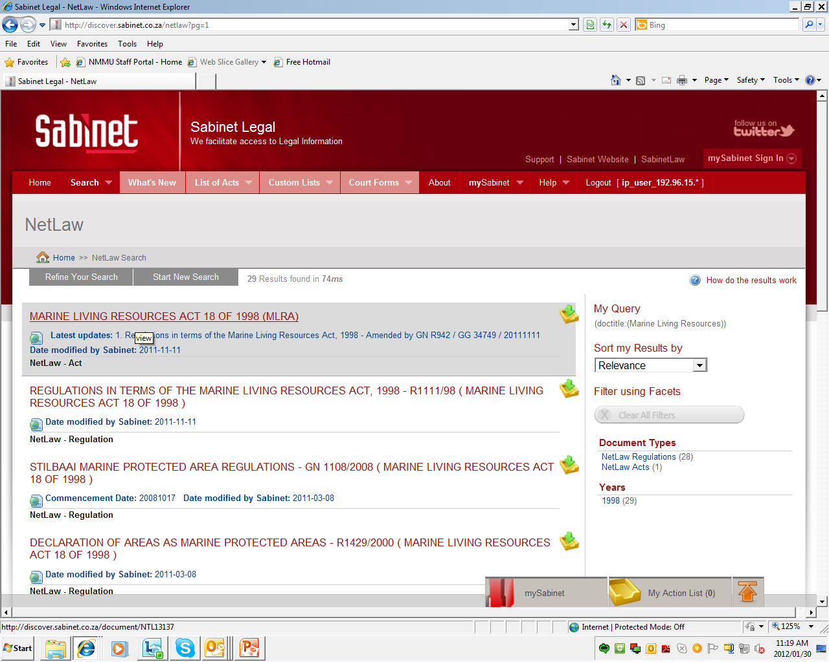
Clicking on the title of the Act itself will take you to the following page …

Slide 38
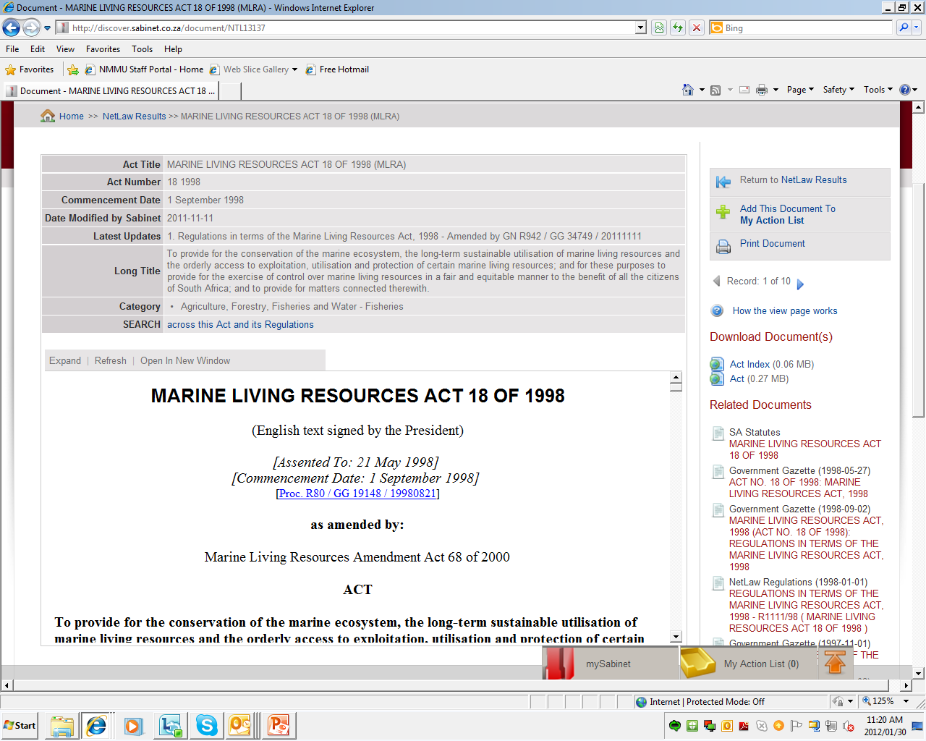

Slide 39
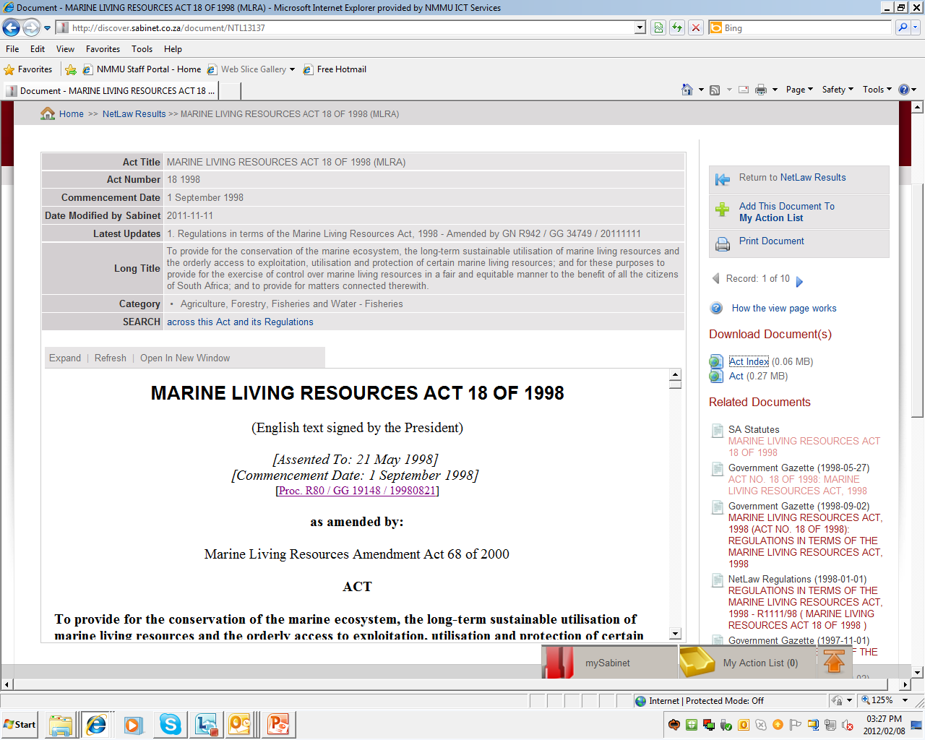

Slide 40
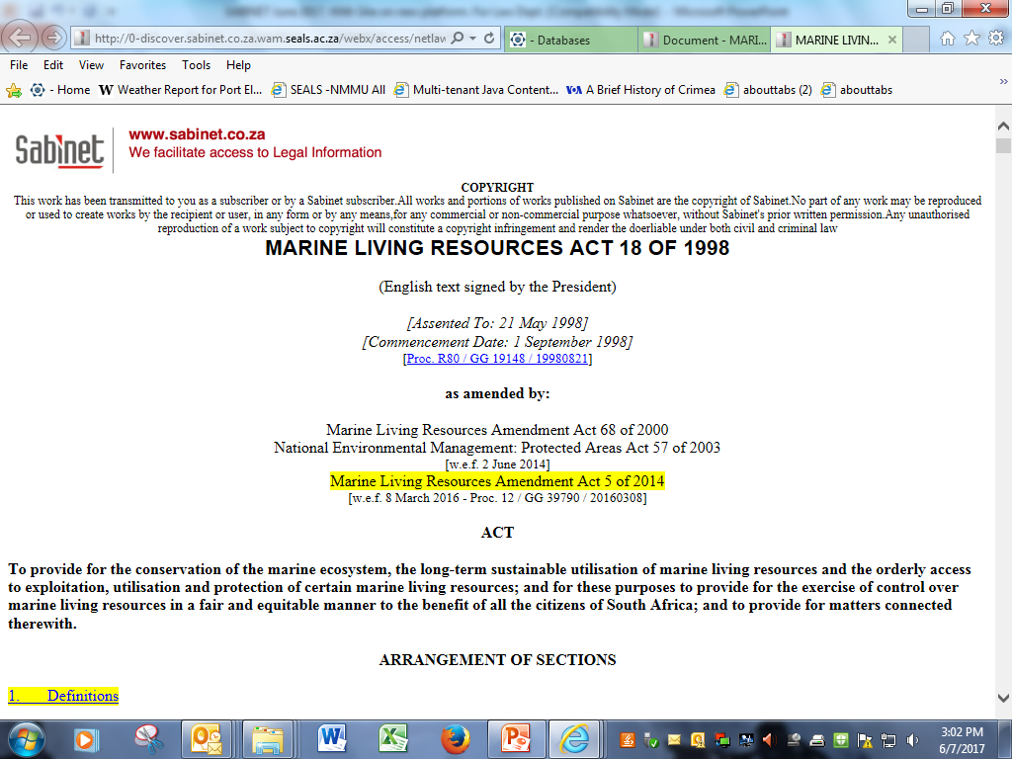

Slide 41
The Act Index contains all associated legislative material

Slide 42
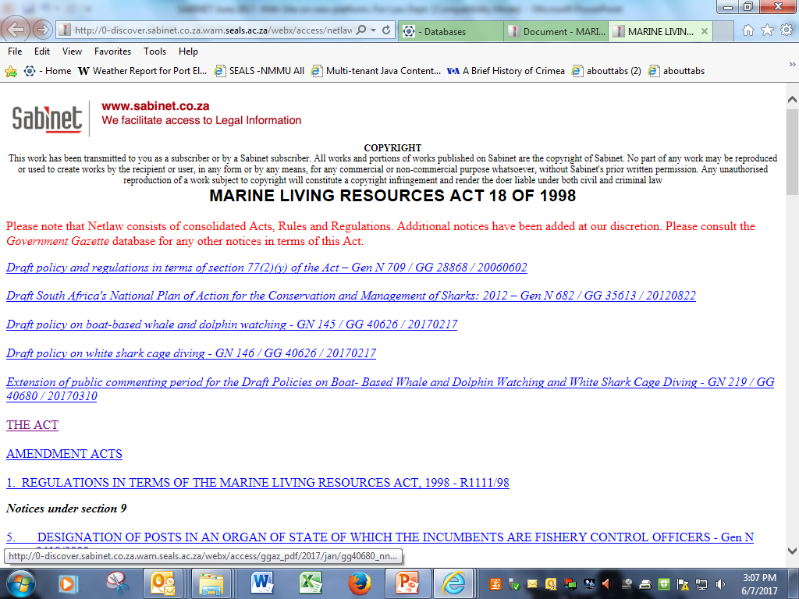

Slide 43
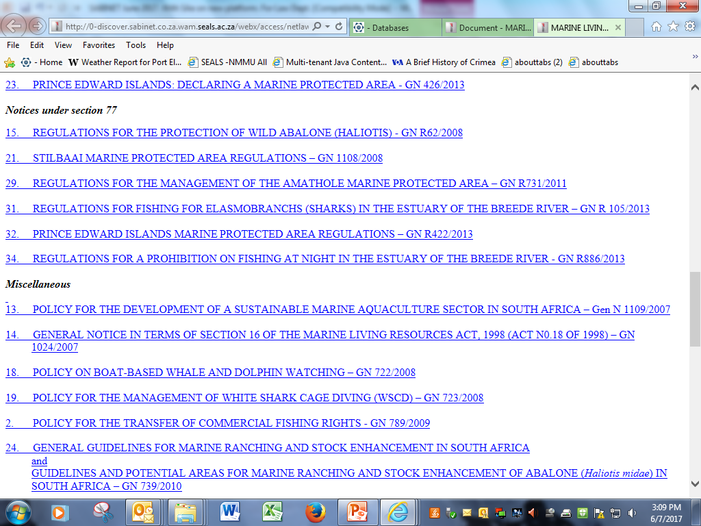

Slide 44
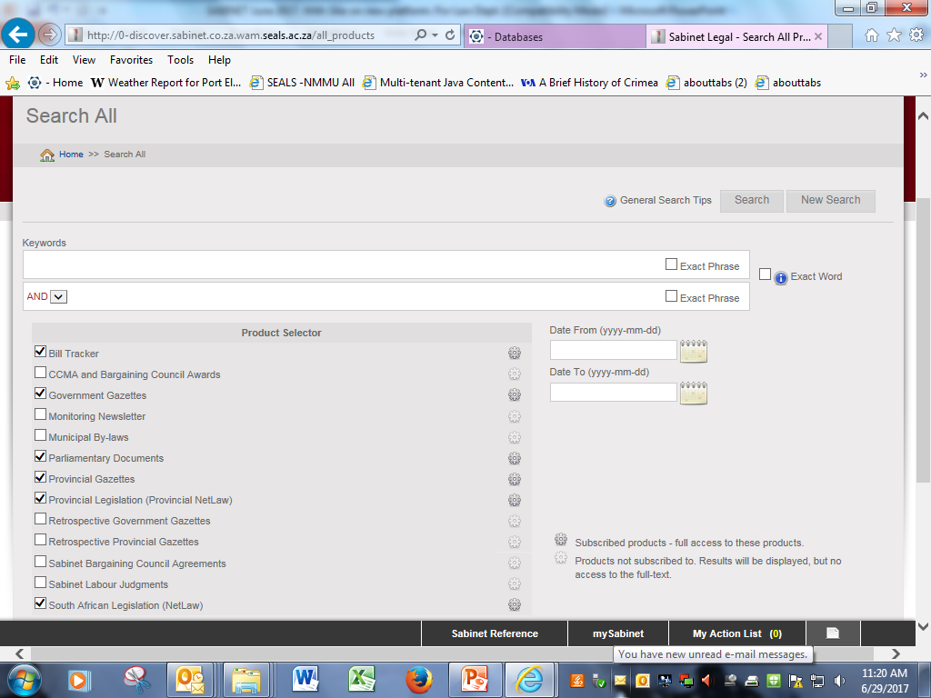
To avoid Sabinet searching all versions of words select the ‘Exact Word’ box
All databases to which we subscribe are automatically selected, but one may unselect those one does not want to search

Slide 45
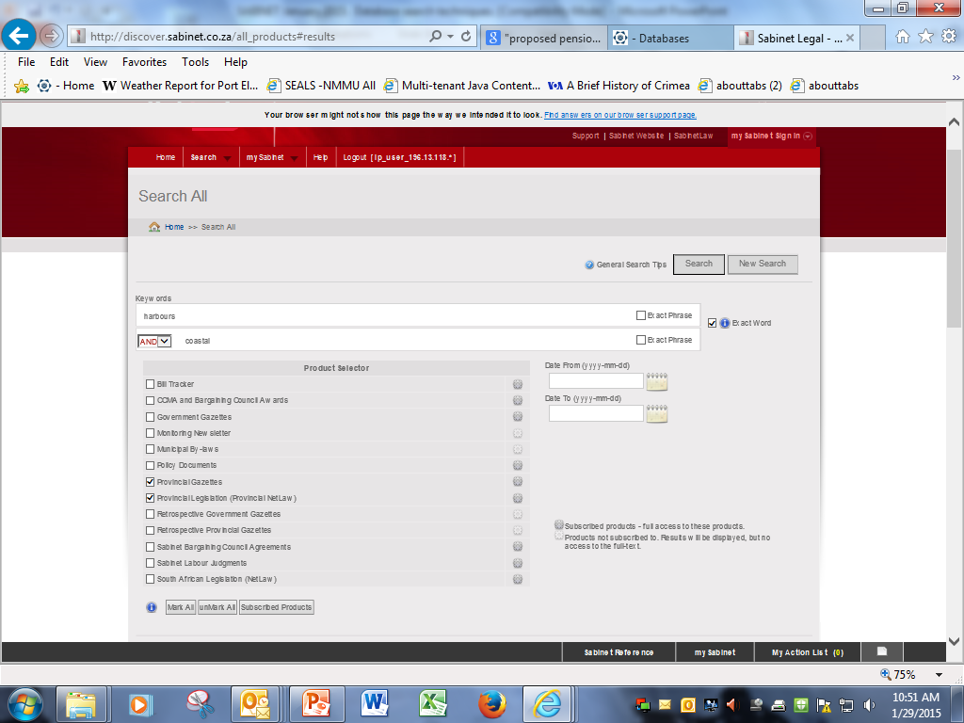

Slide 46
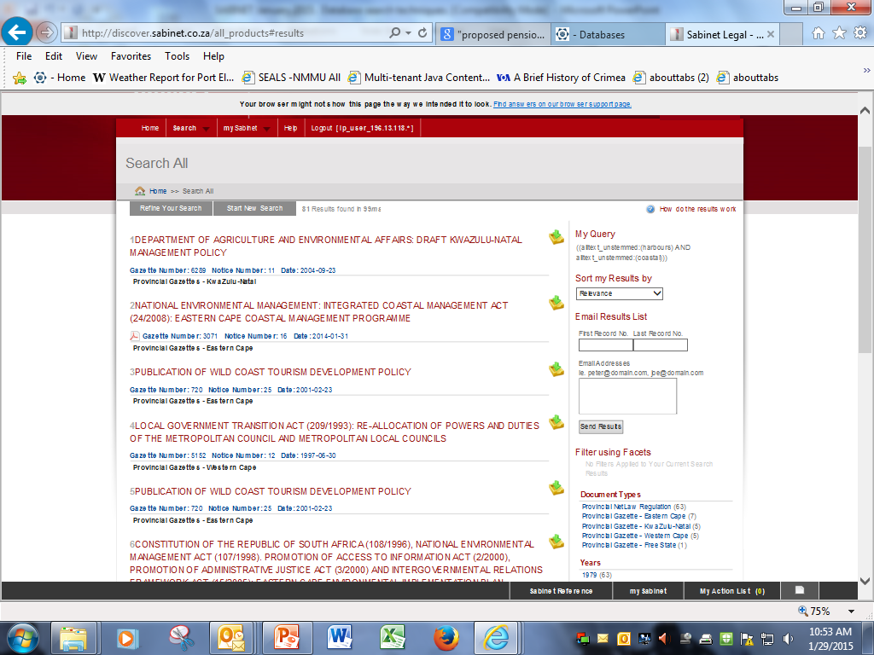
81 results – but not too many to scroll through and select the most useful items ….

Slide 47
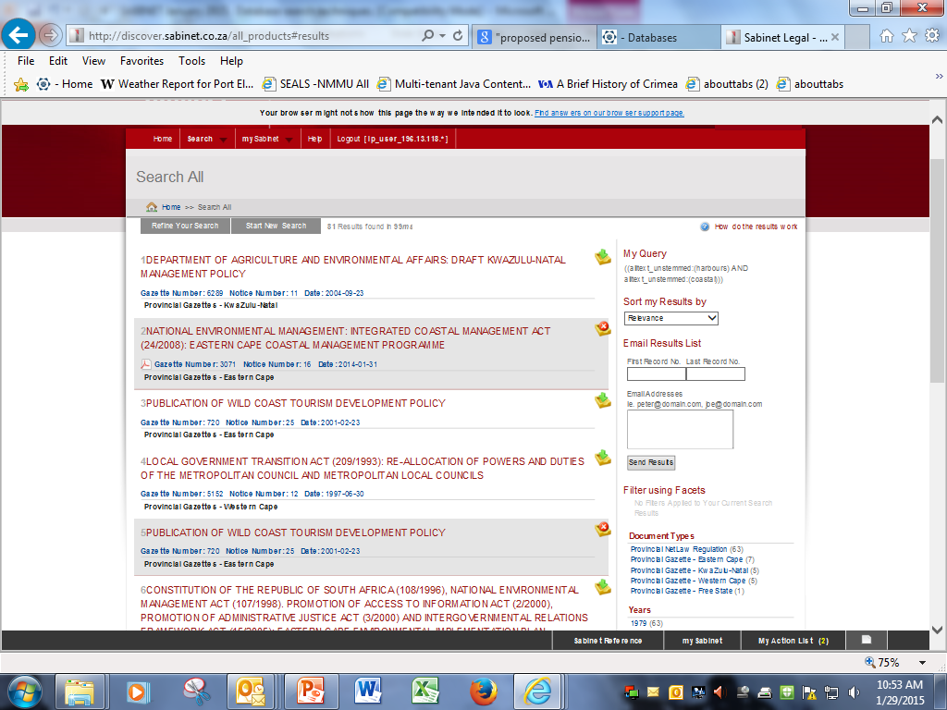
When you select them they are saved in a folder called ‘My Action list’

Slide 48
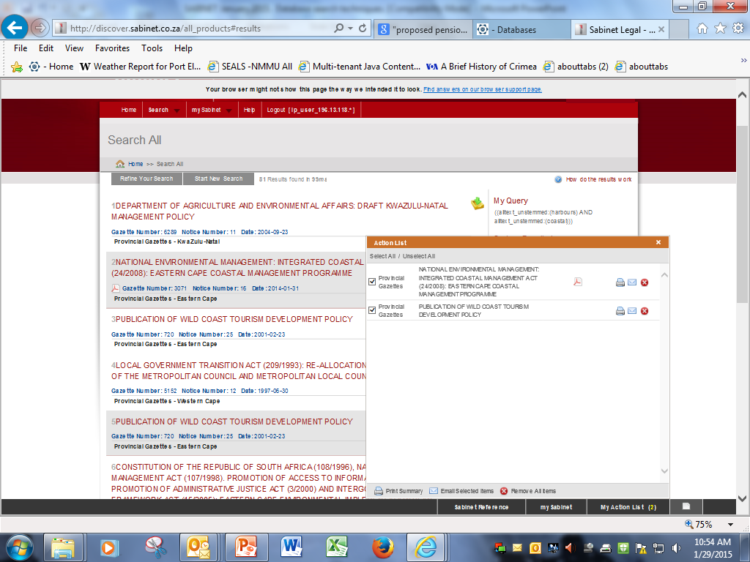
Opening your Action List …
Some articles are available in pdf format only and some in other formats.
The principle is – If you want to send the full text of items available in pdf format you must send them individually; if you want to send a list with links you ‘Select All’ and ‘Email Selected Items’.

Slide 49
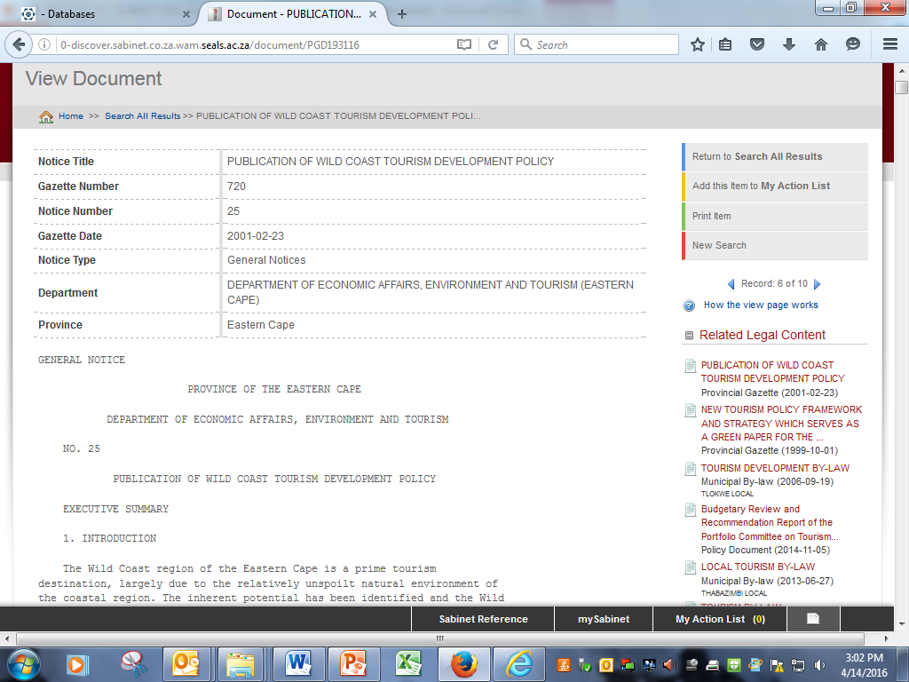
GENERAL NOTICE PROVINCE OF THE EASTERN CAPE DEPARTMENT OF ECONOMIC AFFAIRS, ENVIRONMENT AND TOURISM NO. 25 PUBLICATION OF WILD COAST TOURISM DEVELOPMENT POLICY EXECUTIVE SUMMARY 1. INTRODUCTION The Wild Coast region of the Eastern Cape is a prime tourism destination, largely due to the relatively unspoilt natural environment of the coastal region. The inherent potential has been identified and the Wild Coast delineated as a Spatial Development Initiative area, with tourism as a lead economic sector. - The Wild Coast Tourism Development policy includes: - The identification of Key issues - Tourism Policy Guidelines - Environmental Policy Guidelines - Institutional arrangements for the Policy - Procedural guidelines for project applications 2. KEY ISSUES A number of critical issues have been identified as constraining long term, sustainable tourism development along the Wild Coast. The table below provides an informative overview of the issues to be addressed in the guidelines. _________________________________________________________________________ ISSUE DESCRIPTION _________________________________________________________________________ TOURISM ------- The need This is essential to facilitate the upgrading of for an existing facilities and the exploitation of the many enabling opportunities along the Coast. The availability of, and environ- access to, finance, land tenure and the control over ment and development, tourism development controls and the development application and approval process and responsible institutions must be addressed _________________________________________________________________________ Local There are constraints on the ability of local people to community become involved and empowerment in tourism along the partici- Wild Coast and little incentive to private sector pation, developers to enter into arrangements that facilitate benefit he involvement of local communities. _________________________________________________________________________ Small, Enterprises Tourism presents opportunities for SMME Medium development that are presently not realised due to a and Micro lack of information and support mechanisms. Enter- prises _________________________________________________________________________ Education, The Wild Coast is characterised by a lack of awareness Training with regard to tourism. and Awareness _________________________________________________________________________ Provision The existing physical infrastructure is poor, and as a of Physical result both communication and access to facilities is Infra- limited. trucure _________________________________________________________________________ Tourism This has been limited by funding constraints, but is Marketing essential for the viable development of tourism. and Promotion _________________________________________________________________________ Safety he Wild Coast region suffers from a negative perception and relating to the safety of tourist in the region. Security _________________________________________________________________________ Standards These are traditionally low, with limited incentive for and hotels and tourism operations to improve standards and Service service levels. _________________________________________________________________________ Institu- Institutional arrangements within the tourism industry tional Ar- are unclear rangements _________________________________________________________________________ ISSUE DESCRIPTION _________________________________________________________________________ THE ENVIRONMENT --------------- Access to Almost all the people living outside urban settlements natural depend to some extent on the natural resources of the resources region for their livelihood. Access to these resources must be ensured. _________________________________________________________________________ Biodiversity The maintenance of the biodiversity of the Wild Coast conservation must be considered to be of national and international importance. _________________________________________________________________________ Overex- There has been heavy exploitation of the marine ploitation resource. of resources _________________________________________________________________________ The impact These activities can cause soil erosion, the siltation of agri- of estuaries, pollution of rivers and estuaries, the culture drying up of watercourses and the loss of indigenous and forests. forestry activities _________________________________________________________________________ The un- This uncontrolled development has severe negative controlled impacts on the environment and tourism development spread of potential. alleged illegal holiday cottages _________________________________________________________________________ The lack There is currently a fragmented and uncoordinated of an inte- approach to coastal planning and management in the grated Wild Coast area. planning and development process for the area _________________________________________________________________________ Waste Increasing tourism development will require close management attention to ensuring effective waste management and and pol- pollution control. lution control _________________________________________________________________________ Alien plant The climate ideal situation for the invasion of alien invasions plants. This danger has received very little attention up to now. _________________________________________________________________________ The lack of Due to a lack of skilled personnel and financial environmental resources, there is a lack of capacity for environmental management policing and management within provincial government. capacity _________________________________________________________________________ The lack of The management of the cultural resources of the Wild management Coast has received very little attention. of cultural resources _________________________________________________________________________ ISSUE DESCRIPTION _________________________________________________________________________ INSTITUTIONAL ARRANGEMENTS -------------------------- Current There are a large number of institutions involved in institutional processing, policy, financing and legislation, resulting arrangements in confusion and a lack of clear and decisive decision making. _________________________________________________________________________ Capacity Capacity within government is limited and limitations uncoordinated, resulting in lengthy procedures and poor within response time to development applications. government _________________________________________________________________________ Land Issues around the implementation of land reform policy issues - in the area have not been finalised, though the tenure Department of Land Affairs has made progress with the and re- development of specific procedures for this area. stitution _________________________________________________________________________ Legal/ Numerous pieces of legislation and controls are in regulation force, many of which are contradictory and could limit situation development. _________________________________________________________________________ Policy There is no specific development policy for the region related issues _________________________________________________________________________ No defined The lack of a clearly defined and approved 'development 'development' plan' for the coastal region has resulted in ad hoc plan' developments and investor insecurity. _________________________________________________________________________ Potential The overall perception of the Wild Coast is that it has high risk a high crime rate and no defined parameters for investment development. The business sector regards the area as area 'investor unfriendly'. _________________________________________________________________________ ISSUE DESCRIPTION _________________________________________________________________________ COMMUNITY --------- Definition A functional "definition" of, or at least an of local understanding of, who comprises the local "community" "community" is needed. This has implications in terms of the flow of benefits. _________________________________________________________________________ Need for It is not a particularly desirable situation that local active people are simply the passive beneficiaries of "rent" involvement of for the use of their land. Local people should be as local actively involved as possible, in the core activity people as well as in related SMMEs _________________________________________________________________________ Local people, as well as other interested and affected Transparency parties, should easily be able to access information about the proposed development. _________________________________________________________________________ Appropriate This does not exist at present at local community level. local develop- Community tourism trust offer a possible way forward. ment insti- These trusts could be active participants in joint tutions ventures with investors but also channel benefits derived from tourism (e.g. rent) to the local community. _________________________________________________________________________ Capacity Tourism development plans should clearly outline a building training and capacity building programme to ensure more active community involvement in the tourism _________________________________________________________________________ Significant This relates to two aspects. One is the targeting. Who benefits in the community will derive benefits from the must accrue development? to local Will this simply include the local elite? people - The second is the opportunity cost of the development. majority What is the current use of the land targeted for should be development and how does the anticipated return from better off tourism compare with the current rate of return on the because of land for local people. development. _________________________________________________________________________ No one in This is particularly important with regard to the more community marginal families. should be prejudiced - made worse off- as a result of the proposed development. _________________________________________________________________________ Differential Immediate local community members might feel that they benefits have greater rights to benefits from a local resource associated than people living further afield. This might lead to a with local two-tier system of benefits. community rights _________________________________________________________________________ Exclusivity Some types of tourism require a certain level of exclusivity. This has implications for the number of visitors (tourists) catered for, as well as the restriction of access to certain areas for local people. This exclusion should be carefully negotiated at local community level and be sensitively introduced. _________________________________________________________________________ Need for The tourism enterprise cannot only offer potential for some level deferred gratification. Some type of immediate return of im- for the local community - through rent in the case of mediate joint ventures - needs to be built into the planning return _________________________________________________________________________ Contractual In the case of joint ventures, a clear contract needs to agreement be entered into between legitimate community representatives and the external investors. _________________________________________________________________________ 3. TOURISM AND ENVIRONMENTAL POLICY GUIDELINES The Wild Coast Tourism Development Policy is intended to promote, facilitate and regulate tourism development along the Wild Coast, during the conceptualisation, planning, construction and operational stages. These guidelines should also provide the principles that ensure that environmental considerations are effectively integrated into all processes concerned with promoting, facilitating and regulating tourism on the Wild Coast. The Wild Coast Tourism Development Policy is applicable along the length of the Wild Coast, from the Umtamvuna River in the north to the Kei River in the south, excluding the area which falls within the Port St Johns Transitional Local Council. The policy applies over a 1000m strip inland of the high tide mark, including the tidal portions of estuaries. A review of this spatial area of concern is to be conducted to determine whether the spatial area should be extended to include 4km inland from the 1000m delineation. The policy should apply to all proposed developments and commercial activities within the spatially defined area, whose prime activities are related to tourism i.e. the majority of their business is directly related to tourism. This includes all those ventures that provide goods and services to tourists. It should be noted that the guidelines are seen as complimentary to the IEM procedure, and are not a substitute for the EIA Regulations contained in the Environmental Conservation Act, 1989. The guidelines for the promotion, facilitation and regulation of tourism development have the following underlying principles: - Government should provide the enabling framework for tourism development. - The use of land and resources by the current land occupiers along the Wild Coast should be recognised, and tourism development should not reduce community access to or sustainable utilisation of resources. - Tourism development along the Wild Coast should be sustainable. - Tourism along the Wild Coast should be private sector driven. - Tourism development along the Wild Coast should be equitable. Tourism development should be efficient. - Tourism development should respect the principle of nodality - Tourism development should ensure a special quality experience for all visitors. - Tourism development should be dependant on the establishment of co-operation and close partnerships among key stakeholders. - Tourism should be developed along the Wild Coast to cater for the international and domestic tourist, as well as to meet the needs of local residents who engage in day trips. The tourism policy guidelines can be summarized as: _________________________________________________________________________ SECTION GUIDELINES MAIN PROVISIONS _________________________________________________________________________ 3.4.1 Spatial - Tourism should be concentrated in First and Guidelines Second Order nodes - First Order nodes are extensively developed, with large hotels and cluster development - Second order nodes are family holiday resorts, with cottages, cluster developments and family hotels - Ecotourism zones where low impact environmentally and culturally tourism developments - No tourism development outside these nodes and zones - Compatible mix of tourism uses within each node _________________________________________________________________________ 3.4.2 Siting & - Siting of tourism development to ensure Design economic efficiency Guidelines - Emphasis on cluster development which maximises open space provision - Range of tourism facilities, types and intensities to be achieved - Limited number of people within an area - Tourism development not to exceed carrying capacity - No tourism development without permission of relevant government authority - Tourism development and activities to accommodate needs of physically and mentally challenged, where reasonable - Design and construction to be sensitive to, and reflect local heritage _________________________________________________________________________ 3.4.3 Provision - Synergy with planned provision of of Tourism infrastructure for key anchor projects, Infrastructure existing resort nodes and nodes with potential and growth opportunity - Infrastructure provision should be designed to accommodate increasing use by tourism developments and local communities, within acceptable carrying capacity limits - Priority to provision of transportation infrastructure - Internal infrastructure within tourism developments in accordance with bylaws and tourist thresholds - ECTB to ensure tourism promotion and information infrastructure is provided _________________________________________________________________________ 3.4.4 Tenure - Leasehold is the preferred form of tenure for Guidelines new tourism development. The Minister of Land Affairs will serve as the lessor in cases where the land has not yet been transferred to community ownership. _________________________________________________________________________ 3.4.5 Local - Communities resident in immediate proximity to Community a proposed Participation, Benefit tourism development should be consulted with and the and Empowerment maximum participation in and benefit from the proposed venture facilitated, where desired by the community. - (Co-) landowning communities, and individual community members and groups should have the right to lodge an objection against any proposed tourism development. - Decisions on tourism development applications should take into account the efforts of communities to negotiate their own agreements. - Local community leaders should be informed of the potential for community involvement in ventures and the potential costs and benefits - Local communities should identify, or be assisted to identify local skills, aptitudes and assets which could be developed to form the basis of community-led developments and community participation in tourism projects. - In areas defined as special control and no development areas, communities should be encouraged to respond and develop alternative activities such as guided trails - Small scale community enterprises should be encouraged and facilitated to evolve into/ catalyse other developments. - Tourism development should ensure that communities are not worse off that they would be if tourism development did not occur. - Legal entities should be established to represent specific community interests in negotiations relating to tourism developments. - The legal entities should be able to enter into joint venture and equity partnerships with developers, and approach financial institutions for matching funding for community-based developments. - Communities and tourism developers/operators should be encouraged to form Local Resource and Tourism Management Committees to represent their interests. _________________________________________________________________________ 3.4.6 SMME - Wild Coast Development Organisation to provide Development links to support programmes - Intersectoral linkages encouraged - Facilitation of industry-specific education and training programmes by the Wild Coast Development Organisation - Provincial government to allocate funds to tourism along the coast to facilitate access by the previously disadvantaged - Wild Coast Development Corporation to facilitate access to funding at preferential rate with reduced collateral requirements - Provincial and national government to fund natural and cultural resource management _________________________________________________________________________ 3.4.7 Tourism - Community awareness through workshops, pilot Education, programmes and school tourism modules Awareness & Training - Short courses to equip students with practical skills - Improve levels of standards, service and management through education and training programmes, in-house training and mentoring - Education and training courses accredited to meet NQF _________________________________________________________________________ 3.4.8 Operation - Operation in accordance with licenses issued and Manage- ment of - Regular inspection and monitoring visits to Tourism ensure management plans and controls enforced Develop ments & - Valid complaints regarding management of Activities tourism resources and activities to be lodged at Resource and Tourism Management Committees - Monitoring programmes to identify impacts of developments and activities and propose ameliorative measures _________________________________________________________________________ 3.4.9 Guidelines - Internationally competitive standard of for service and operation, appropriate to type of Standards facility & Service - Regular inspection to ensure that agreed standards are maintained - Allow for gradual attainment of standards by small, basic facilities _________________________________________________________________________ 3.4.10 Marketing & - Promotion of distinct region with- a distinct Promotion identity through a targeted campaign using print, radio and electronic media - Draw on opportunities provided by SATOUR and ECTB for marketing of the region - Strategy to be- monitored and evaluated to assess its effectiveness - Establish network of information centres within the region - Establish centralised reservations facilities _________________________________________________________________________ 3.4.11 Safety & - Increased benefit to and liaison with local Security communities - Installation of reliable communication channels and improved road access - Direct liaison with Tourism Protection Unit - Establishment of community policing structures - Inform tourists of potential threats to their safety and facilitate their assistance in ensuring their own safety and security _________________________________________________________________________ The environmental policy guidelines can be summarized as: _________________________________________________________________________ SECTION GUIDELINES MAIN PROVISIONS _________________________________________________________________________ 3.5.1 Spatial - No tourism development permitted within No Environ- Development Environments, defined on the basis mental of their environmental significance Guidelines - Low impact tourism development permitted in Special Control Environments subject to IEM, EIA procedures and compliance with Ecological Guidelines - Tourism developments within Normal Control Environments (first and second order nodes) should be encouraged to occur within specified parameters _________________________________________________________________________ 3.5.2 Planning - Developments not dependant on a coastal Guidelines location should be located elsewhere - Accessory tourism development should be in first and second order nodes - Minimum setback areas should be enforced - Traffic flows should be minimised and pedestrian flows maximised - Tourism development and activities should not exceed the carrying capacity of the local and coastal environment _________________________________________________________________________ 3.5.3 Aesthetic & - Tourism developments should blend into the Design environment and not be visibly intrusive Guidelines - The landscape viewed from a development should be managed and protected - Tourism developments should have a sense of privacy, seclusion and refuge - Tourism developments should not negatively impact on the qualities of/access to symbolic/special features or symbols - Natural and local materials should be used where possible - Accessory infrastructure should also be subject to the above guidelines _________________________________________________________________________ 3.5.4 Ecological - The location of tourism developments should Guidelines acknowledge the No Development and Special Control environments - There should buffer areas between shoreline residences and coastal waters - Minimum development footprint; with the incorporation of the existing ground form into project design and landscaping and rehabilitation as integral components of design - As little disruption of the ground form and vegetation as possible during site preparation, and close control of disturbances where these occur - Minimise/avoid urban run off - Special attention to and detailed planning for the location and management of sewage disposal, in line with DWAF requirements - Careful attention to solid waste disposal, in line with DWAF requirements - Impact of dams and other water extraction practices on coastal waters to be minimised and carefully considered in the impact assessment of such infrastructure provision - Roads to be designed and constructed as far from the coast as possible and where servicing the coast, perpendicular to the coast so as to minimise impact on drainage patterns _________________________________________________________________________ 3.5.5 Guidelines - Sustainable energy provision practices to be for Resource adopted within tourism developments Consumption - General approach of most efficient and non-wasteful use of water - Use of local materials to be controlled by WCTC - Compliance with regulation pertaining to use of plant and animal resources _________________________________________________________________________ 3.5.6 Tourist - Compliance with regulations and requirements Activities of nature and biological diversity conservation - Operated with respect to ecological capacity and the characteristics of the environment, limited where necessary - Use of powerboats and jet skis prohibited except in demarcated rivers - No vehicles should be driven on beaches (except for launching of boats), in line with the Environmental Conservation Act, 1989 and Decree 9 of 1992 - Ski boats only to be launched on the beach from approved launch sites - Regular inspection and monitoring visits to ensure implementation of management plans _________________________________________________________________________ 3.5.7 Socio- - Public access to natural resources, including Economic beaches and estuaries must be retained. Guidelines - Tourism should not promote degradation of environmental qualities - Compensation for loss of access to areas must exceed the benefits from resources in the areas - Socio-economic aspects must be considered in EIA's _________________________________________________________________________ 3.5.8 Environmental - Tourism development must be in accord with Management provincial and local guidelines Guidelines - Tourism developers have an active role to play in environmental management _________________________________________________________________________ 3.5.9 Environmental - Tourism must be recognised as the lead sector Management and the significance of all proposed of Non- development measured in terms of the impact Tourism on tourism Development & Activities - WCTC, WCDA and the tourism industry should be recognised as significant interested and affected parties to all development proposals along, and impacting on the coastal zone - Developers to inform the WCTC and WCDA of all proposed developments impacting on the coast at an early stage, to allow assessment of the possible significance for tourism _________________________________________________________________________ 4. INSTITUTIONAL ARRANGEMENTS FOR THE IMPLEMENTATION OF THE GUIDELINES In order for the guidelines to be effectively implemented the following institutional arrangement is recommended. 4.1 Wild Coast Development Organisation In the short to medium term the Centre for Investment and Marketing in the Eastern Cape (CIMEC) will perform the function of the Wild Coast Development Organisation. In terms of their mandate and legal powers, the functions envisaged for the Wild Coast Development Organisation are compatible with the functions of CIMEC. For CIMEC to perform this function it will need to work directly with other agencies, in particular the Eastern Cape Development Corporation and the Eastern Cape Tourism Board with regard to planning, marketing and access to development finance. This will mean a degree of joint decision making amongst the three institutions. A dedicated and staffed desk is to be established within CIMEC to undertake the work. The immediate and short-term functions of the Development Organisation are: - To undertake an immediate review of all spatial and institutional arrangements presently in place on the ground on the Wild Coast and to establish their legitimacy. - To co-ordinate efforts of all existing authorities with powers to administer and enforce legal and policy provisions. - Communication and information dissemination relating to the tourism and environmental guidelines. - To develop a decision-making structure. - To provide support, advice and assistance as outlined in the tourism guidelines to potential tourism investors and communities resident along the Wild Coast. Medium Term Functions The following two functions are to be completed within two years of establishment: - To encourage and ensure that the relevant government departments commence with the preparation and application of a regional development plan based on the primacy of the tourism and environmental guidelines - To undertake a feasibility study to determine the need and desirability, and if positive, the viability of the establishment of a permanent Wild Coast Development Authority. 4.2 The Wild Coast Technical Committee (WCTC) The WCTC should be composed of: - The national Department of Land Affairs - The provincial Department of Housing and Local Government - The provincial Department of Agriculture and Land Affairs - The provincial Department of Economic Affairs, Environment and Tourism - The Office of the Premier - The Kei District Council - The Amatola District Council - The Wild Coast District Council - The Eastern Cape Development Corporation - The Eastern Cape Tourism Board The Provincial Department of Economic Affairs, Environment and Tourism will chair the WCTC. The overall purpose of the WCTC is to enable and ensure decision making with regard to all development and project applications along the Wild Coast. The following are the proposed functions of the WCTC with regard to its immediate responsibilities: 1. In the interim, to make recommendations to the Minister of Land Affairs and/or the Minister of Water Affairs and Forestry and the MEC for Economic Affairs, Environment and Tourism for the approval or rejection of projects along the Wild Coast. 2. Once established, to make recommendations to the Development Tribunal as set out in the Development Facilitation Act No 67 of 1995 on matters pertaining to the development of the Wild Coast. 3. To appraise projects applications against the criteria as set out in the pre-application conditions. 4. To ensure inter departmental consultation and co-ordination of the technical assessment of project applications. 5. To recommend changes in policy for the development of the Wild Coast 6. To ensure co-ordination for the delivery of departmental services relevant to any development project on the Wild Coast 7. Determination of whether the spatial area over which these guidelines apply should be extended. 8. To recommend the granting of operating licences in conjunction with the relevant licensing authority. 5. PROCEDURAL GUIDELINES FOR PROJECT APPLICATIONS 5.1 Project application and approval The application and approval procedure in figure 1 is to be used as a guideline. Once project approval has been granted construction can commence. On completion, and approval of construction, the developer is to be issued with a building certificate and an environmental clearance certificate. 5.2 Environmental Management Procedures In terms of the Environmental Impact Regulations promulgated in terms of Section 21 of the Environmental Conservation Act, 1989 (Act No. 73 of 1989) EIA's are required in certain instances. "Resorts" (which would include tourist developments on the Wild Coast) are specifically mentioned as activities in which EIA procedures are mandatory. Due to their nature, therefore, proposed new tourism developments, or substantial extensions to existing ones, will require an EIA. As many of the infrastructure improvements associated with tourism developments are listed, these will also require EIA's to be undertaken. The changes in land use identified in the regulation as requiring EIA's effectively mean that all development proposals on land outside of the town planning scheme area of Port St. Johns will be subject to an environmental impact assessment. Within the town planning scheme area of Port St. Johns, EIA's would be expected if the proposed activities are scheduled in the regulations or are areas considered environmentally sensitive or valuable. An EIA is also required if a proposed development involves the reclamation of land below the high water mark of the sea, and inland water, including wetlands, or are located in any of the specific locations or general types of areas listed as "No Development Environments" or if they are likely to affect certain specified aspects within a particular "Special Control Environment". The Department of Economic Affairs, Environment and Tourism and the Chief Directorate: Environmental Affairs is directly responsible for administering the regulations and the associated EIA procedures within the Eastern Cape. The Standard EIA Application Form to be completed at the commencement of any required EIA procedures can be collected from the regional offices in Kokstad, Umtata and East London. In the case of the development of the Wild Coast, the application should be submitted with the detailed project application to CIMEC, who will submit it to the relevant government authority. After considering the application, the relevant authority may request the applicant to submit a plan of study for scoping for the purposes of a scoping report or a scoping report without a prior plan of study. After a scoping report has been accepted, the relevant authority may decide the information contained in the scoping report is sufficient for the consideration of the application without further investigation, or that the information contained in the scoping report should be supplemented by an environmental impact assessment which focuses on the identified alternatives and environmental issues identified in the scoping report. After the relevant authority has received the relevant documentation, including the environmental impact report (if requested) the relevant authority must consider the application and decide to approve the application with or without conditions; or refuse the application. 5.3 Community Participation in Development Projects The guidelines for community participation in tourism ventures within the Wild Coast SDI are intended to provide potential investors with guidelines on the processes they should follow to ensure a high level of community participation in the ventures. The following is recommended for facilitating and ensuring active community involvement: 1. Consultation with the local authority 2. Consultation with the traditional authority. 3. Provide notice of public meetings and prominently display these, at lea, at local authority premises, magistrate's court and tribal court for a period of at least three weeks before the meeting. 4. Hold public meetings in close proximity to the proposed area of operation 5. Hold on-site investigations of lease areas with local community representatives using PRA methods (including maps) 6. Hold follow-up workshops for local community members (or elected representatives) 5.4 Project/Development Assessment Criteria The following criteria and conditions will be applied when considering and assessing proposals submitted by potential investors/operators. The criteria are to act as a framework for potential proposals, and as such different weightings should be applied depending upon the particular type of proposal. 1. Developmental benefits of the project 2. Impact on other developments 3. Job creation - 4. Economic Empowerment 5. Policy and development objectives 6. Environmental impact 7. Financial viability 8. Capital investment 9. Community participation and support 10. Development locations 11. Siting and Design 12. On going management 13. Any other criteria or legislated matters deemed relevant by the provincial government. WILD COAST TOURISM DEVELOPMENT POLICY Table of Content EXECUTIVE SUMMARY 1. INTRODUCTION 1.1. Background 1.2. Context 1.3. Structure of the Policy 2. KEY ISSUES 2.1. Key Tourism Issues 2.1.1. The need for an enabling environment 2.1.2. Local community participation. benefit and empowerment 2.1.3. Small, Medium and Micro Enterprises 2.1.4. Education, Training and Awareness 2.1.5. Provision of Physical Infrastructure 2.1.6. Tourism Marketing and Promotion 2.1.7. Safety and Security 2.1.8. Standards and Service 2.1.9. Institutional Arrangements 2.2. Key Environmental Issues 2.2.1. Access to natural resources 2.2.2. Biodiversity conservation 2.2.3. Overexploitation of resources 2.2.4. The impact of agriculture and forestry activities 2.2.5. The uncontrolled spread of alleged illegal holiday cottages 2.2.6. The lack of an integrated planning and development process for the area 2.2.7. Waste management and pollution control 2.2.8. Alien plant invasions 2.2.9. The lack of environmental management capacity 2.2.10. The lack of management of cultural resources Key Institutional issues 2.3.1. Current institutional arrangements 2.3.2. Capacity limitations within government 2.3.3. Land issues - tenure and restitution 2.3.4. Legal/regulation situation 2.3.5. No defined 'development' plan' 2.3.6. Policy related issues 2.3.7. Potential high risk investment area 2.4. Key Community issues 2.4.1. Definition of local 'community' 2.4.2. Need for active involvement of local people 2.4.3. Transparency 2.4.4. Appropriate local development institutions 2.4.5. Capacity Building 2.4.6. Differential benefits associated with local community rights 2.4.7. Exclusivity 2 4.8 Need for some level of immediate return 2.4.9. Contractual agreement 2.4.10. Land ownership 3. WILD COAST TOURISM DEVELOPMENT POLICY Purpose of the Guidelines 3.2. Application of the Policy 3.3. Principles for Tourism Development along the Wild Coast 3.4. Tourism Development Guidelines 3.4.1 The Spatial Guidelines 3.4.2. Siting and Design Guidelines 3.4 3 Provision of Tourism Infrastructure 3.4.4. Tenure Guidelines 3.4.5. Local Community Participation. Benefit and Empowerment 3.4.6. Small, Medium and Micro Enterprise Development 3.4.7. Tourism Education, Training and Awareness 3.4.8. Operation and Management of Tourism Developments and Activities 3.4.9. Guidelines for Standards and Service 3.4.10. Marketing and Promotion 3.4.11. Safety and Security 3.5. Environmental Policy Y Guidelines For Tourism Development 3.5 1 The Spatial Environmental Guidelines 3.5.2. Planning Guidelines 3.5.3. Aesthetic and Design Guidelines 3.5.4. Ecological Guidelines 3.5.5. Guidelines for Resource Consumption 3.5.6. Tourist Activities 3 5 7 Socio - Economic Environmental Guidelines 3.5.8. Environmental Management Guidelines 3.5.9. Environmental Management of Non-Tourism Developments and Activities 4. INSTITUTIONAL ARRANGEMENTS FOR THE POLICY 4.1. Proposed Institutional Arrangements 4.2. Wild Coast Development Organisation 4.2.1. Role. Function and Activities required of CIMEC 4.2.1.1. Immediate short term functions 4.2.1.2. Medium Term Functions 4.3. The Wild Coast Technical Committee (WCTC) 4.3.1. The WCTC structure 4.3.2. The purpose of the WCTC 4.3.3. Functions and duties of the WCTC 4.3.4. Rules of Order for the WCTC 4.3.4.1. Meetings 4.3.4.2. Chairperson 4.3.4.3. Secretariat 4.3.4.4. Technical. task and project teams 4.3.4.5. Notice of meetings 4.3.4.6. The agenda 4.3.4.7. Quorum 4.3.4.8. Attendance register 4.3.4.9. Minutes 4.3.4.10. Proceedings at meetings 4.3.4.11. Decision making for recommendations 4.3.4.12. Disciplinary measures of members 4.3.4.13. Additional committee members PROCEDURAL GUIDELINES FOR PROJECT APPLICATIONS 5.1. Project Application and Approval 5.1.1. Pre-application phase 5.1.1.1. Responsibilities 5.1.2. Application phase 5.1.2.1. Responsibilities 5.1.3. Application assessment phase 5.1.3.1. Responsibilities 5.1.4. Approval/rejection phase 5.1.4.1. Responsibilities 5.1.5 Building/construction phase 5.1.5.1. Responsibilities 5.1.6. Building completion phase 5.1.7. Appeal 5.1.8. Extensions to current development 5.2. Environmental Management Procedures 5.2.1. Background and Context 5.2.2. The Legal Basis 5.2.3. The Institutional Framework 5.2.4. Application of the Regulations 5.2.4.1. Listed Activities 5.2.4.2. Types of environments likely to require an Environmental Report 5.2.4.3. Responsibilities & procedures for Environmental Reports 5.3. Community Participation In Development Projects 5.4. Project/Development Assessment Criteria 5.4.1. Developmental benefits of the project 5.4.2. Impact on other developments 5.4.3. Job creation 5.4.4. Economic Empowerment 5.4.5. Policy and development objectives 5.4.6. Environmental impact 5.4.7. Financial viability 5.4.8. Capital investment 5.4.9. Community participation and support 5.4.10. Development location 5.4.11. Siting and Design 5.4.11.1. Hotels 5.4.11.2. Camping and Caravaning 5.4.11.3. Picnicking 5.4.11.4. Cottages 5.4.12. On going management 5.4.13. Other issues APPENDIX A - MAP IDENTIFYING DEVELOPMENT NODES 1. INTRODUCTION 1.1. Background The Wild Coast region of the Eastern Cape is a prime tourism destination, largely due to the relatively unspoilt natural environment of the coastal region. The inherent potential of the Wild Coast has been identified by Government and the Wild Coast has been delineated as a Spatial Development Initiative area, with tourism as a lead economic sector. The objectives of the Spatial Development Initiative (SDI) Programme are to: - Generate sustainable economic growth and development in relatively underdeveloped areas, according to the locality's inherent economic potential; - Generate long term and sustainable employment for the local inhabitants of the SDI area; - Maximise the extent to which private sector investment and lending can be mobilised into the SDI area; - Exploit the spin-off opportunities that arise from the crowding-in of private and public sector investments for the development of SMME's and the empowerment of the local communities; - Exploit under-utilised locational and economic advantages for export-oriented growth. Despite the widespread recognition of the tourism potential of the region, this has remained unrealised. The Wild Coast Tourism Development policy is intended to provide a policy framework for tourism development. The policy consists of the identification of key issues which hinder tourism development along the Wild Coast and provides policy guidelines for tourism development by providing: - Tourism development and management guidelines - Environmental policy guidelines for tourism development and management - Institutional arrangements necessary for the implementation of the policy - Procedures for tourism development applications 1.2. Context The preparation of the policy for tourism development along the Wild Coast occurred within a context of rapid growth in tourism, to and within South Africa, and increasing popularity of the Eastern Cape, and within this of the Wild Coast. In addition to this increasing market pressure, the Wild Coast is under increasing pressure from tourism development - southwards from the South Coast of KwaZulu-Natal, northwards from the Garden Route and internally, as reflected in the proliferation of cottages along the coast. There is, however, widespread recognition that the value of the Wild Coast as a tourism destination is based on the natural environment and that tourism and other development processes should not degrade these qualities. There is also acknowledgement that the Wild Coast is a valuable and unique environment that warrants protection and conservation in its own right. For this reason' tourism environmental guidelines are provided as part as an integral component of the overall Wild Coast Tourism Development Policy. The environmental guidelines are intended to provide the parameters within which appropriate, environmentally sustainable tourism development can be promoted; regulated and facilitated. The policy has been prepared amidst a changing policy and legislative context. The changing policy environment in relation to tourism and the environment has been carefully considered in the preparation of these guidelines. The main points to be highlighted from the review are: - The national tourism policy, as articulated in the Tourism White Paper, has been widely accepted, adopted and implemented in the development of the tourism industry; - A provincial tourism policy in line with the national policy is in the course of preparation; - The SDI principles to guide tourism development along the Wild Coast are in line with national and the emerging provincial tourism policy; and, - Increasing clarity with regard to environmental policy has emerged with the promulgation of the Environmental Impact Regulations in terms of the Environmental Conservation Act (Act 73 of 1989), the National Environmental Management Act (Act 107 of 1998) and the White paper for Sustainable Coastal Development in South Africa. 1.3. Structure of the Policy The policy is structured as follows: Section 2 provides an overview of the key issues to be addressed for tourism development along the Wild Coast to be sustainable and successful. Section 3 contains the Tourism and Environmental Policy Guidelines. The main components of this section are: The Underlying Principles which form the basis from which the tourism, environmental and procedural/institutional guidelines are drawn Tourism Policy Guidelines, which include the following sections: 1. Spatial Guidelines 2. Siting and Design Guidelines 3. Provision of Tourism Infrastructure 4. Tenure Guidelines 5. Local Community Participation, Benefit and Empowerment 6. Small, Medium and Micro Enterprise Development 7. Tourism Education, Training and Awareness 8. Operation and Management of Tourism Developments and Activities 9. Guidelines for Standards and Service 10. Marketing and Promotion 11. Safety and Security Environmental Policy Guidelines, which include the following sections: 1. Spatial Guidelines 2. Planning Guidelines 3. Aesthetic and Design Guidelines 4. Ecological Guidelines 5. Guidelines for resource consumption 6. Tourist Activities 7. Socio-economic Environmental Guidelines 8. Environmental Management Guidelines 9. Environmental Management of Non-tourism Coastal Developments and Activities Section 4 details the institutional arrangements for the implementation of the guidelines. Section 5 identifies the procedures to be followed for project approval, environmental management and community consultation. 2. KEY ISSUES The key issues which the tourism policy will address have been grouped into those relating to: - Tourism - Environment Current institutional arrangements - Communities. 2.1. Key Tourism Issues A number of critical issues require immediate attention if the Wild Coast is to develop as a successful long-term tourism destination. Of particular concern to the tourism industry is: 2.1.1. The need for an enabling environment An enabling environment is required to facilitate the upgrading of existing facilities and the exploitation of the many opportunities along the Wild Coast. The following aspects need to be addressed to develop an enabling environment: Increased availability of, and access to, funding and finance for development within the tourism industry; Clarification of land tenure and the control over land development; The formulation of tourism development controls; and, Clarity regarding the development application and approval process, and the responsible institutions. 2.1.2. Local community participation, benefit and empowerment The limited knowledge, awareness, training and finance on the part of those previously excluded serves to constrain the ability of local people to become involved in tourism along the Wild Coast. In addition, there is little incentive or guarantee to private sector developers to encourage them to enter into joint venture partnerships, or other models that facilitate the involvement of local communities. 2.1.3. Small, Medium and Micro Enterprises The tourism industry presents opportunities for the development of small, medium and micro enterprises. These are, however, presently not realised due to a lack of information and awareness, knowledge, training and access to finance. 2.1.4. Education, Training and Awareness The Wild Coast is characterised by a lack of awareness with regard to tourism. This limits the involvement of local people in the tourism industry, and serves to constrain the development of tourism operations and activities. This is reinforced by the limited opportunities for education and training in tourism available along the Wild Coast. 2.1.5. Provision of Physical Infrastructure The existing physical infrastructure in the region is not geared to the needs of tourists and tourist developments. In general physical infrastructure along the coast is poor, and as a result both communication and access to facilities is limited. 2.1.6. Tourism Marketing and Promotion The marketing of the region as a tourism destination, to the domestic and international tourist, has previously been limited by funding constraints, but is essential for the viable development of tourism, and to overcome the constraints imposed by the seasonal nature of the tourism industry. 2.1.7. Safety and Security The levels of safety and security are of particular concern, as the growth in tourism is heavily influenced by the perceptions of safety. The Wild Coast region suffers from a negative perception relating to the safety of tourists in the region. 2.1.8. Standards and Service These are, unfortunately, traditionally low in the tourism industry. Along the Wild Coast this situation has been perpetuated by the limited incentive for hotels and tourism operations to improve standards and service l
If there is no pdf or HTML full text on the left under a heading
‘Download Document(s)’
you can copy and paste the text into a word document

Slide 50
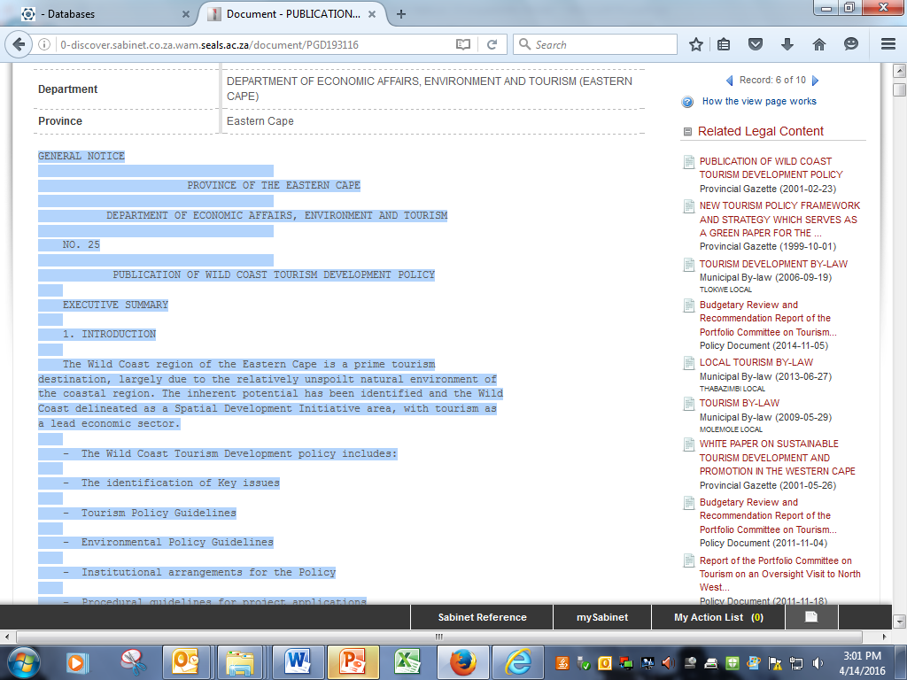

Slide 51
THANK YOU

