Slide 1
Searching for SA Law Report or SA Criminal Law Report using Jutastats Online databases

Slide 2
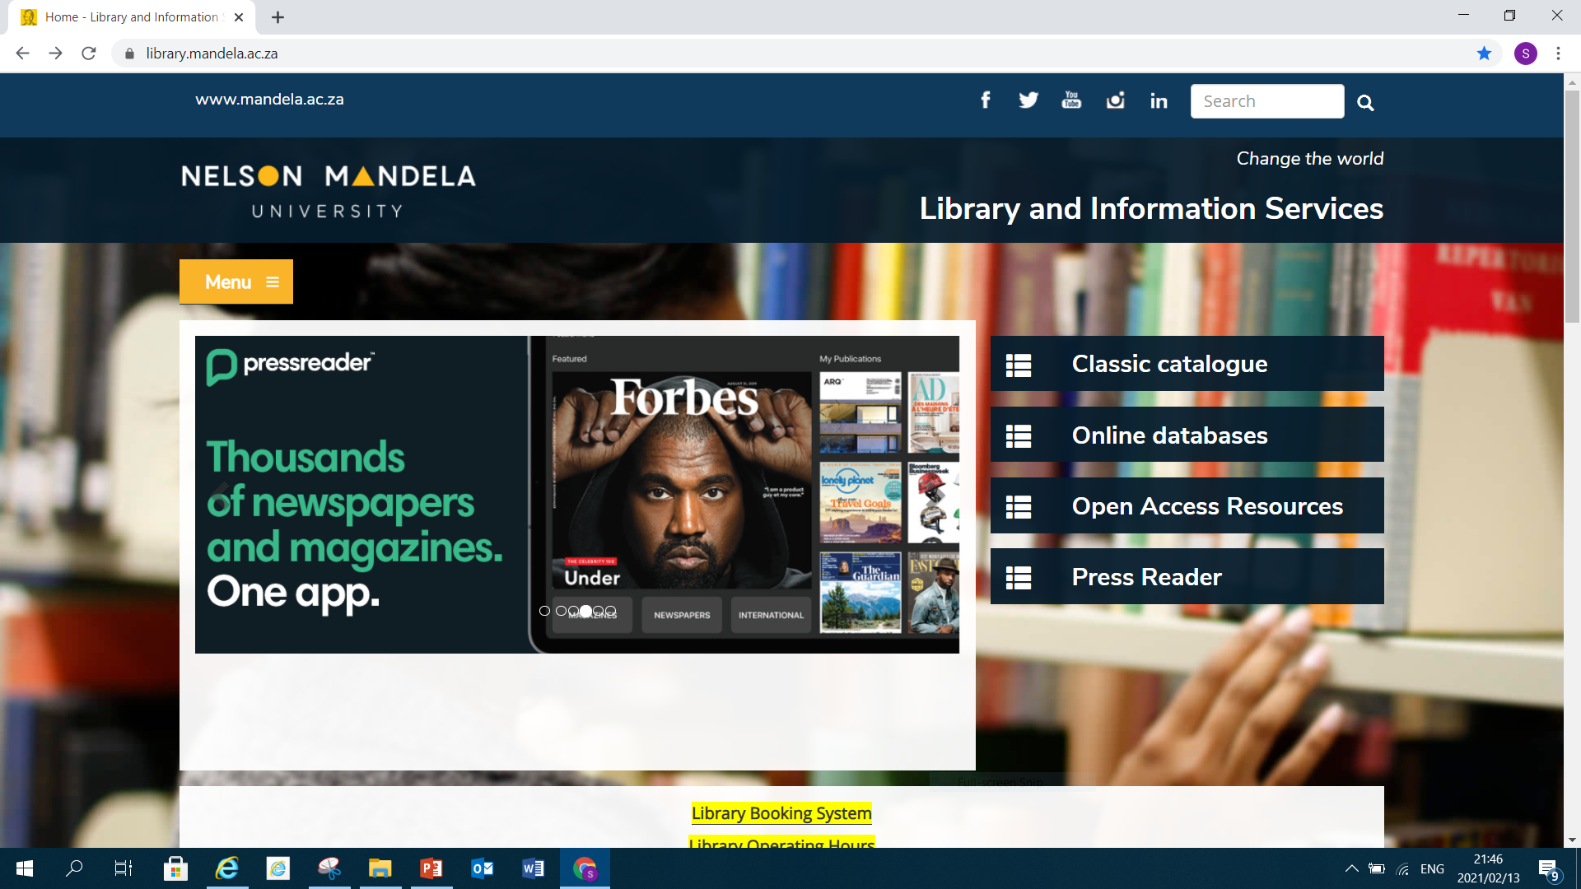
Open the Library database through Google Chrome

Slide 3
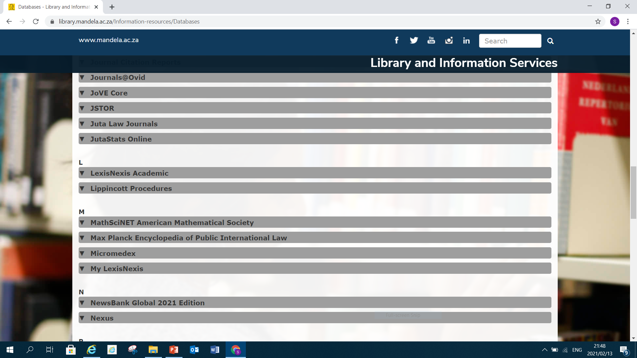
Scroll down and click on JutaStats Online

Slide 4
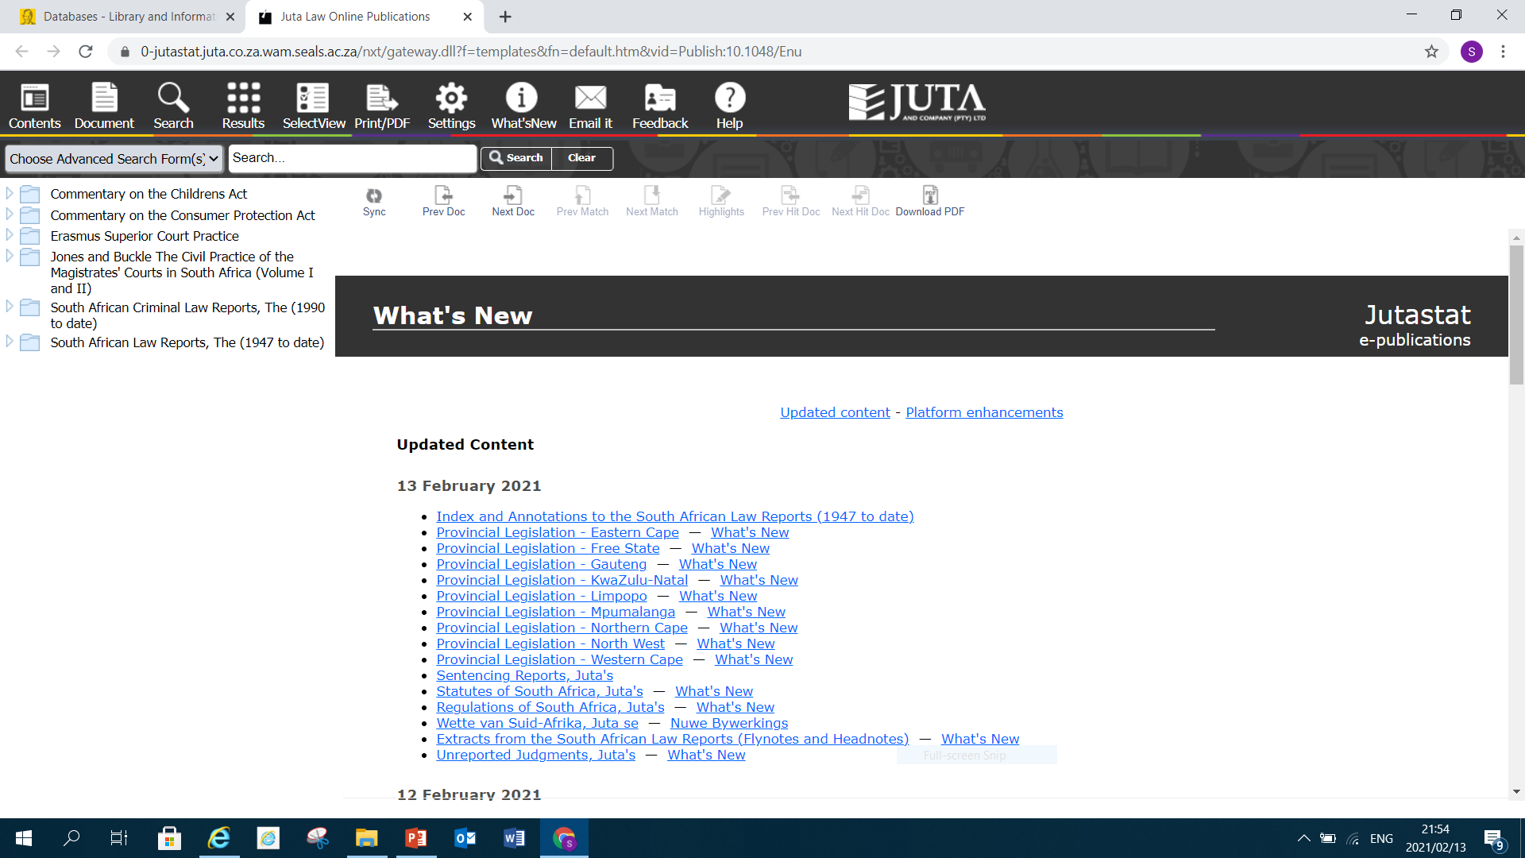

Slide 5
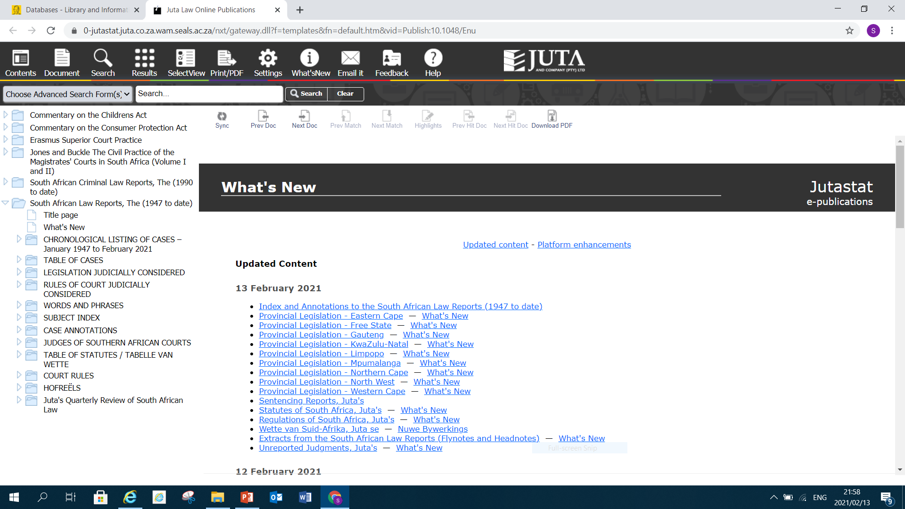
Click on South African Law Report if you are searching for it

Slide 6
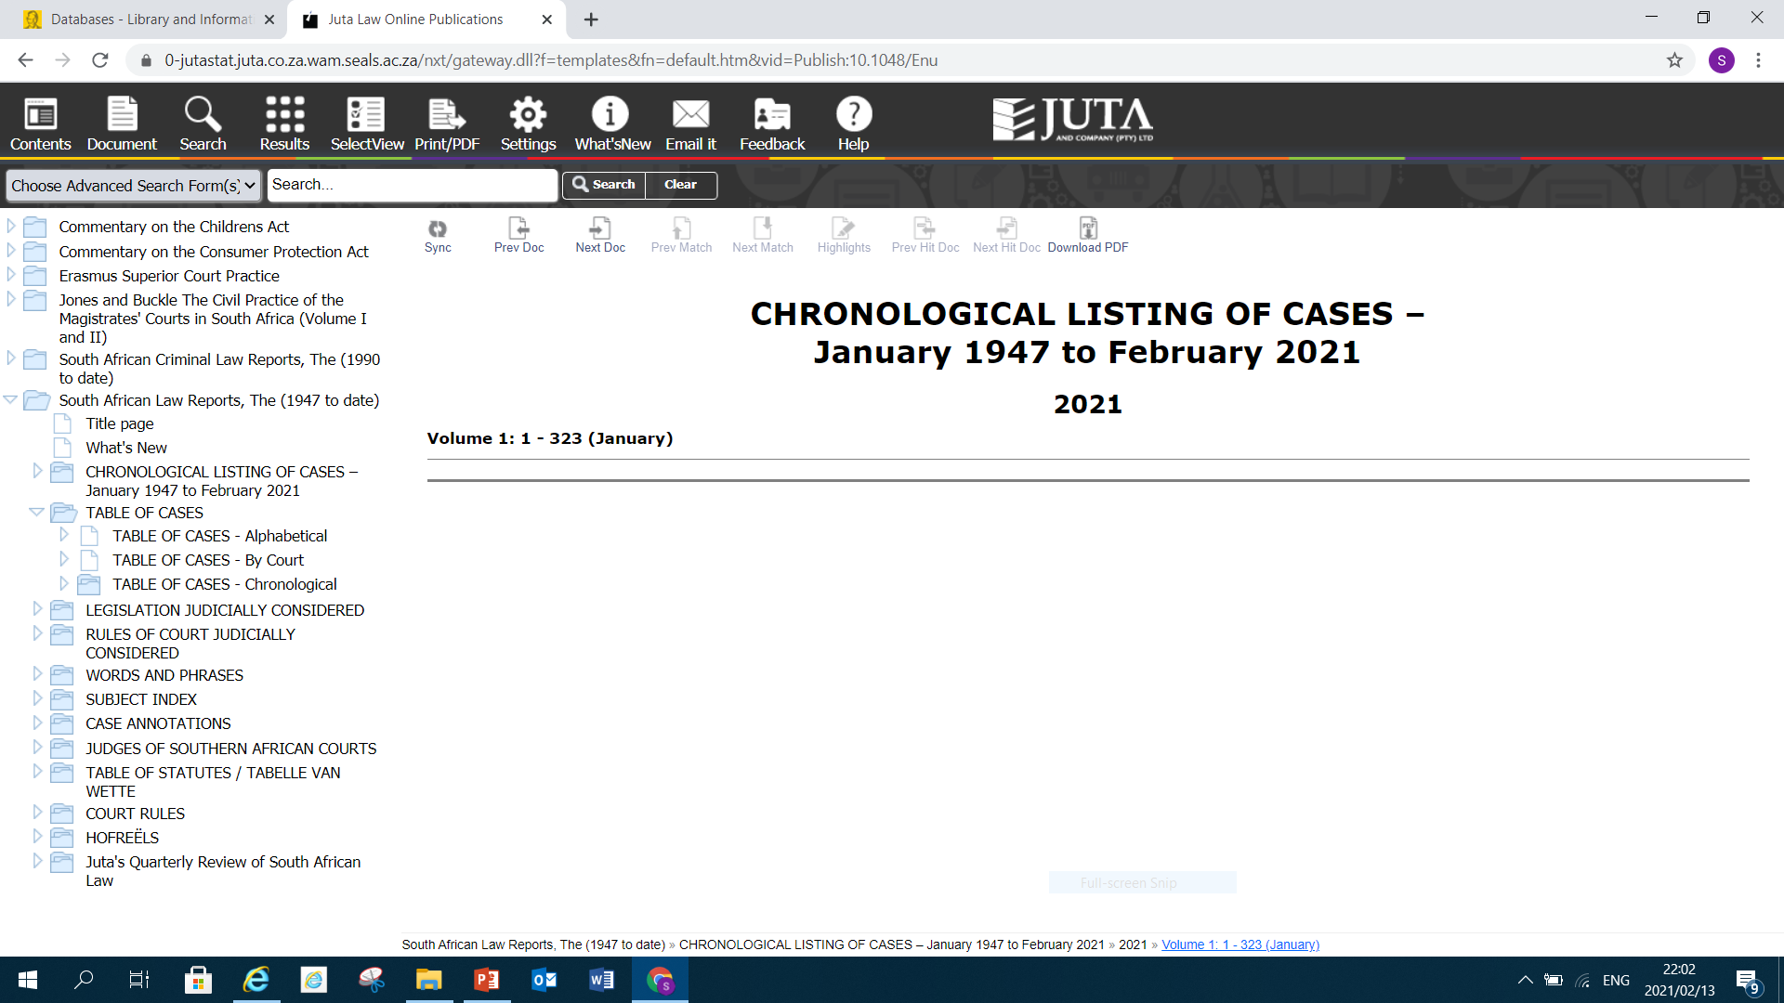
One can either search for the cases Chronological if you have the year of the case of Alphabetical or by Court

Slide 7
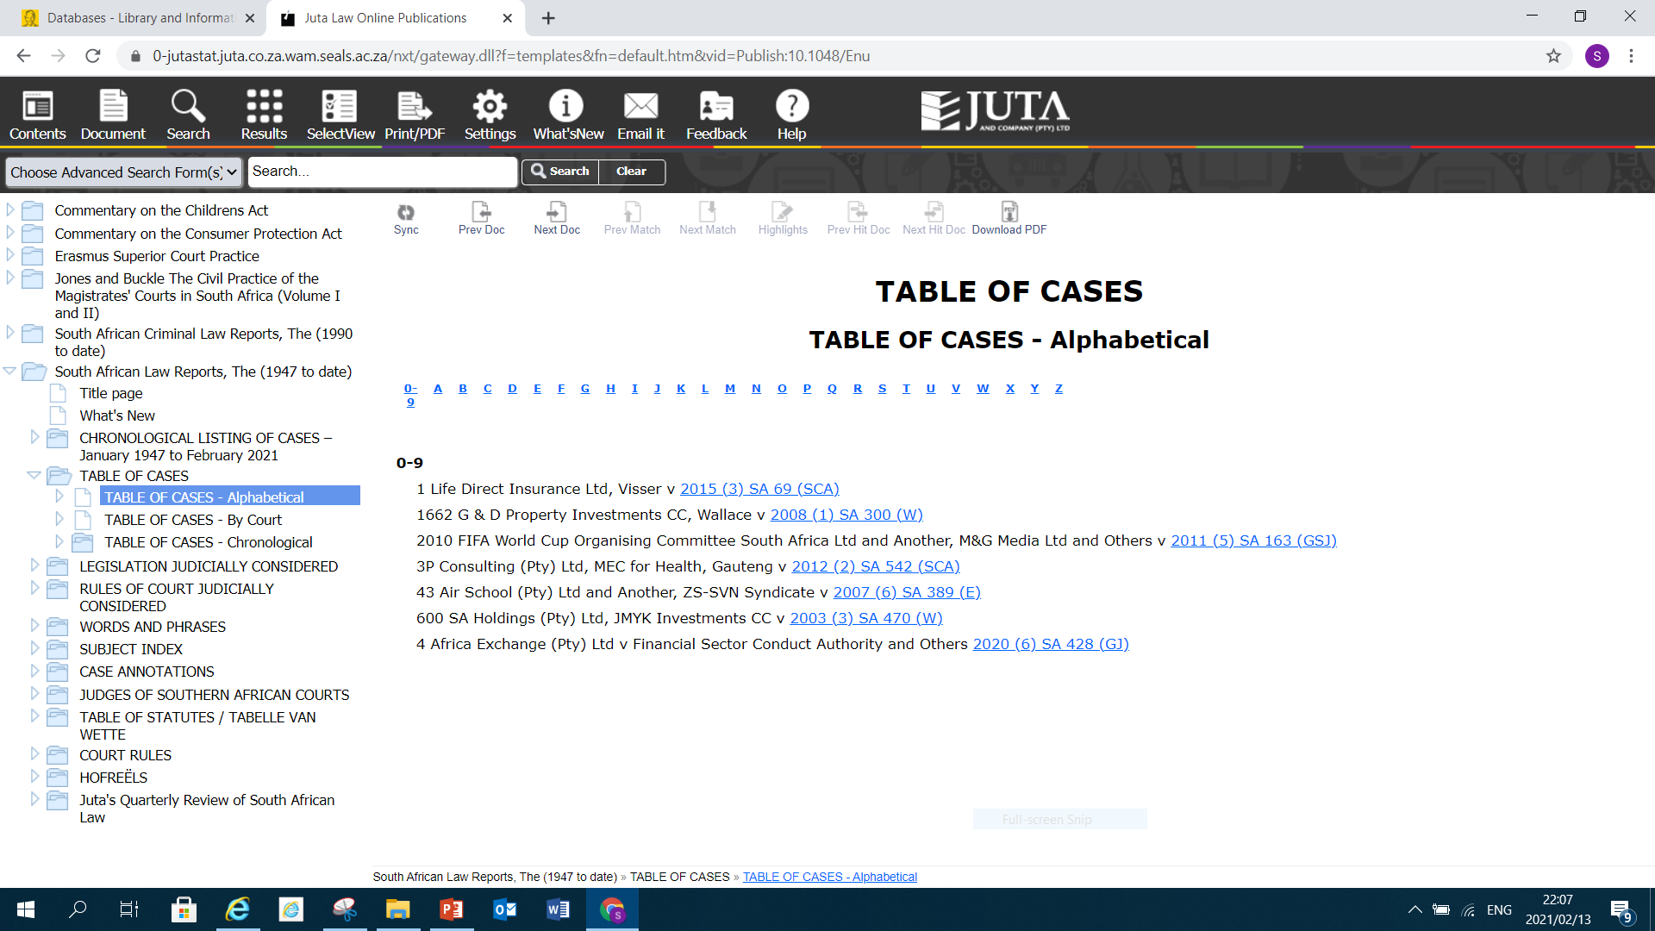
Click Table of cases if you intend to search for cases alphabetical.

Slide 8
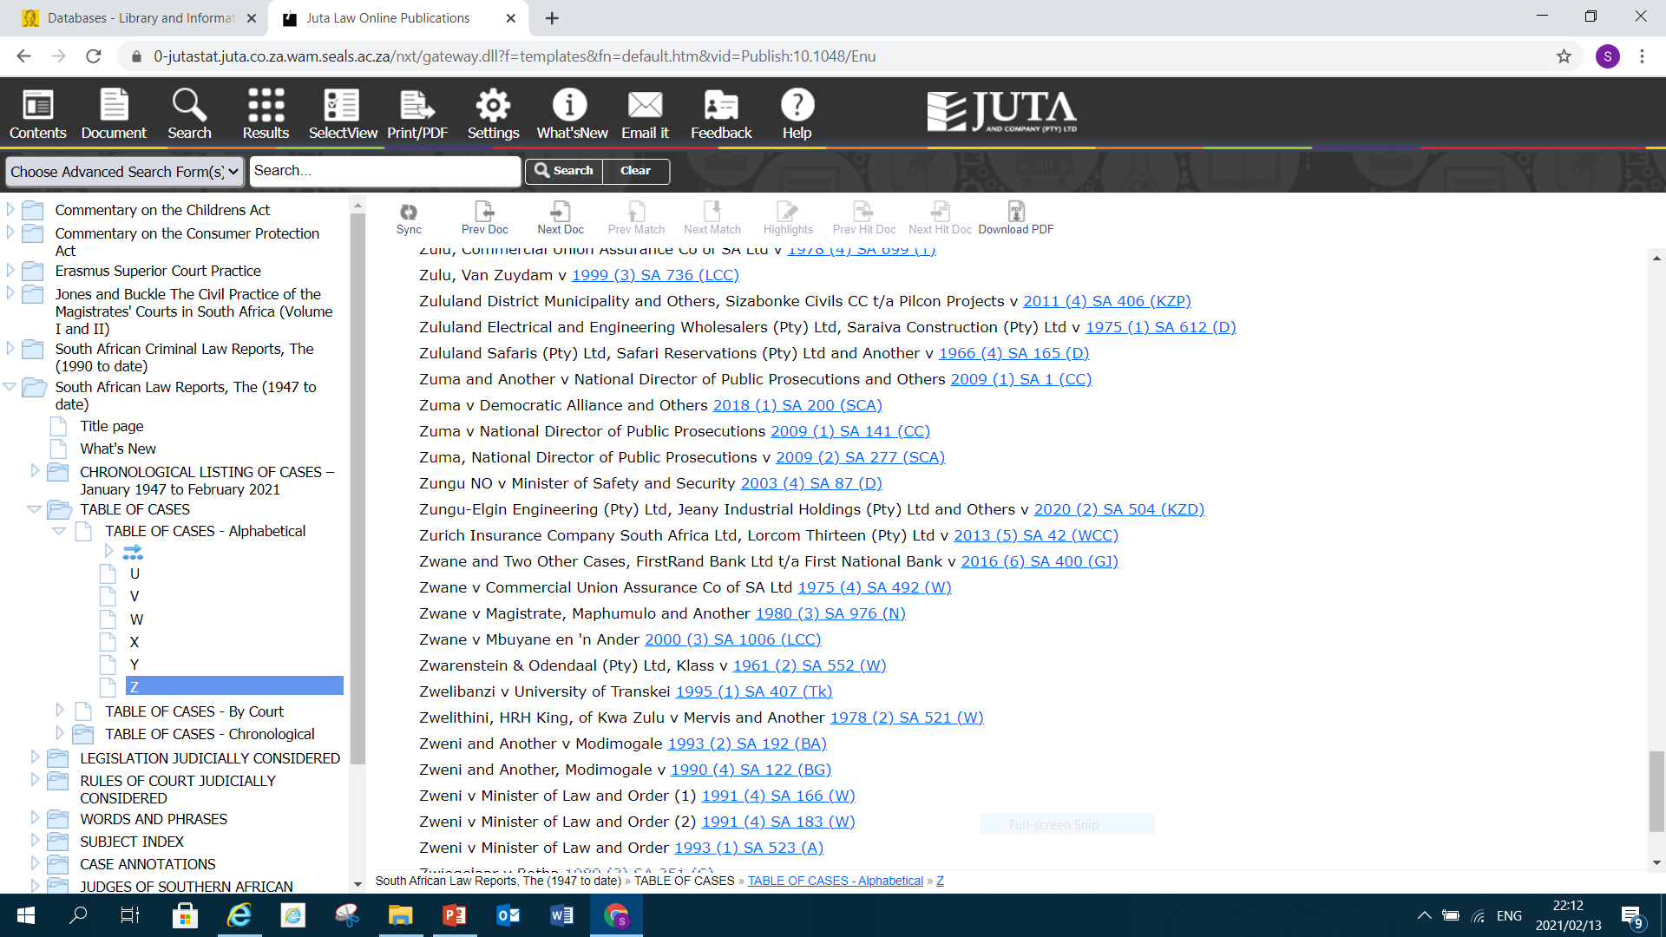
Click “Z” if you are searching for Zuma and Democratic Alliance and others

Slide 9
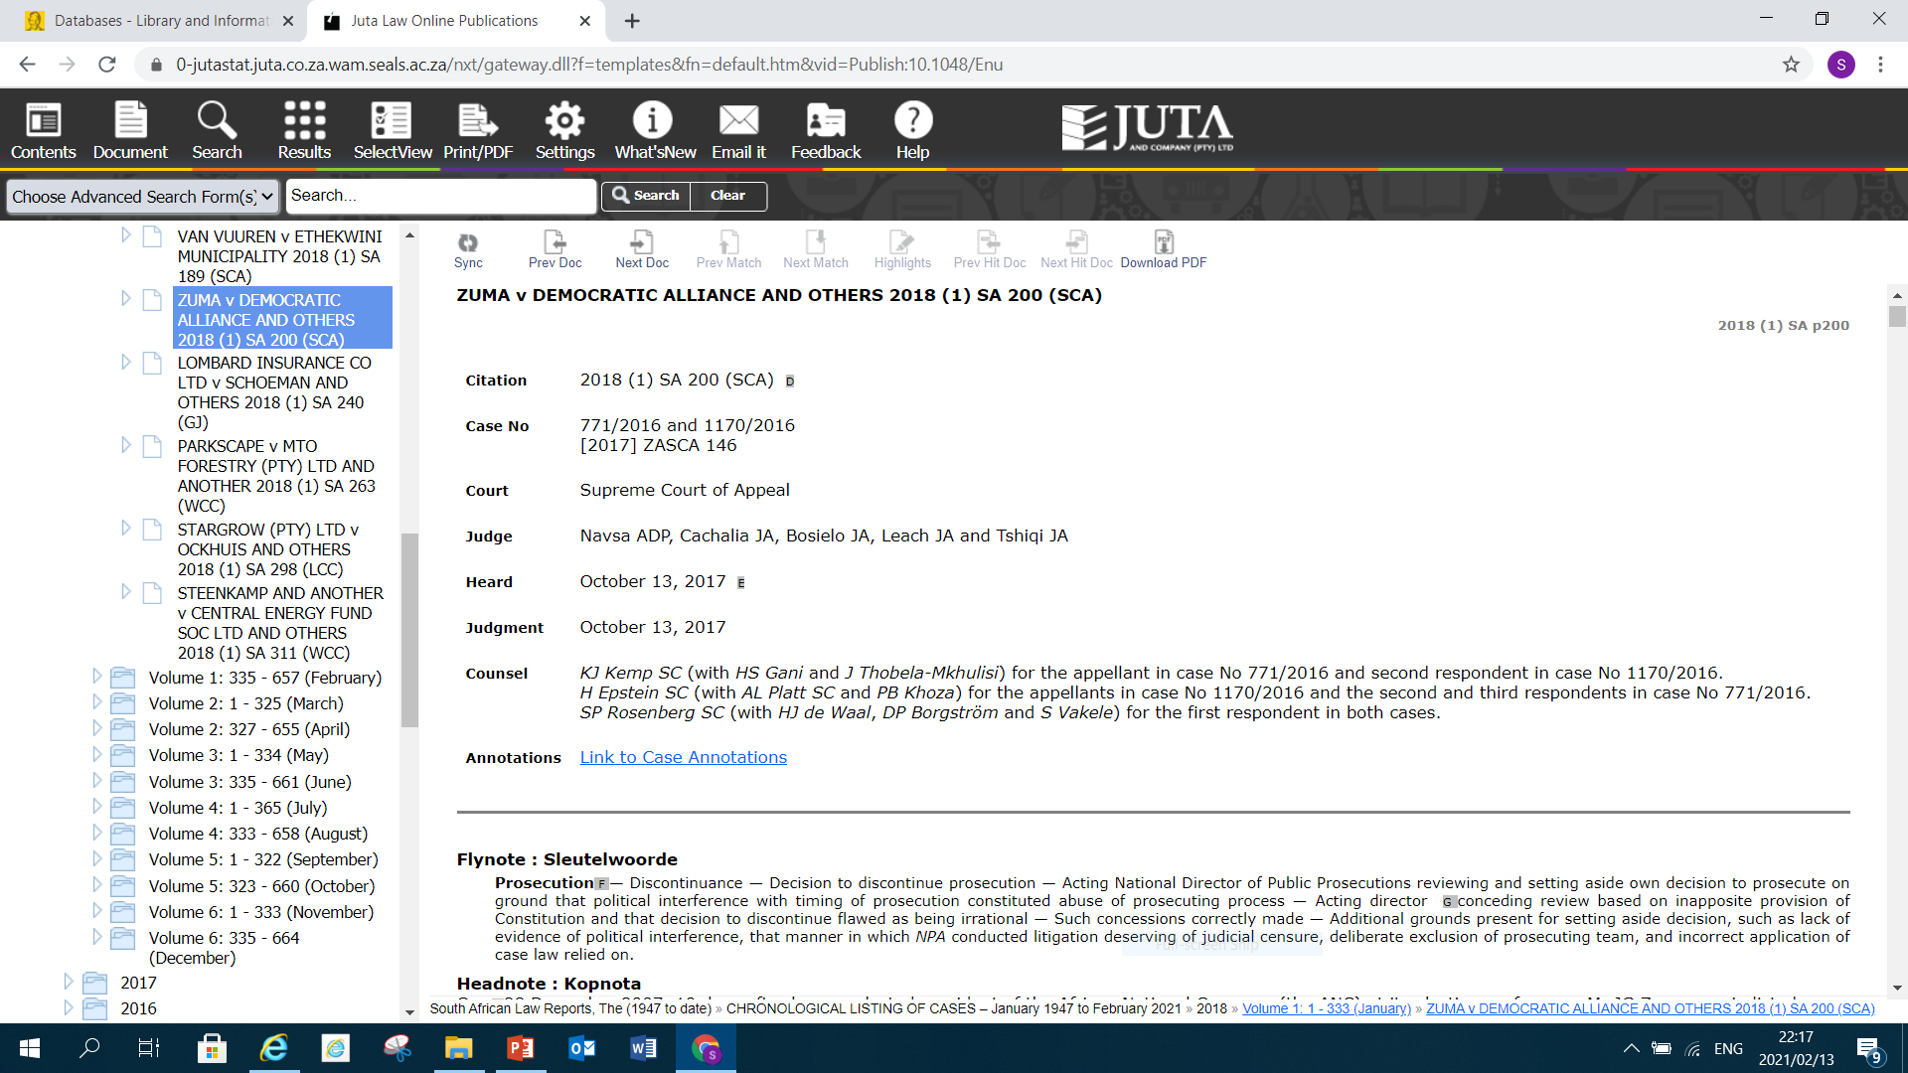
Click on the citation and you will get the full case report.

Slide 10
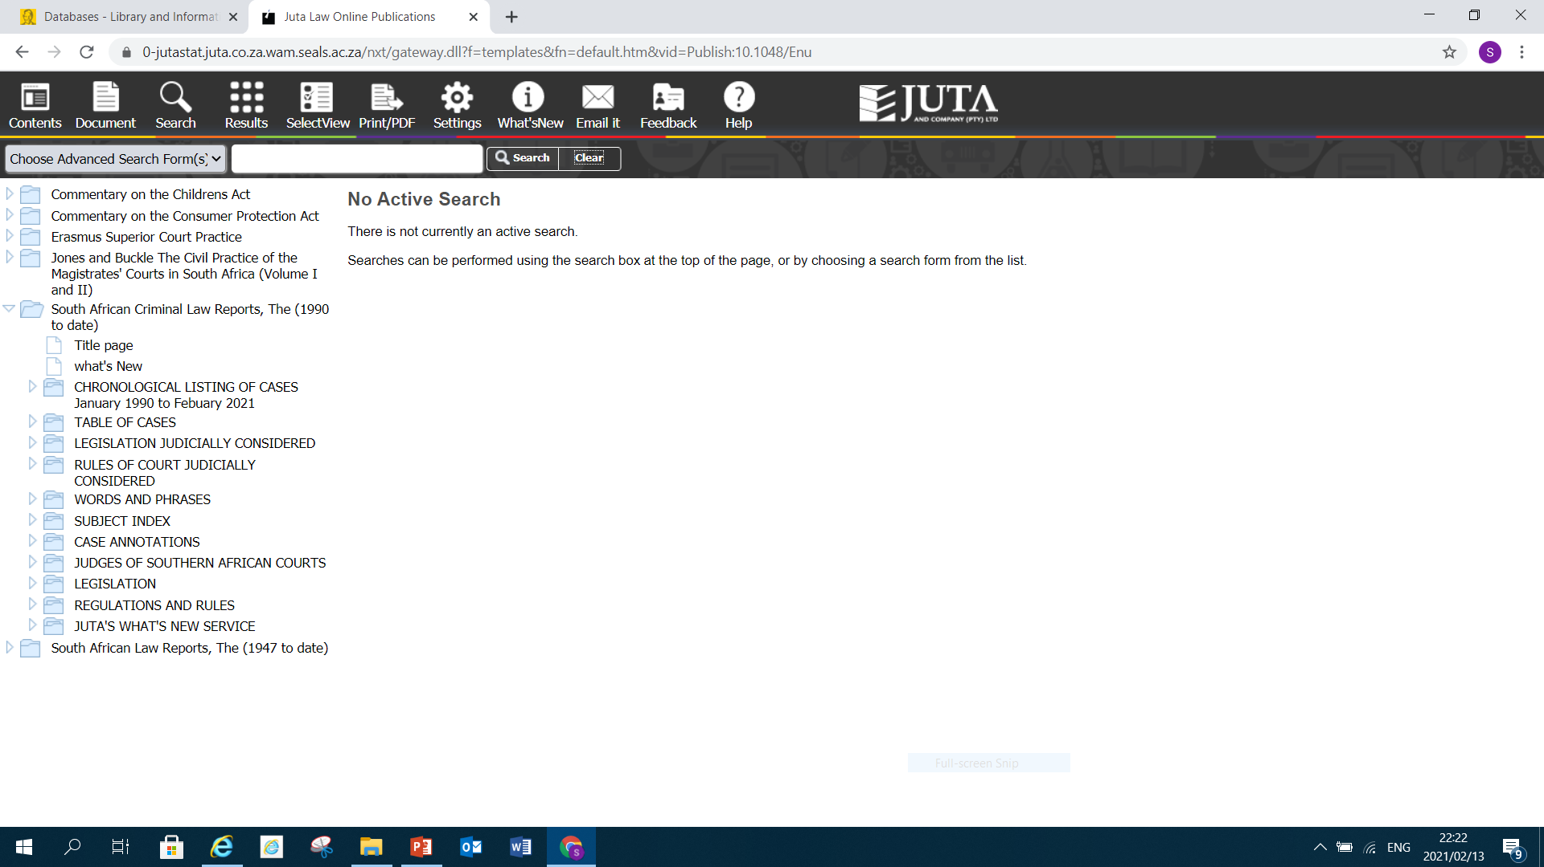
To search for Criminal Law report you use the same strategy used in searching for the Law Report
If you intend to search for a case using chronological option it important to have the correct citation

Slide 11
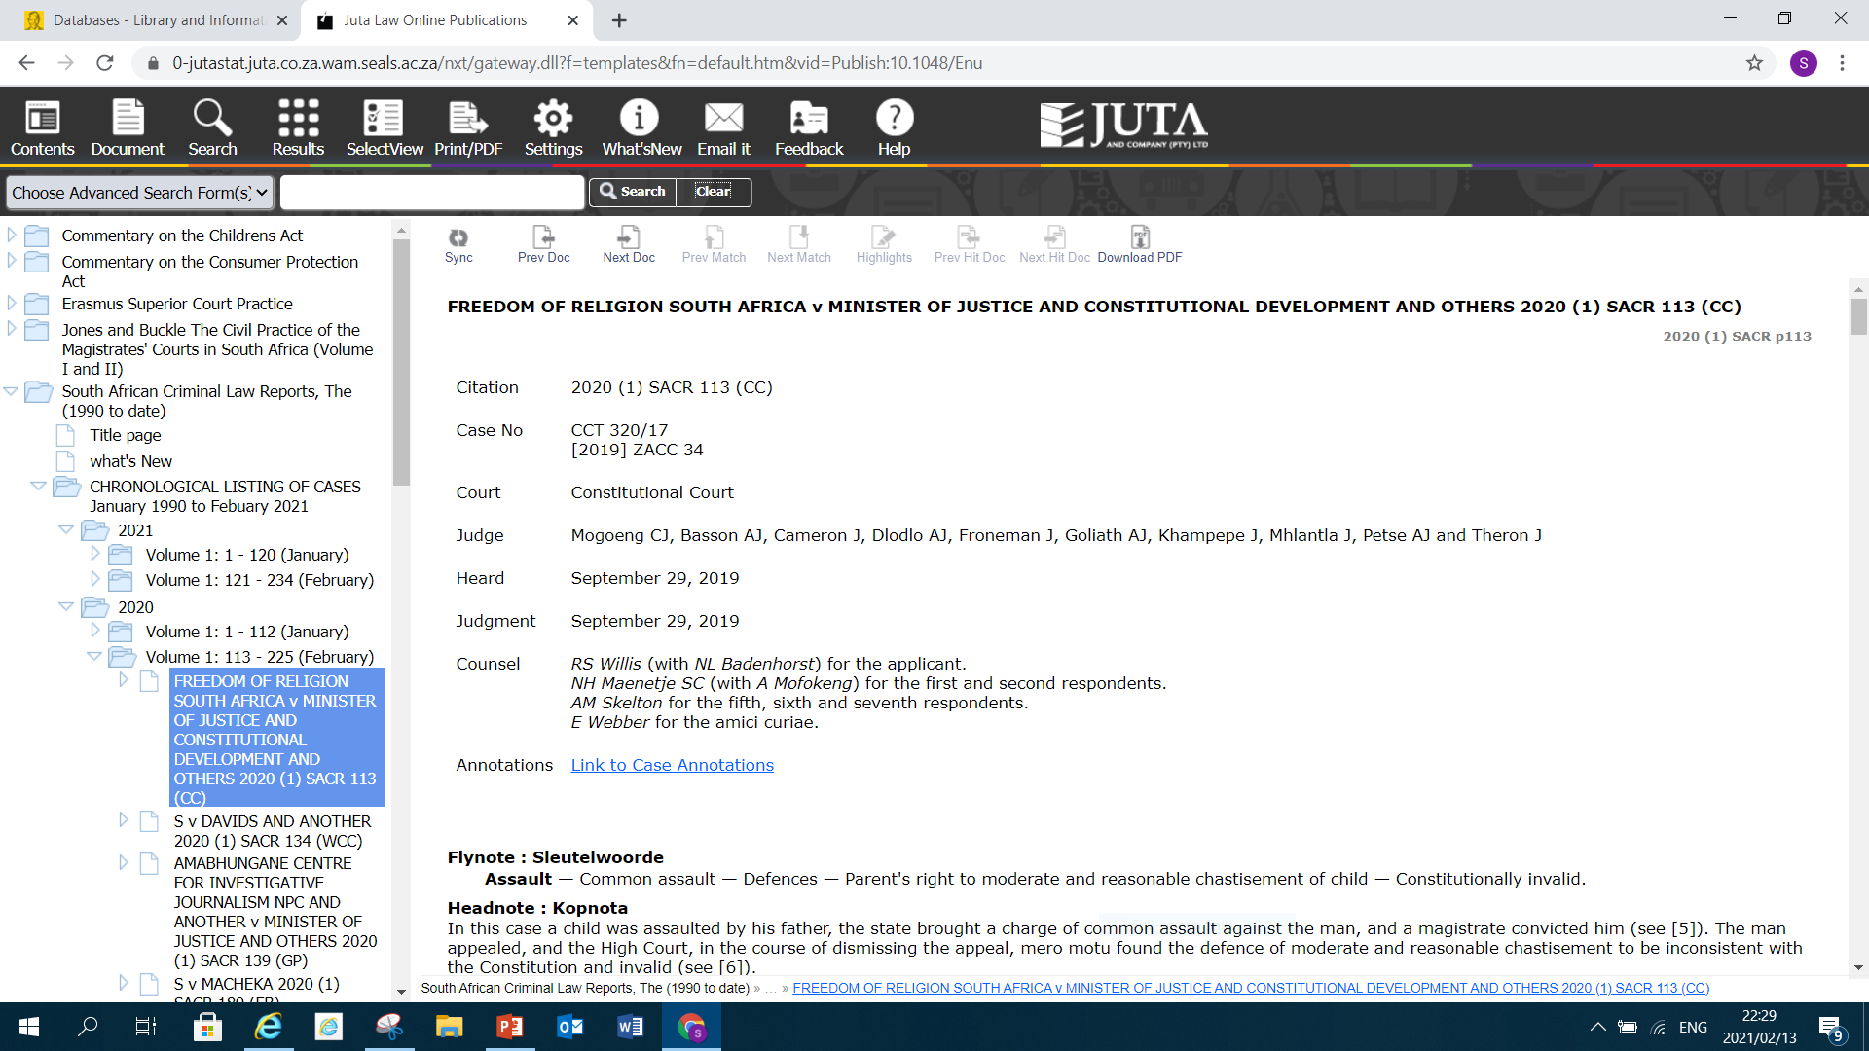
The below Criminal Law Report was searched using chronological listing of cases.

Slide 12
THANK YOU

