Slide 1
Locating books using Classic Catalogue

Slide 2
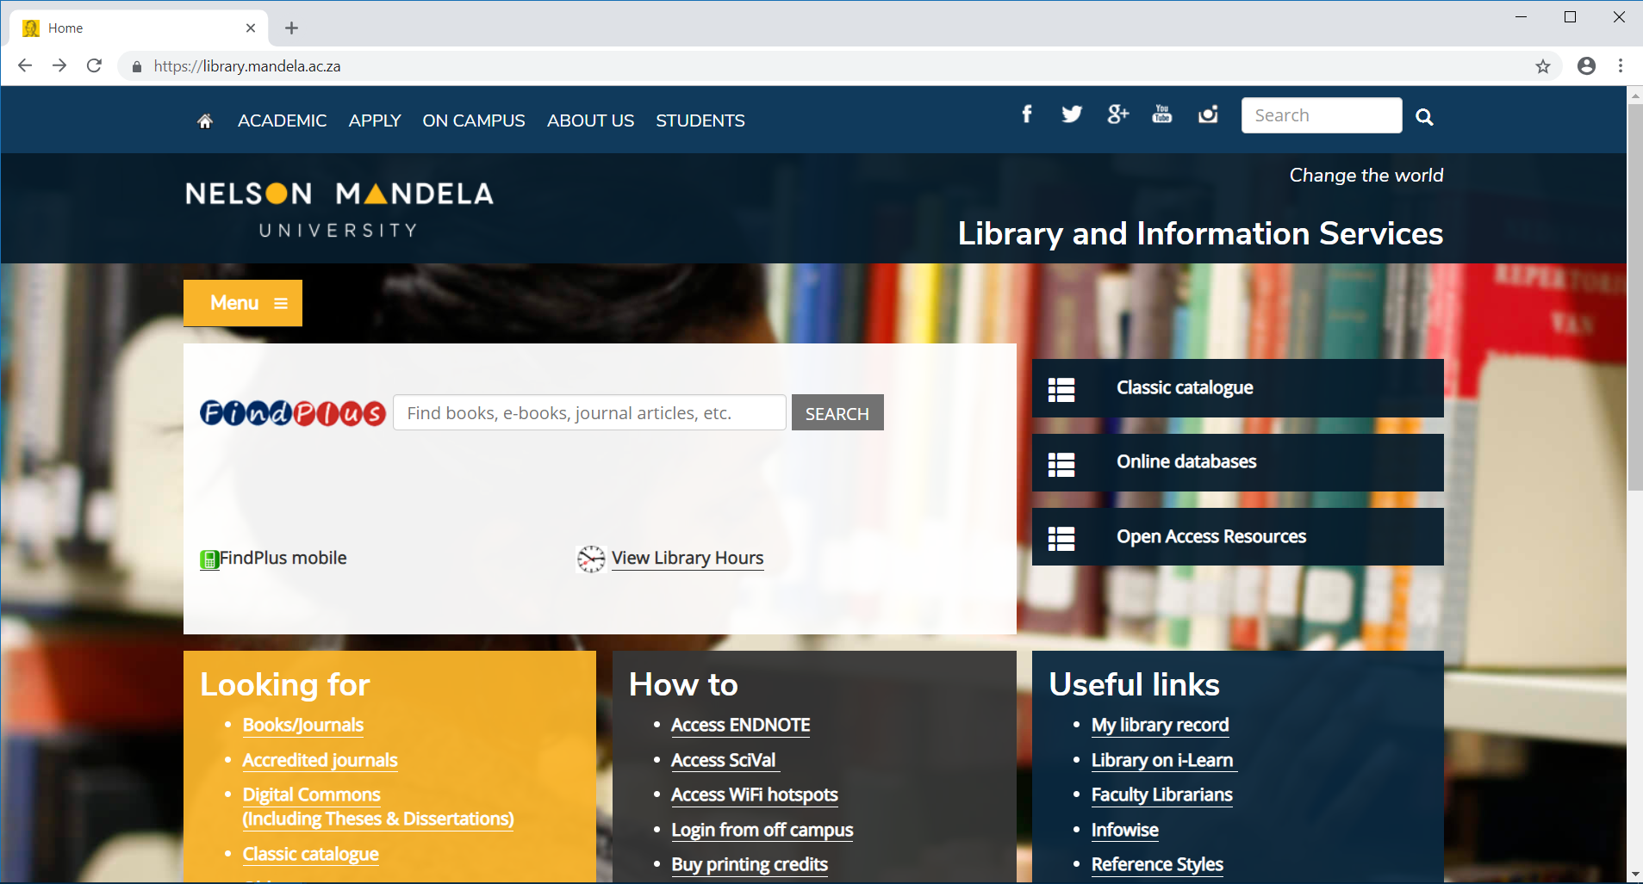
Access Library database through Google Scholar and click Classic Catalogue

Slide 3
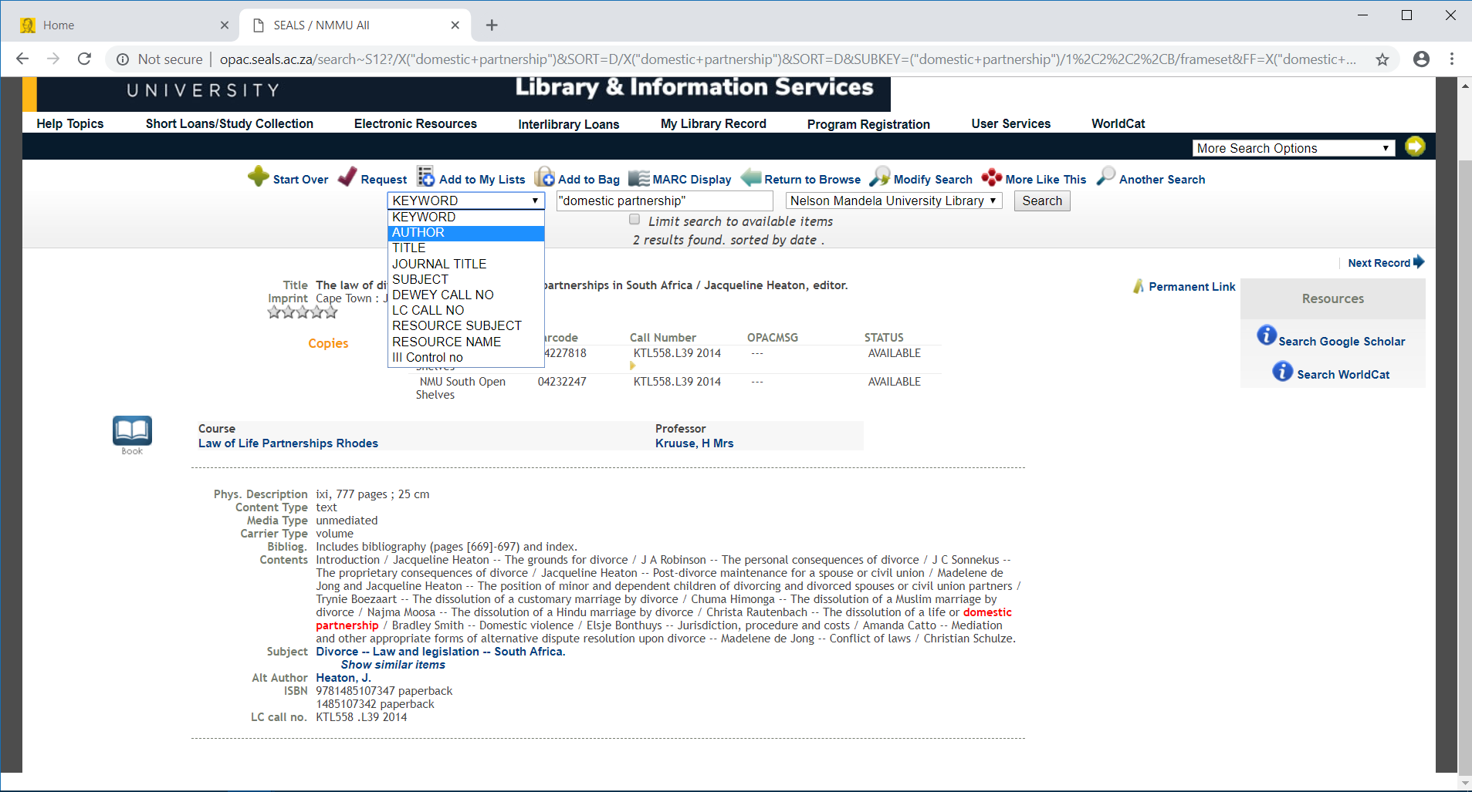
Searching the book using phrases;

Slide 4
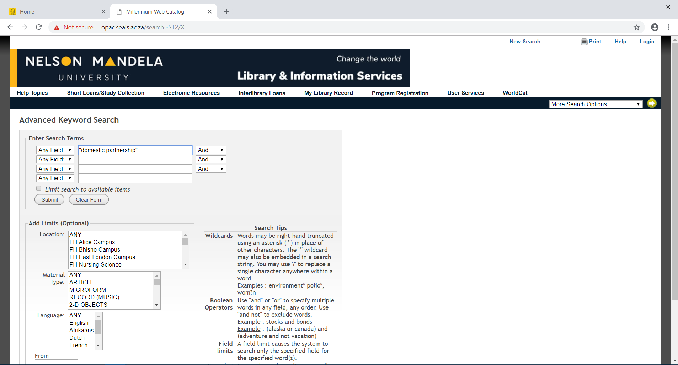
Advanced search - Search for the phrase “domestic partnerships”
Keyword search, use “… “ for a phrase

Slide 5
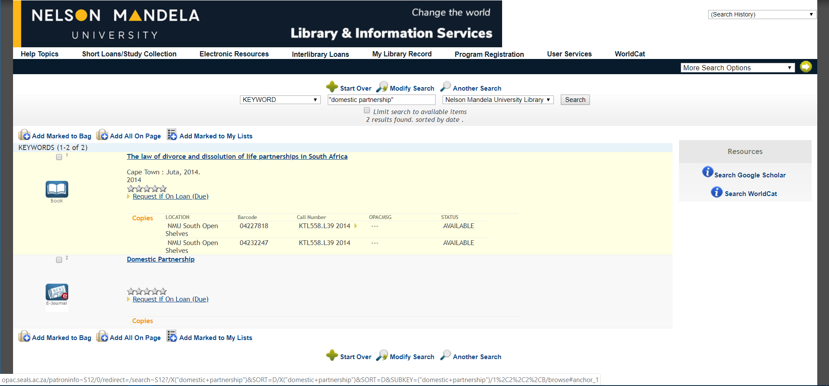
See the results retrieved: Two types of two books print and eBook.
Publication
Location
Call Number

Slide 6
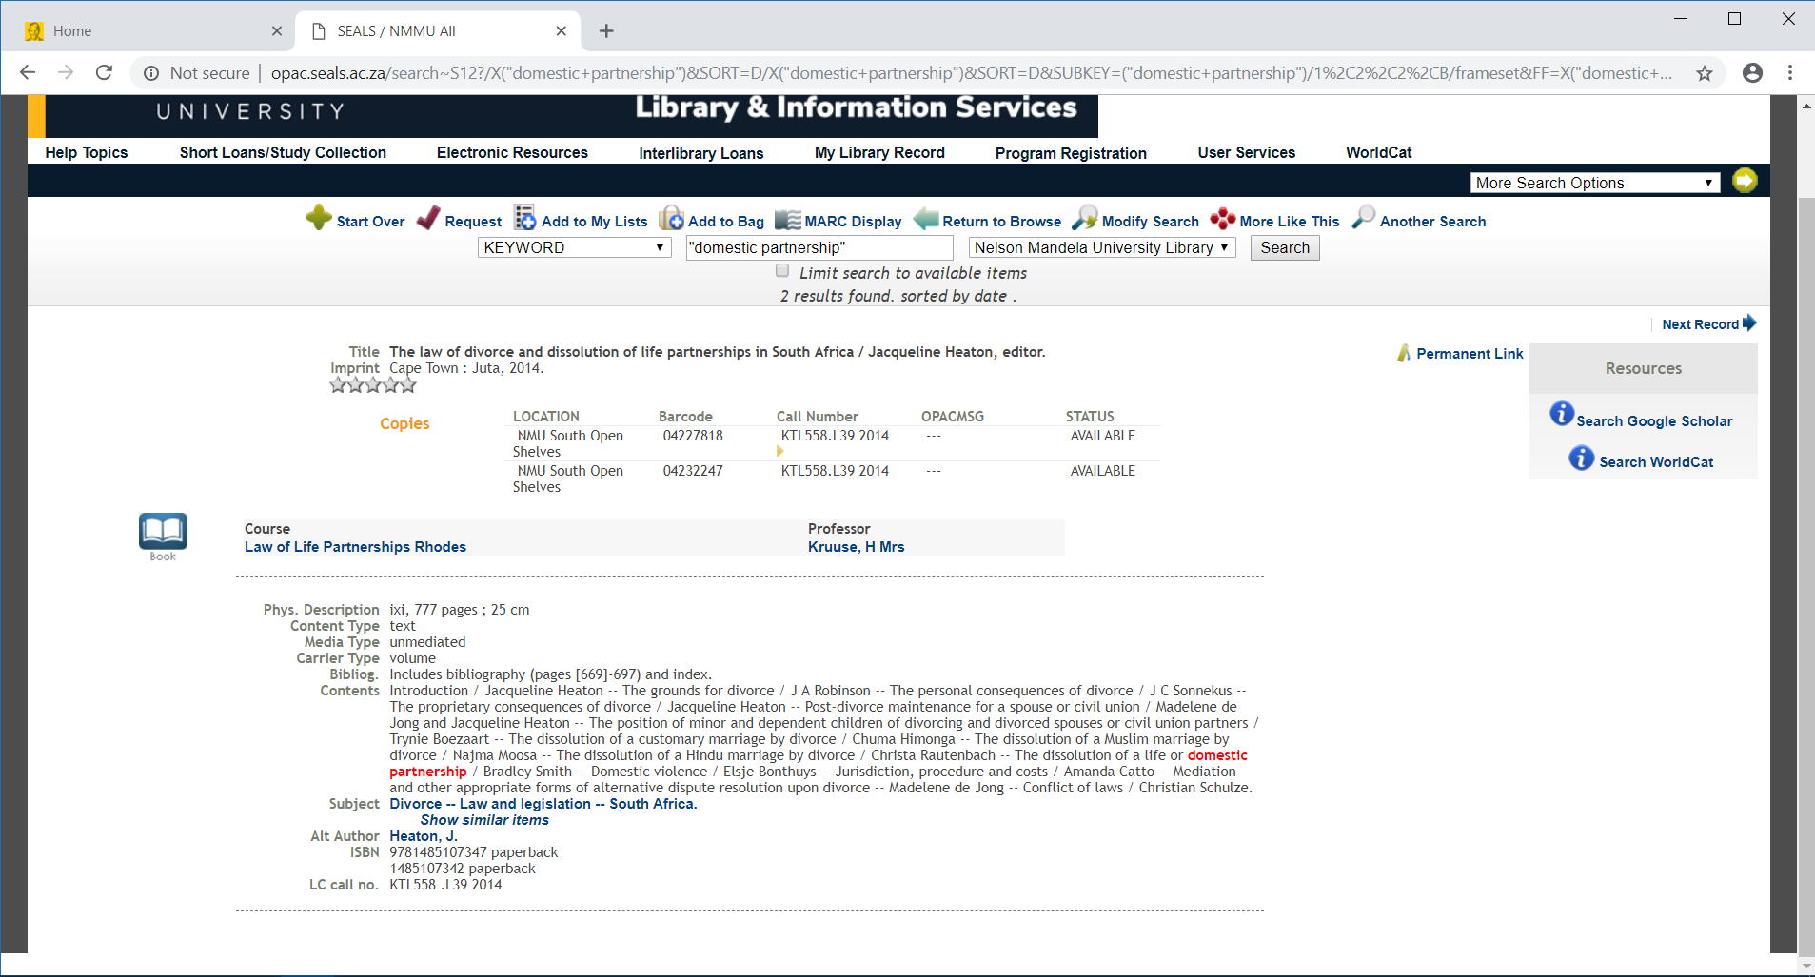
Full description of the book

Slide 7
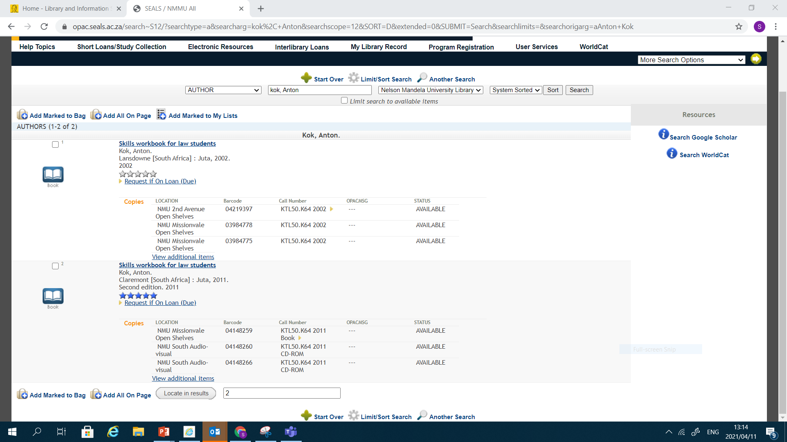
Alternatively you can search for the books using author

Slide 8
Thank you.

