Slide 1
Searching the Legislation. Acts – called Legislation or Statutes. (You may use the hardcopies or the online materials)

Slide 2
Open the library database through
Google Chrome: https://library.mandela.ac.za/

Slide 3
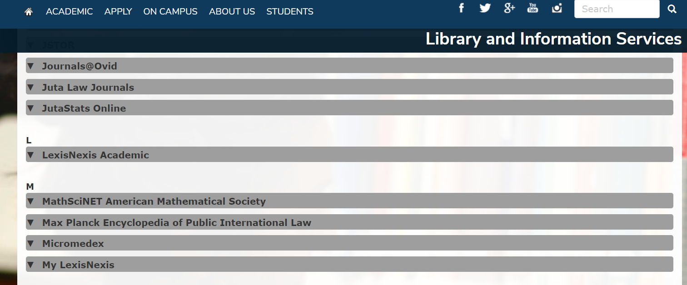
Select My LexisNexis

Slide 4
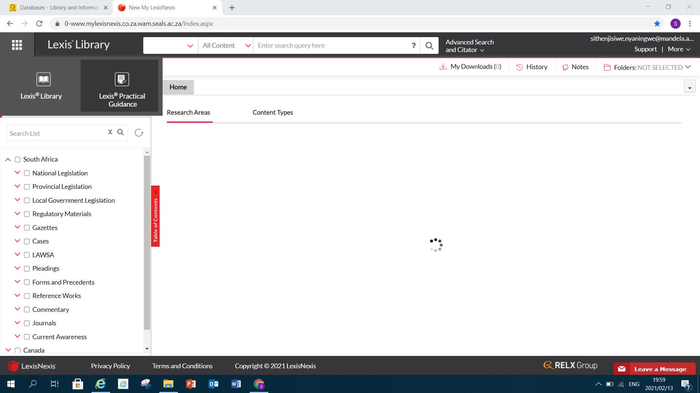
Click on National Legislation

Slide 5
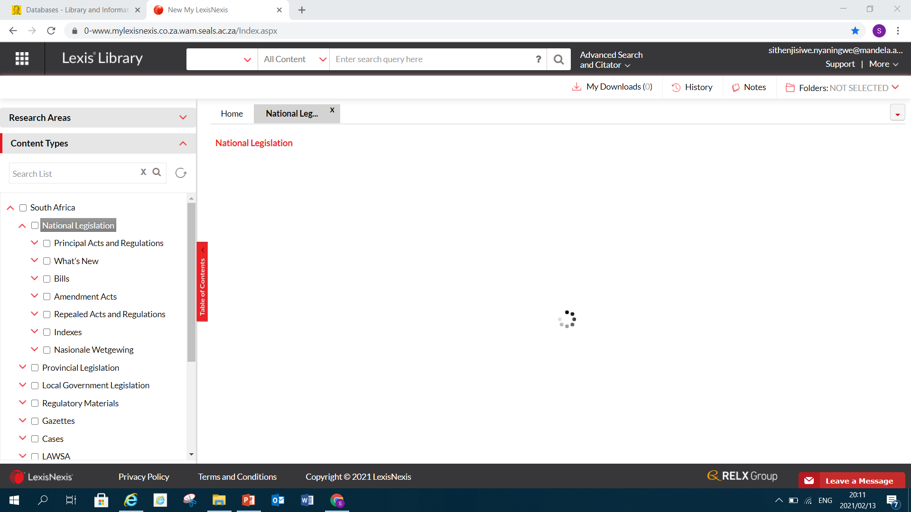
Click on National Legislation

Slide 6
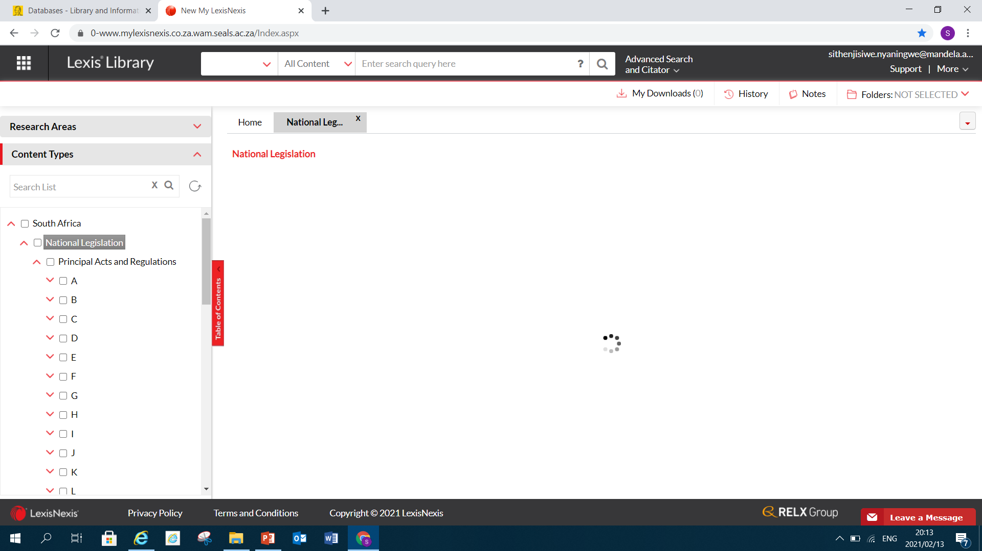
Click on drop down menu. Acts are arranged alphabetically. Select the required Act: for example Children’s Act No 38 of 2005 you will select C

Slide 7
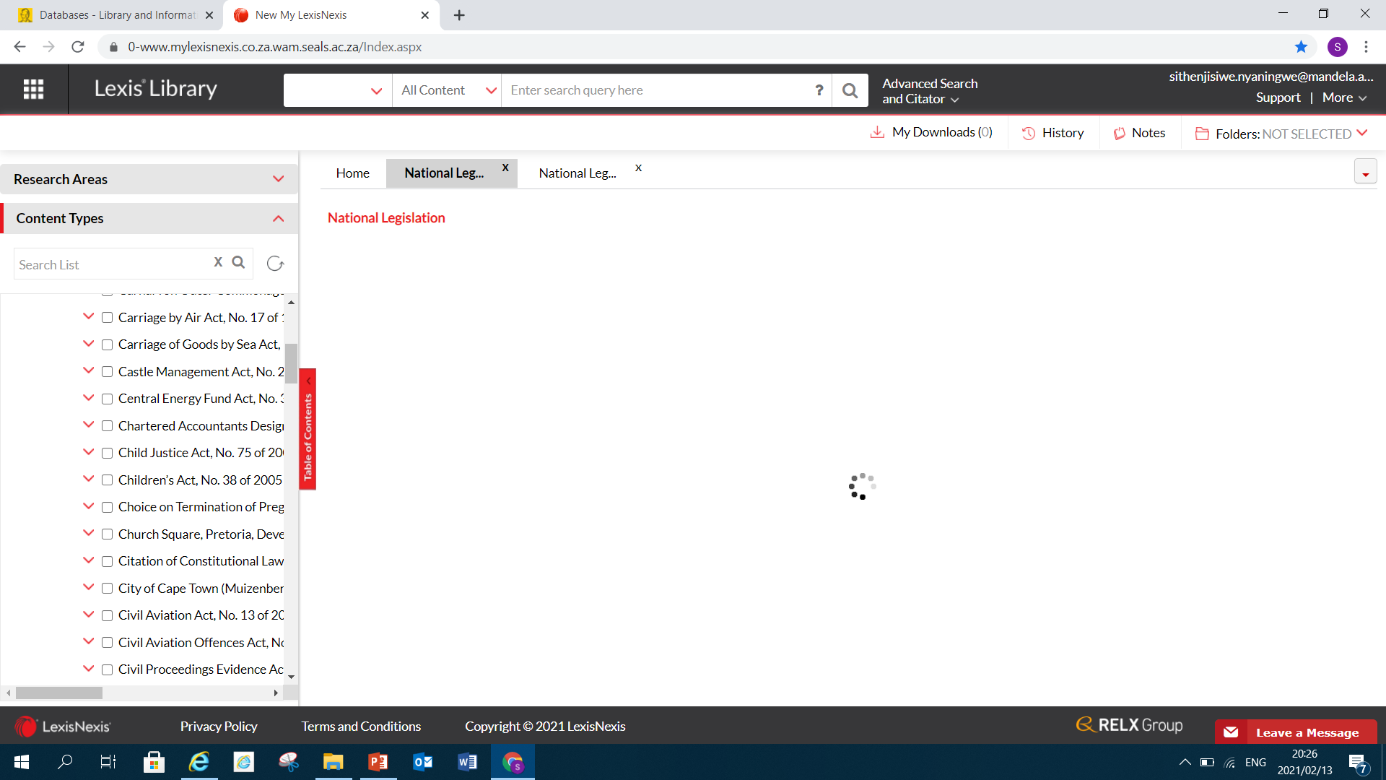
Scroll down and select the Children’s Act No 38 of 2005

Slide 8
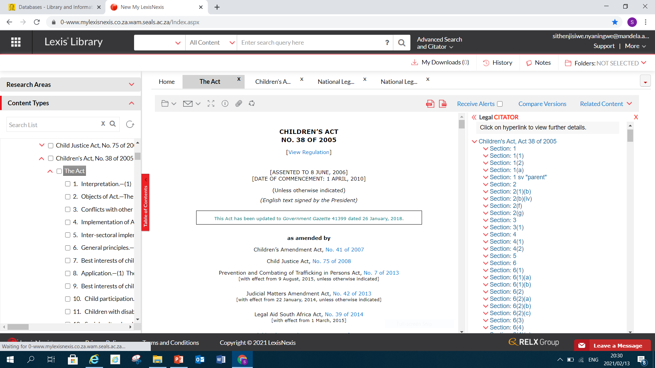
Click on the Act and you see all the relevant information pertaining the Act: scroll further down the Act to search for parental responsibility for unmarried fathers

Slide 9
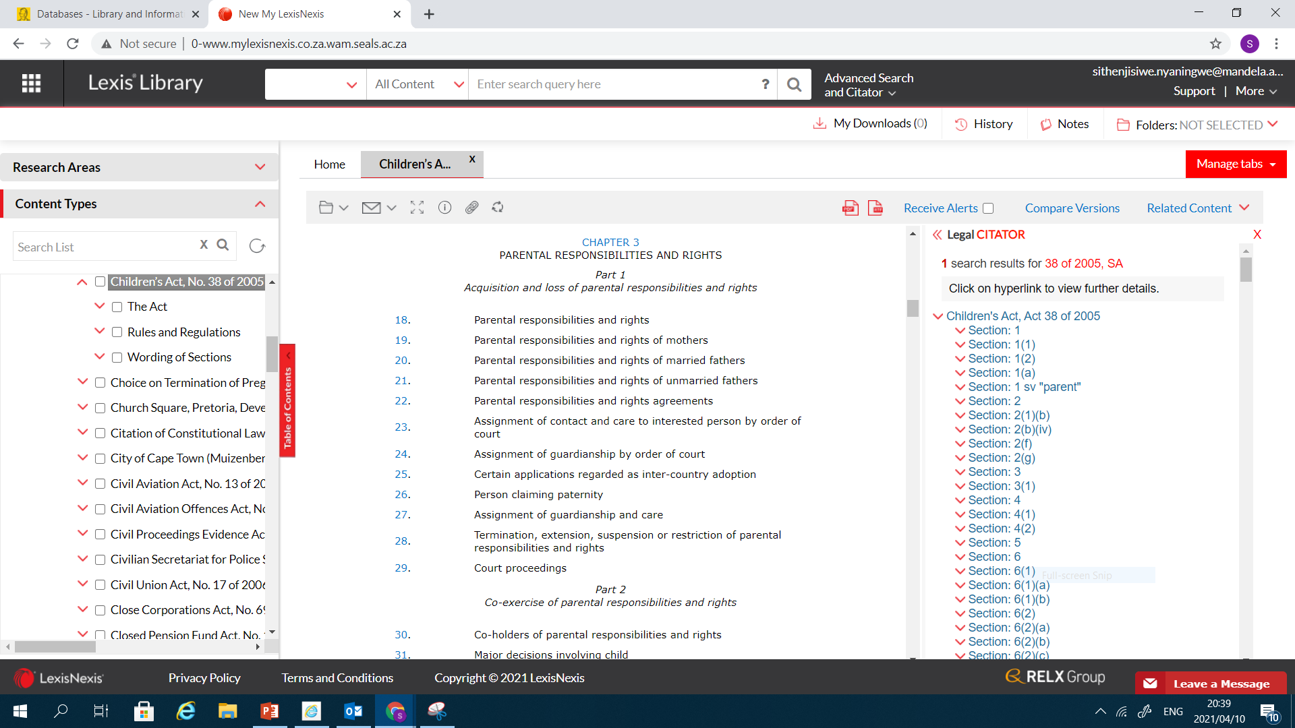

Slide 10
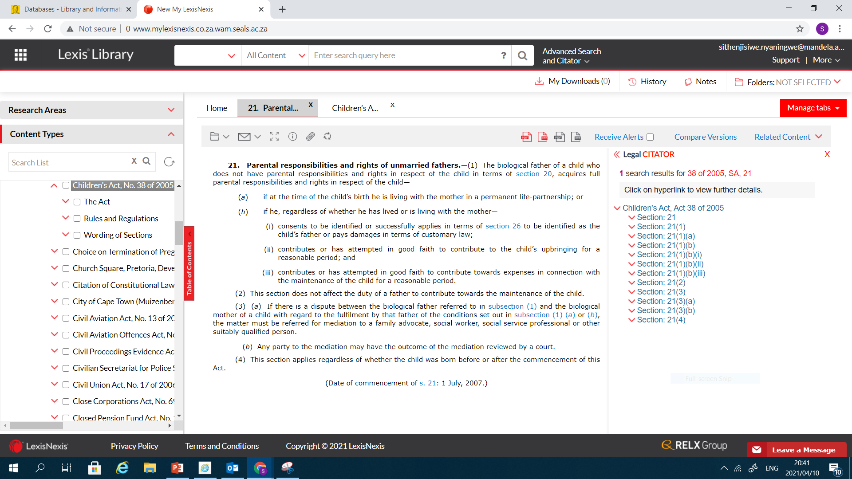

Slide 11
THANK YOU

