Slide 1
libguides.sun.ac.za/law SA LAW REPORTS

Slide 2
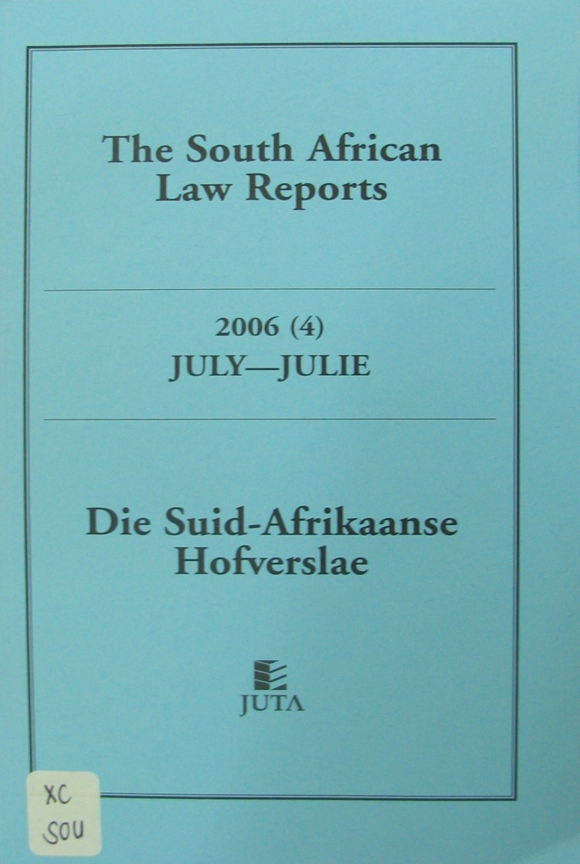
SOUTH AFRICAN LAW REPORTS

Slide 3
SOUTH AFRICAN LAW REPORTS
Uitsprake van die Hoër Hof
(ook SCA en CC)
Uitgewer: JUTA
Maandeliks
6 gebonde dele per jaar.
Raknommer XC SOU
Verwysing:
2020 (1) SA 1 (CC)
Judgments of High Court
(also SCA and CC)
Publisher :JUTA
Monthly
6 bound volumes annually.
Shelf No XC SOU
Reference:
2020 (1) SA 1 (CC)

Slide 4
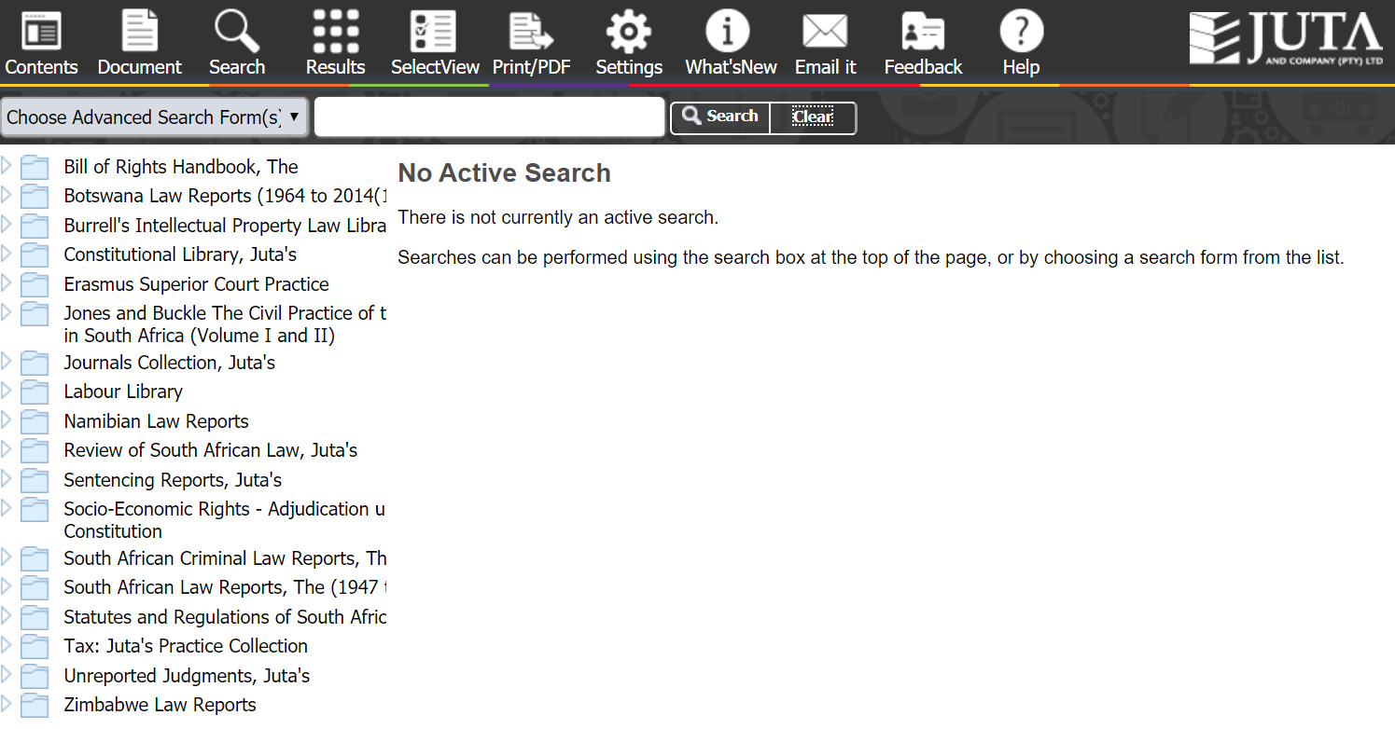
SA LAW REPORTS

Slide 5
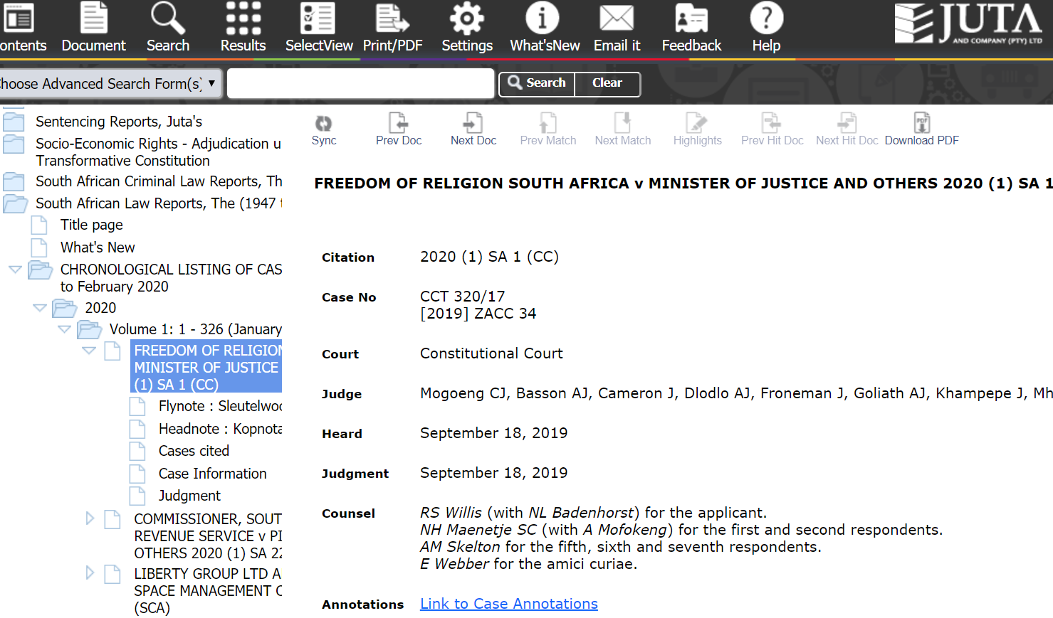

Slide 7
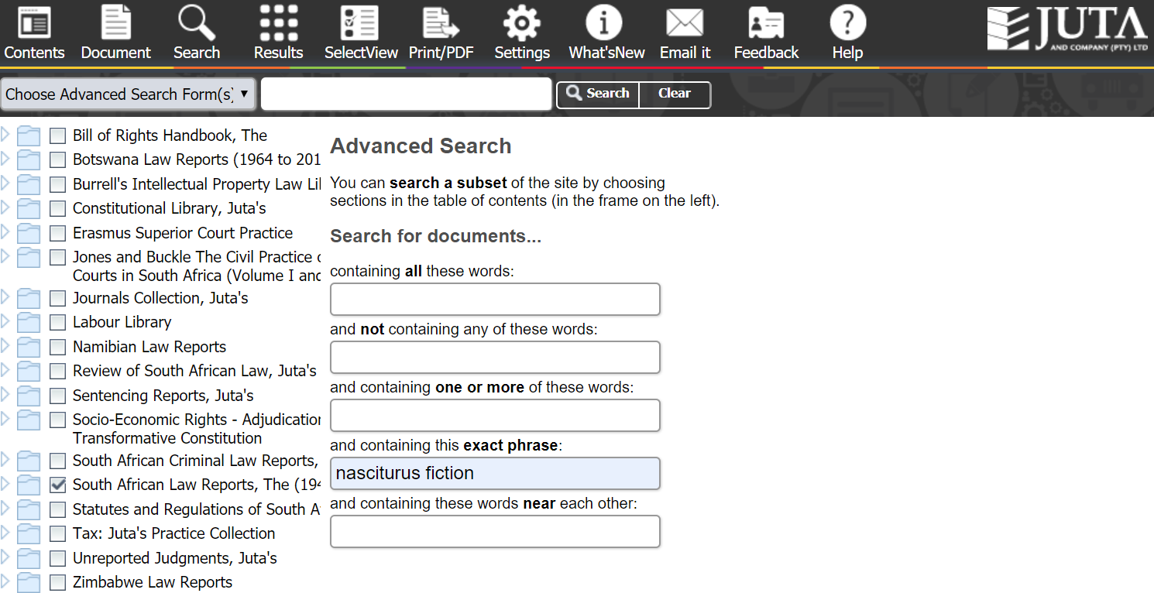
Use Advanced Search
Enter your keywords or subject

Slide 8
Click on case citation to read law report

Slide 9
All South African Law Reports (All SA)

Slide 10
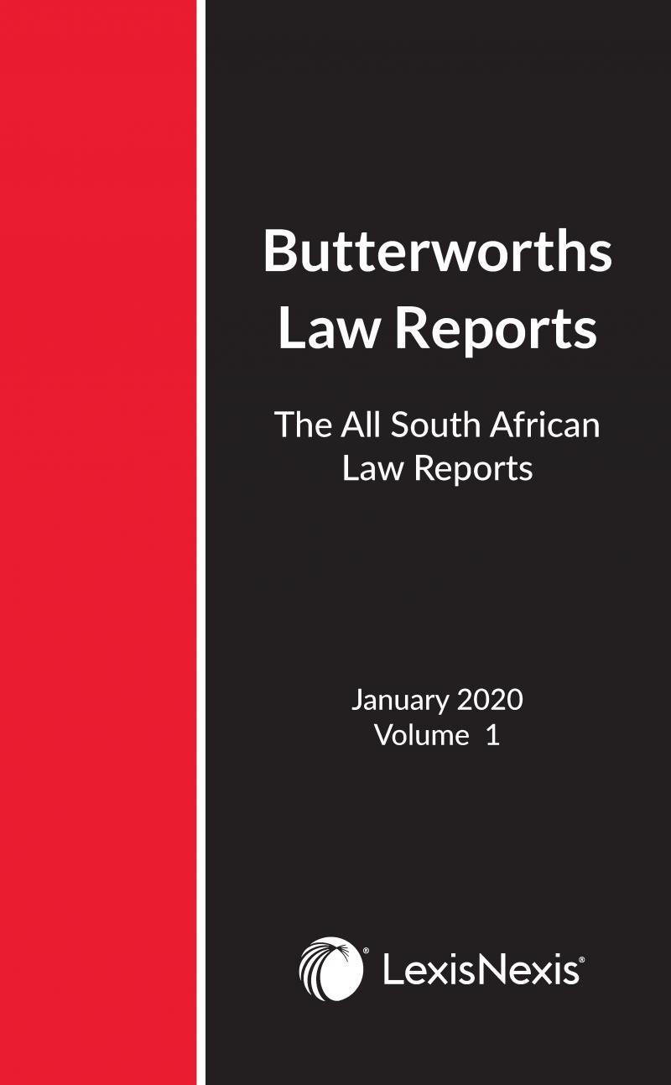
All South African Law Reports (All SA)
Weekliks gepubliseer
Published weekly
Uitgewer / Publisher
LEXISNEXIS Butterworths
Citation:
[2020] 1 All SA 1 (SCA)
Shelf number: X ALL

Slide 11
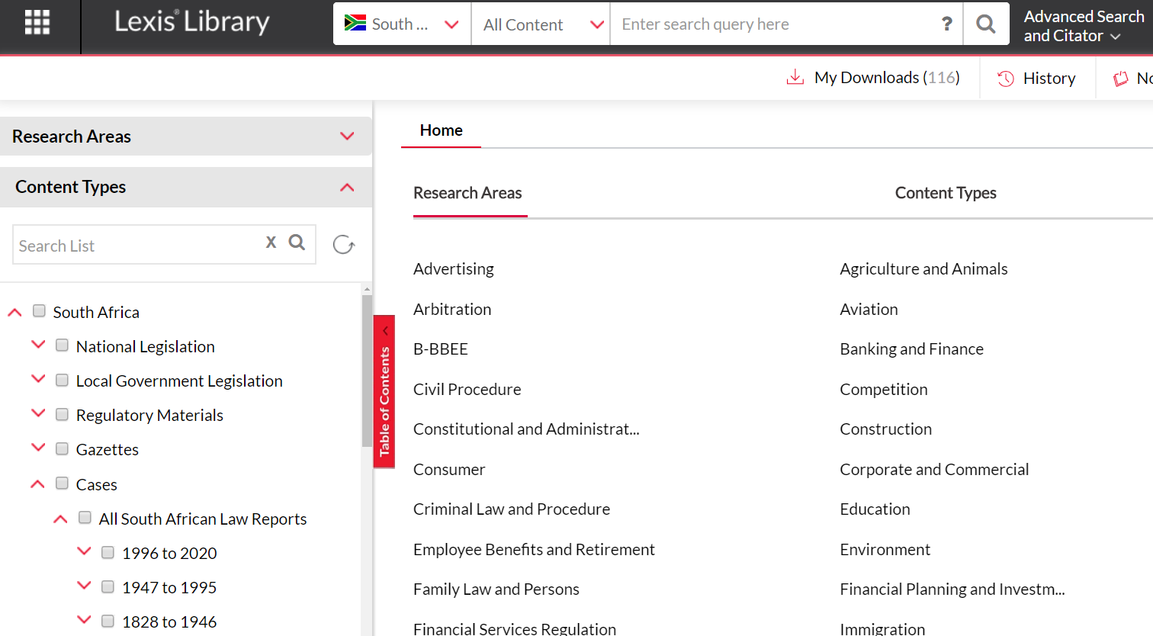
2020] 1 All SA 1 (SCA)

Slide 12
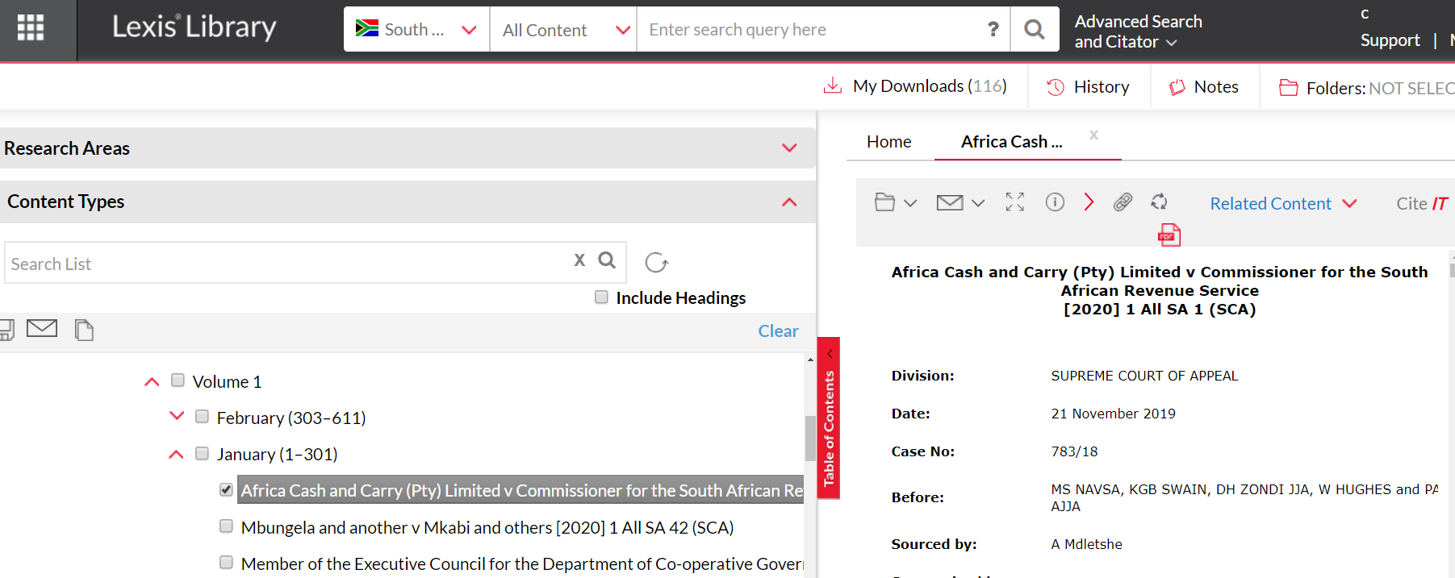
[2020] 1 All SA 1 (SCA)
Pdf download

Slide 13
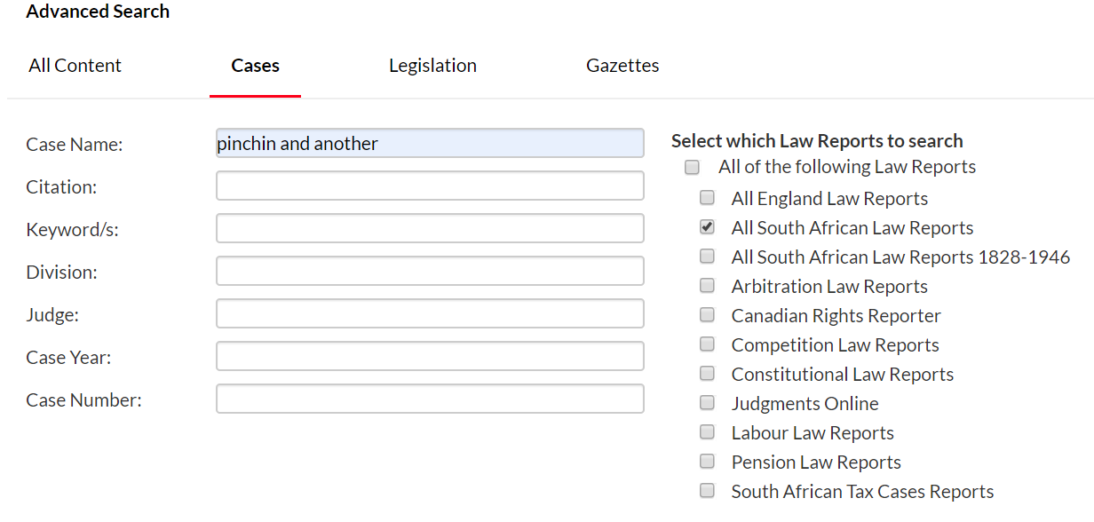
Use Advanced search to find a case or a topic

Slide 15
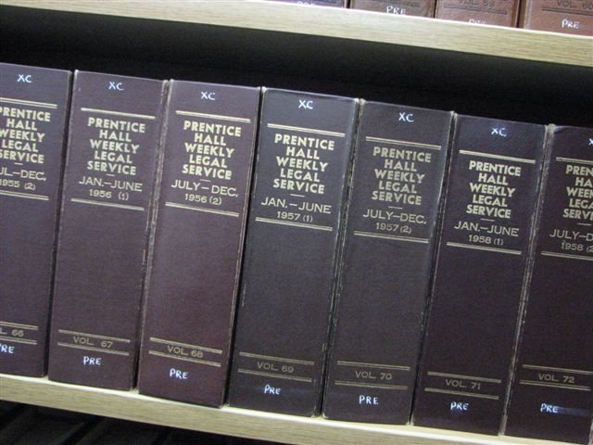
Prentice Hall Weekly Legal Service
Published weekly
(1923-1995)
Judgments in short format.
Cases are:
Published by subject.
Numbered (J28).
Abbreviated as P.H.
Verskyn weekliks (1923-1995)
Uitsprake kernagtig weergegee.
Gepubliseer volgens uitgesoekte onderwerpe.
Hofsake word genommer (bv J28).
Die hofsake word as P.H. afgekort.
New title:
ALL SA LAW REPORTS

Slide 16
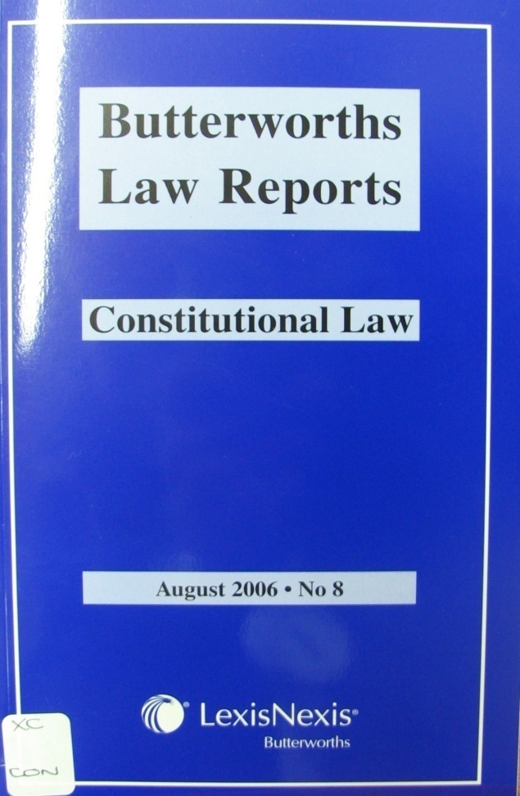
Constitutional Cases
BUTTERWORTHS CONSTITUTIONAL
LAW REPORTS
Citation:
[2000] 11 BCLR 230 (CC)
Index:
Butterworths index to constitutional cases

Slide 17
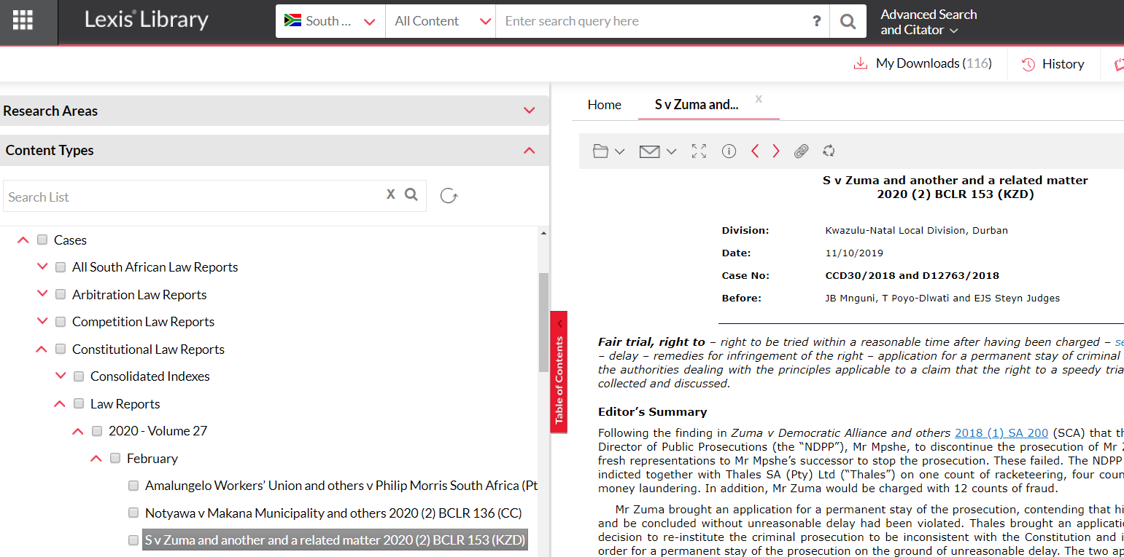

Slide 18
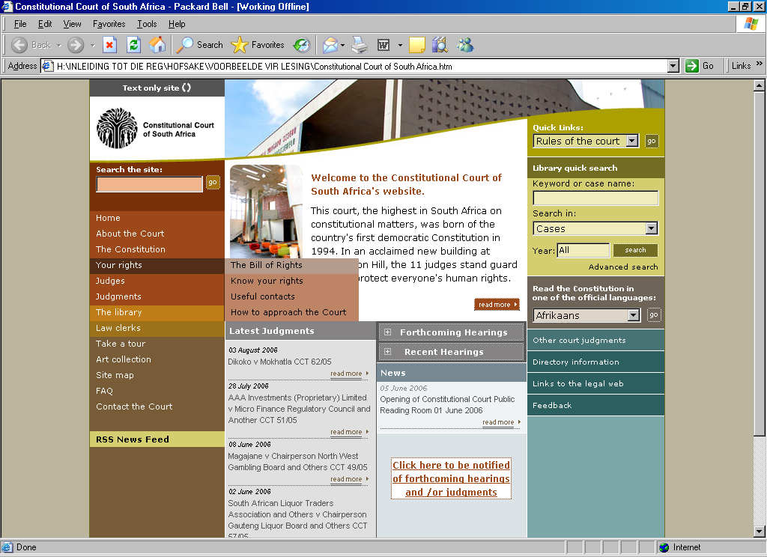
Judgments
on CC
website

Slide 19
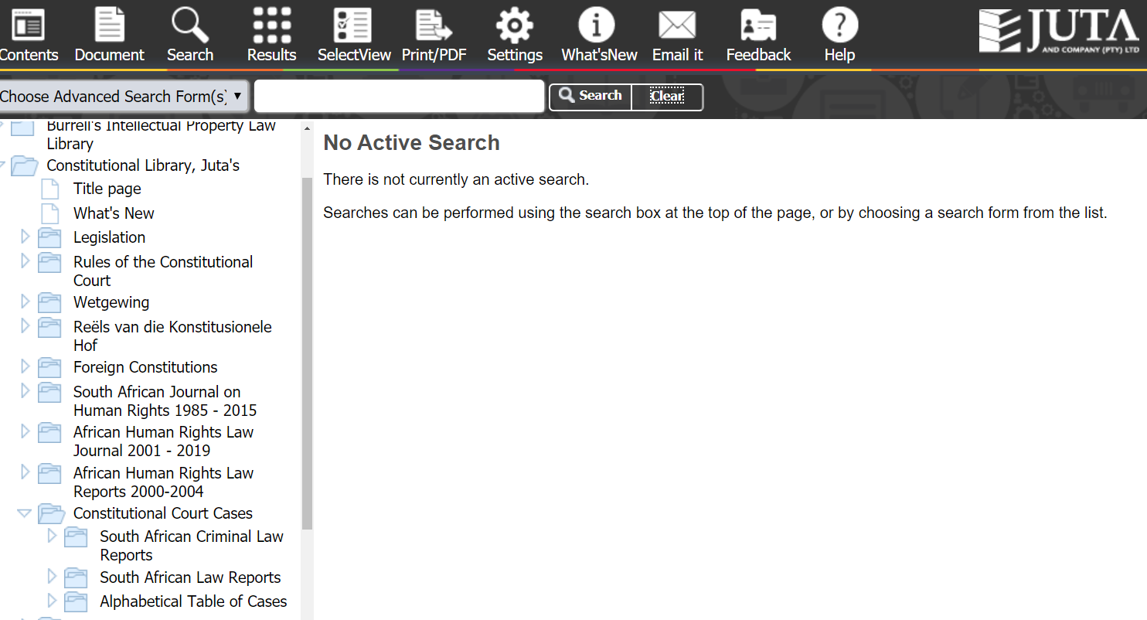
Constitutional Court cases on Juta

Slide 20
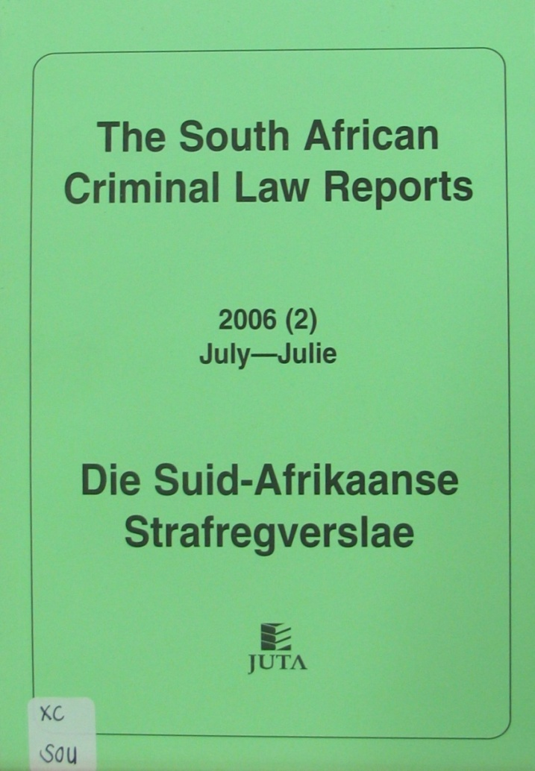
CRIMINAL REPORTS
Cases listed by name of accused
S v Smith 1991 (2) SACLR 234 (C)
Monthly
Shelf no XC SOU
Published since 1990
ELECTRONIC: JUTAS
20

Slide 21
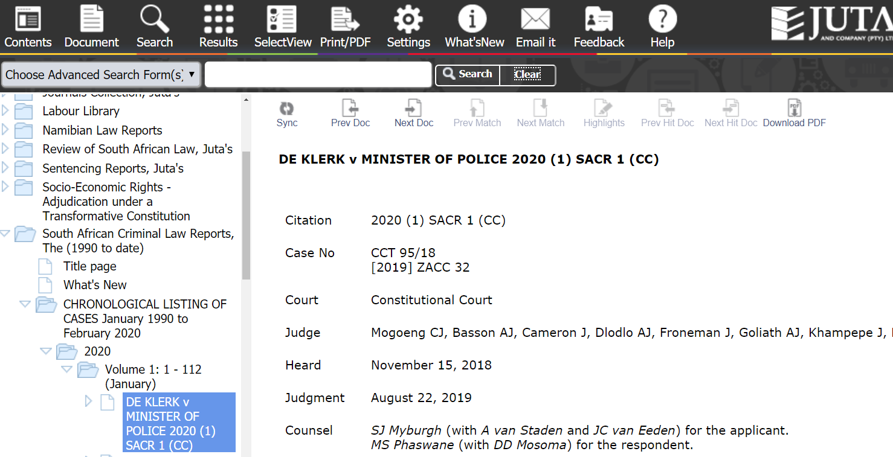
SA Criminal Law cases

Slide 22
LexisNexis Labour Law Reports: BLLR &BALR
Butterworths Labour Law Reports
Verwysing /Citation: [2014] 2 BLLR 107 (SCA)
Raknommer/ Shelf no: XC LAB
Butterworths Arbitration Awards
Verwysing /Citation: [2014] 3 BALR 221 (MEIBC)
Raknommer/ Shelf no: XC ARB

Slide 23
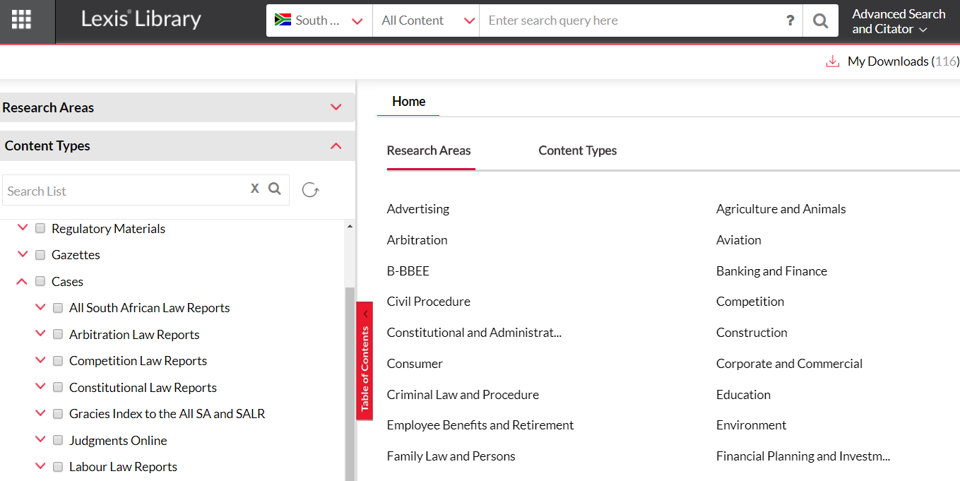

Slide 24
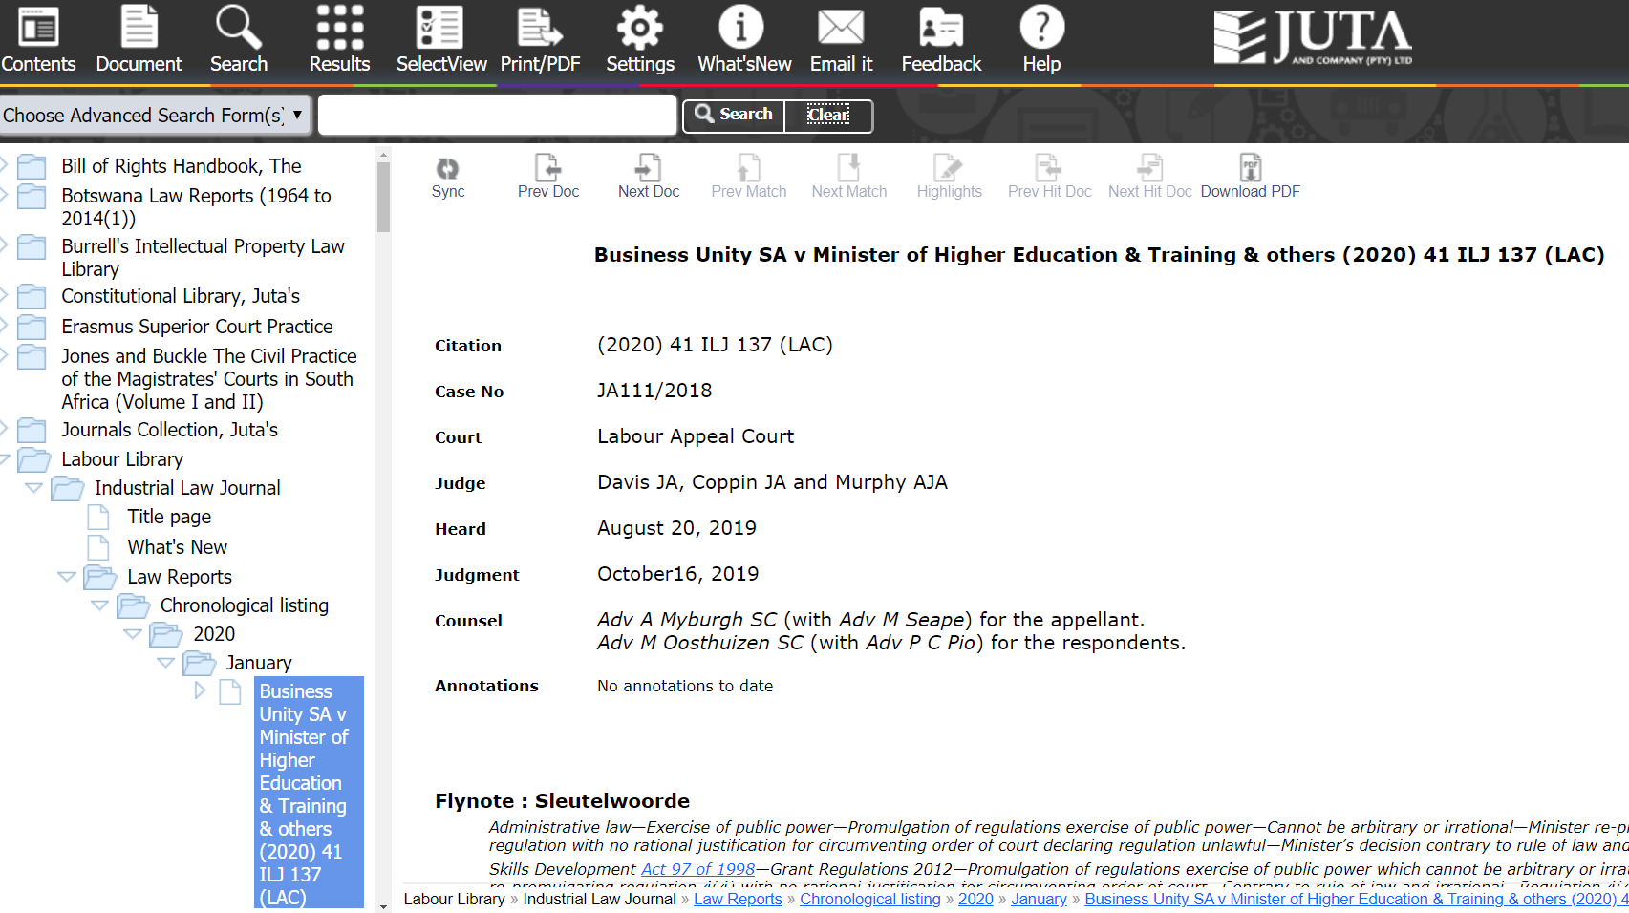
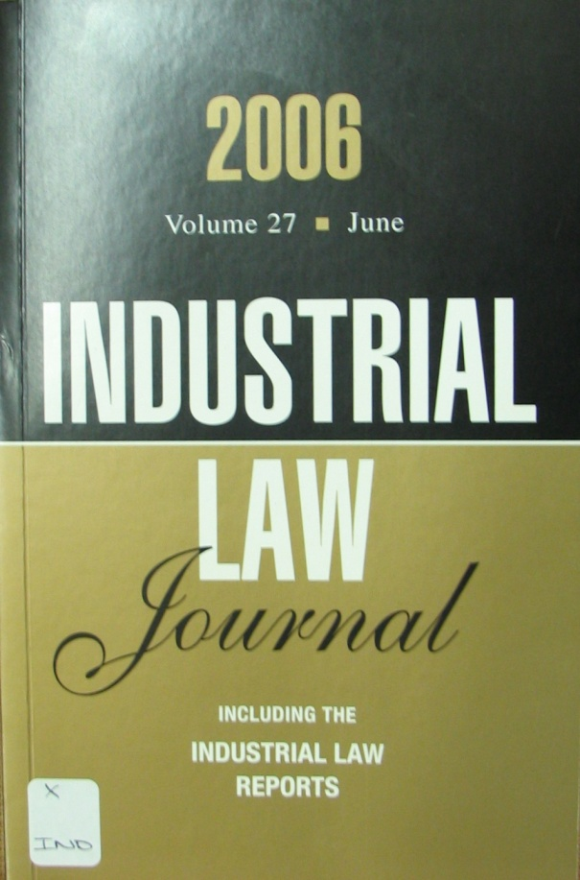
Juta’s Labour Law cases in the Industrial Law Journal
ILJ

Slide 25
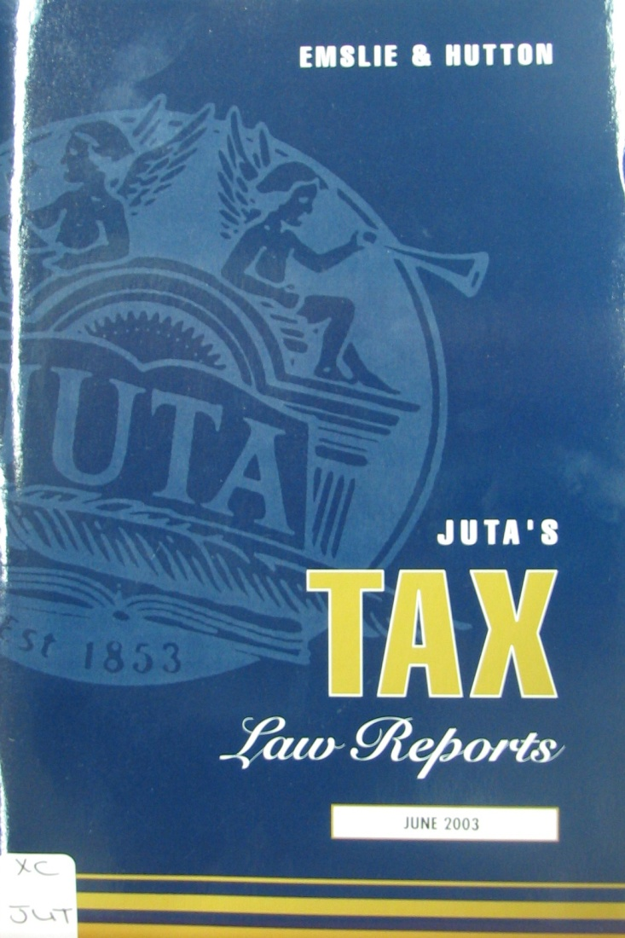
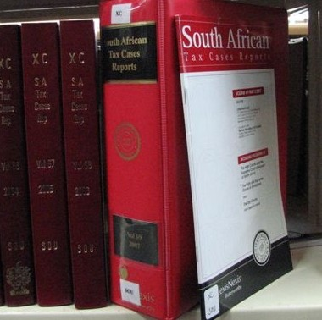
Tax cases

Slide 26
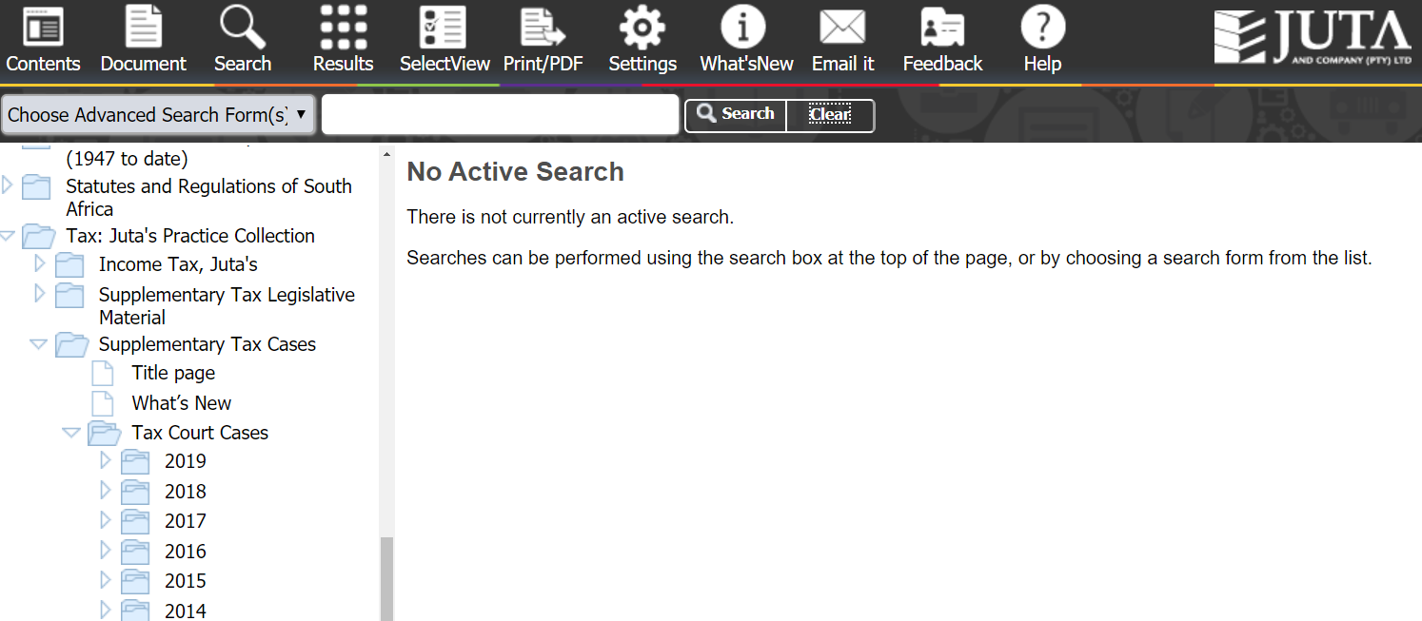

Slide 27
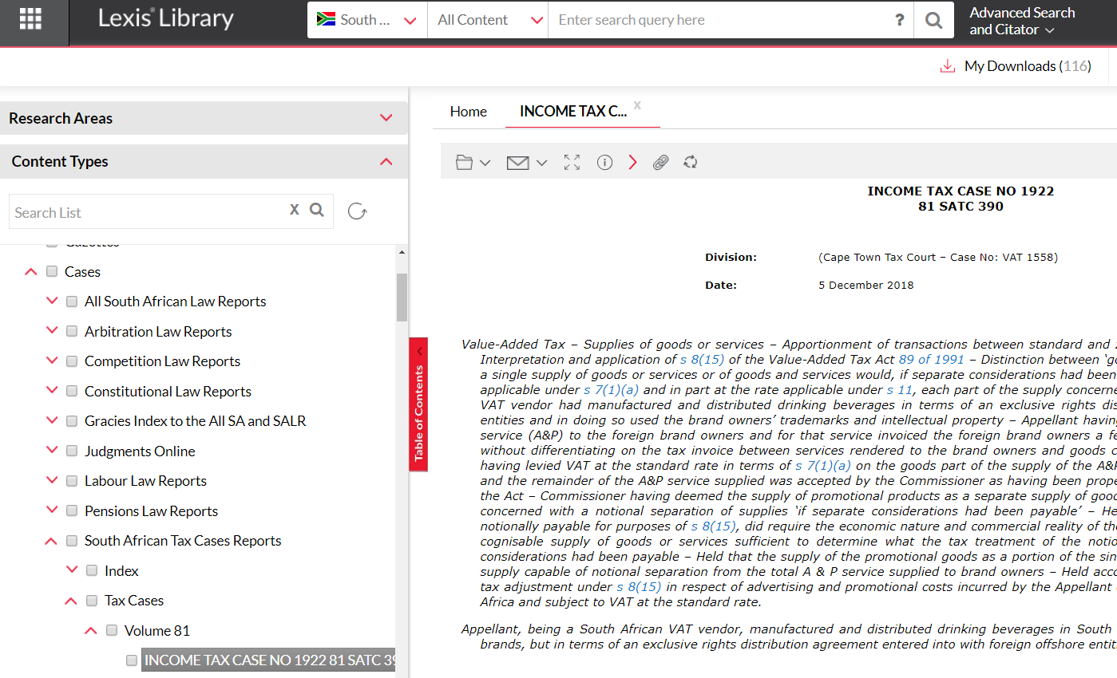

Slide 28
PATENT REPORTS
COPYRIGHT REPORTS

Slide 29
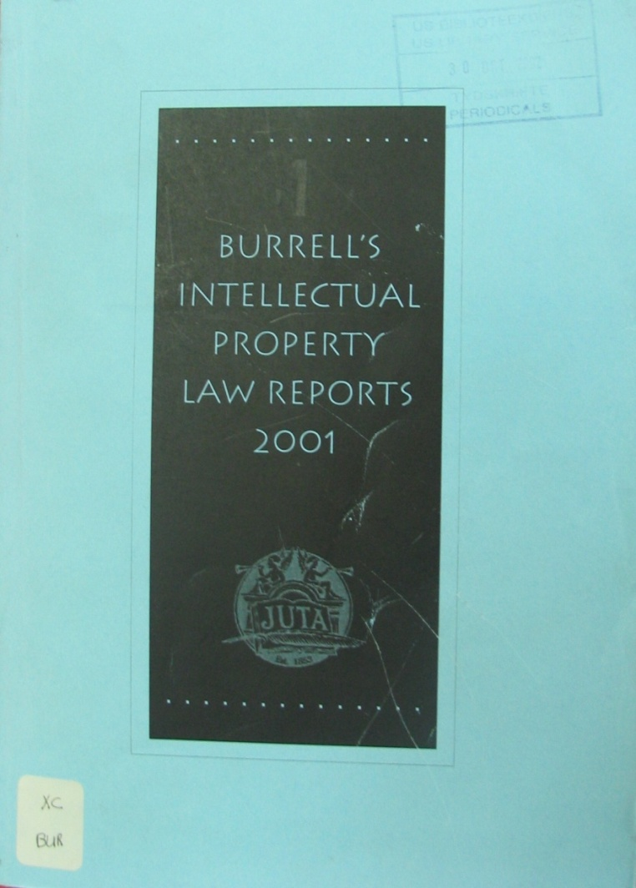
Burrell’s Patent cases
1953-1958
(XC BUR)
Now:
Burrell
Intellectual Property
Law Reports

